Slide 1
Accessing Your SNF VBP Confidential Quarterly Facility Reports
Accessing your Quarterly Confidential Report through the Certification and Survey Provider Enhanced Reporting (CASPER) Application

Slide 2
CASPER/QIES Reporting Systems
The following slide deck provides facility staff a tutorial in accessing their Confidential Quarterly SNF VBP Reports.
If your facility has not registered with Medicare’s CASPER/QIES Reporting Systems please contact the help desk at help@qtso.com for registration and passwords.
For general information about the SNF VBP program including, measure specifications, please review the SNF VBP website at https://www.cms.gov/Medicare/Quality-Initiatives-Patient-Assessment-Instruments/Value-Based-Programs/Other-VBPs/SNF-VBP.html.

Slide 3
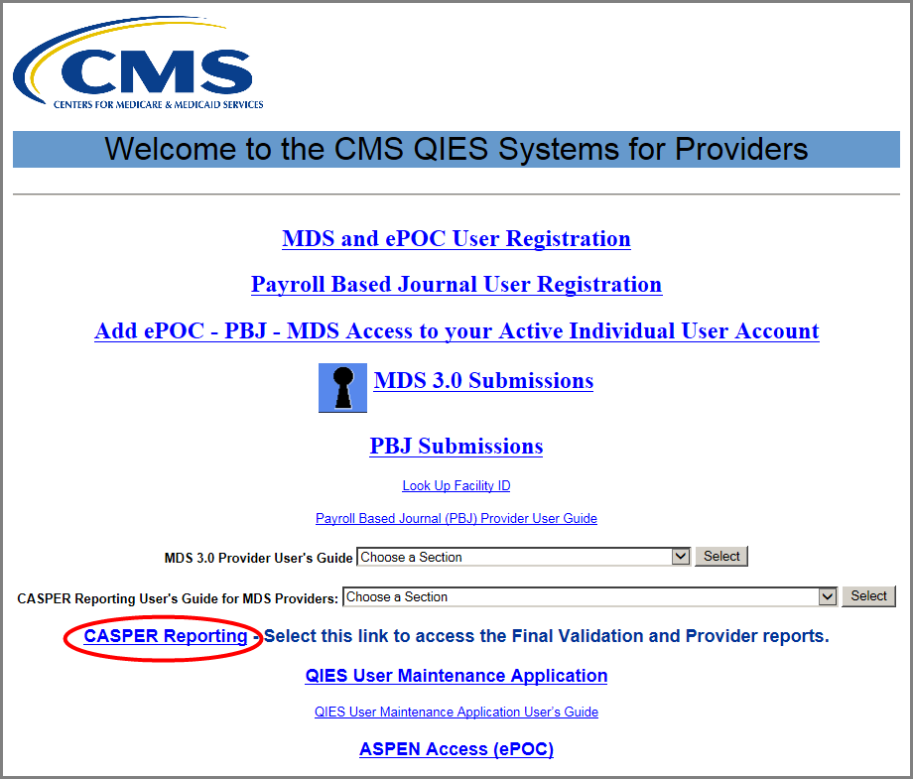
CMS QIES System Welcome Page
Once you have successfully logged into the CMS network with your CMSNet user ID and password, select the CASPER Reporting link on the ‘Welcome to the CMS QIES Systems for Providers’ web page.

Slide 4
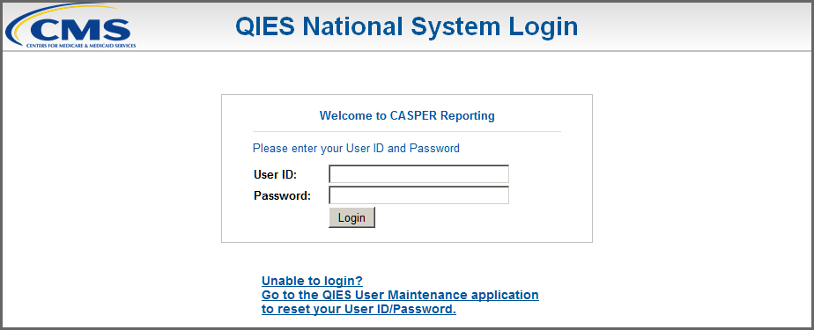
CASPER Login Page
Next, enter your QIES user ID and password in the fields on the QIES National System Login page.
The QIES user ID and password are the same credentials you use to submit MDS 3.0 records to the Assessment Submission and Processing system.
Then, select the Login button.

Slide 5
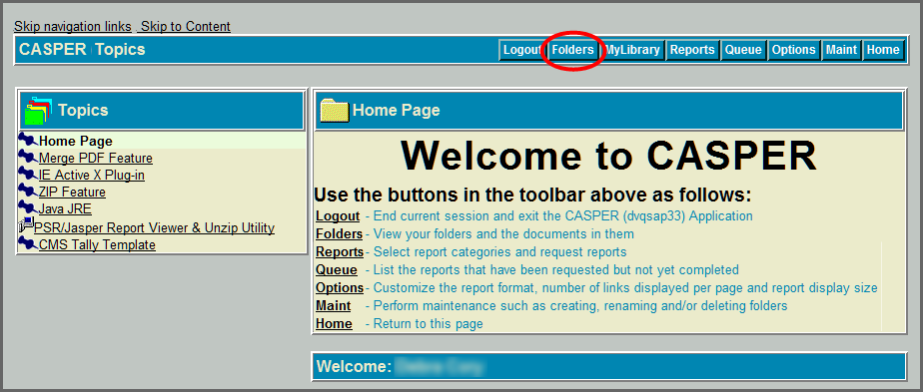
CASPER Topics Page
On the CASPER Topics page, select the Folders tab, that is circled in red from the menu bar.

Slide 6
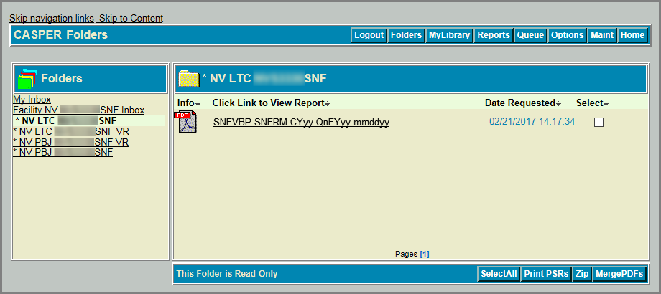
CASPER Reports Page
On the CASPER Folders page, a list of folders to which you have access displays in the left frame.
The SNF VBP reports will be automatically stored in your facility’s SNF shared folder. You’ll see this is the SNF non-VR folder that is highlighted for you.
Once you select the SNF shared folder, a list of SNF VBP report links will display on the right-hand side of the web page.
Select the desired report name link to view the report. Note, that SNF VBP is included in the file name.

Slide 7
Resources
For questions about accessing CASPER, please contact the QIES Technical Support Office (QTSO) Help Desk: help@qtso.com.
For more information about the SNFVBP Program, visit: https://www.cms.gov/Medicare/Quality-Initiatives-Patient-Assessment-Instruments/Value-Based-Programs/Other-VBPs/SNF-VBP.html.
If you have additional questions, email them to: SNFVBPinquiries@cms.hhs.gov.

