Slide 1

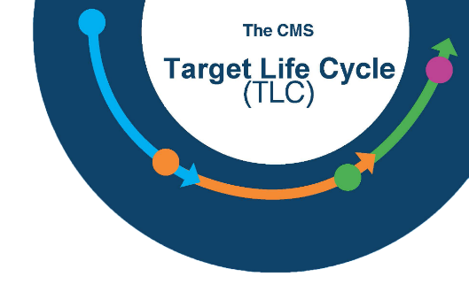

CMS Target Life Cycle (TLC)
Introduction to the TLC Initiate Phase
INFORMATION NOT RELEASABLE TO THE PUBLIC UNLESS AUTHORIZED BY LAW: This information has not been publicly disclosed and may be privileged and confidential. It is for internal government use only and must not be disseminated, distributed, or copied to persons not authorized to receive the information. Unauthorized disclosure may result in prosecution to the full extent of the law.

Slide 2
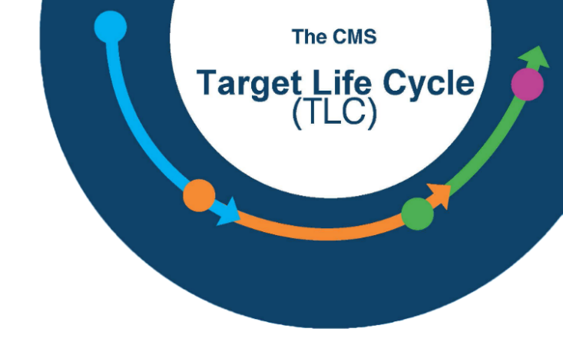
Target Life Cycle – Initiate Phase
Section I: TLC Overview
Section II: Initiate Phase Overview
Section III: Business Case
Section IV: Governance Review Team
Section V: Governance Review Board
Section VI: Acquisition Planning

Slide 3
TLC Overview
Section I:
TLC Overview

Slide 4
Target Life Cycle
The Target Life Cycle (TLC) is CMS’ IT system development life cycle governance framework. It provides:
  CIO oversight of IT budget and acquisition activities
  Capital Planning and Investment Control (CPIC) and technical governance
  Structured processes from system planning to retirement
  Project assistance and resources to ensure success
  Supports strategic goals and smart portfolio decision-making

Slide 5
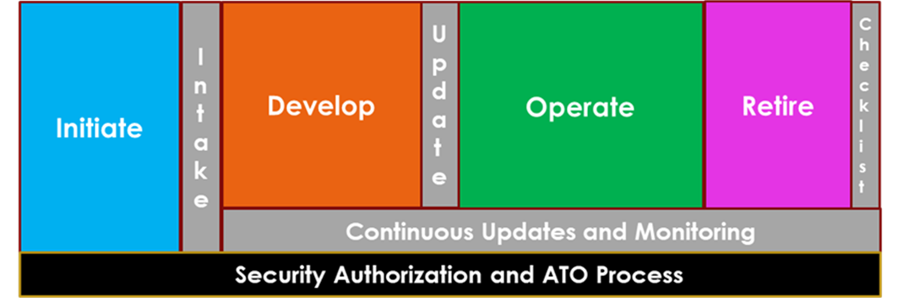
TLC Phase Summary
The TLC is comprised of Four Phases beginning with the Initiate Phase
CMS Target Life Cycle Phase Summary

Slide 6
Initiate Phase Overview
Section II:
Initiate Phase Overview

Slide 7
Initiate Phase
In the Initiate phase, engage the CMS IT Governance Review Team (GRT) by by completing a brief Intake Form.
From there we will connect you to various SMEs to start thinking through and documenting the options for meeting your business need
The Initiate phase ends with a go/no-go decision from the CMS IT Governance Review Board
Approved projects receive a Life Cycle ID. The project team will utilize the Life Cycle ID on funding and acquisition requests.

Slide 8
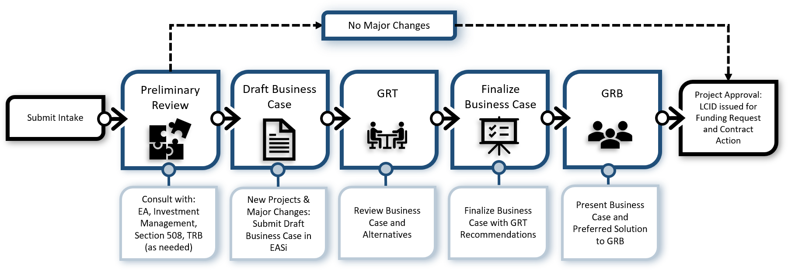
TLC Initiate Phase Process Flow

Slide 9

TLC Initiate Phase – How do I start?
To begin, complete the IT Intake Form located on the CMS IT Governance SharePoint site
The Intake Form will ask:
  If your request is for a new system or service, changes/upgrades to an existing system, or a contract re-compete
  Your business need and how you are thinking of solving it
  Cost changes,
  Funding number & source, and
  Contract information

Slide 10


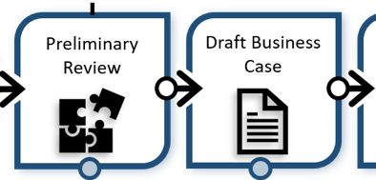
TLC Initiate Phase – What’s Next?
Based on the information provided, and an established set of triggers, such as cost and complexity, we will review and determine next steps.
For existing projects that do not reach trigger thresholds, the Governance Team will issue a LCID with recommendations.
For new or existing projects with costs and/or complexity that exceed established thresholds, the project will continue through the full governance review process. The CMS Governance Review Board (GRB) must approve the project before the Governance team can issue an LCID.

Slide 11
Business Case
Section III:
Business Case

Slide 12
Business Need
The TLC focuses external oversight up front with an emphasis on planning and documenting your business need.
This insures due diligence and sound IT planning before funding and acquisition approvals.
The Business Case, including alternatives analysis, is the key document and focus of the Initiate Phase GRB review and approval.
An early meeting with Enterprise Architecture will provide some initial guidance and may be able to provide information and options for existing CMS products or services that could meet your business need.

Slide 13

Business Case
General Project Information
Business Need and Justification
Alternatives Analysis
  Include an outline/description of each alternative.
  Each option should document the unique advantages, disadvantages, and risks for that specific option.
  Each alternative should include a five-year cost estimate for development and operations
Governance Review Team Recommendations
*Creation of the Business Case and Alternatives Analysis is inherently governmental work. Contractors may provide assistance in supplying content for the Business Case, but a Federal Employee must write it.

Slide 14
Business Case – Project Description
Start with your Business Need
    A concise description of what your problem/need is
    Provide an explanation of what this project intends to accomplish and how it can solve the problem.
Potential Drivers could be:
    Legislation • Modernization
    Cost savings • Data Security
    Efficiency • Automation
Describe benefits to CMS and alignment with organizational priorities and strategic direction.
Discuss performance measures
    Identify what critical success factors the project team will meet in order for you to succeed and achieve the goal. Be Specific.
    WHO is going to do exactly WHAT, by exactly HOW MUCH, by exactly WHEN?

Slide 15
Alternatives Analysis – Pros
Your Alternatives should indicate the Pros and Cons for each particular solution.
Examples of Pros:
  Cost savings
  Re-use of existing software
  Use of COTS
  Enhanced security characteristics
  Established 508 capabilities
  Short development time to a viable product

Slide 16
Alternatives Analysis – Cons
Examples of Cons:
  Need for extensive customization
  Use of old technology
  High costs
  Lack of skilled Contractor support for software
  Need for specific hardware
  Manual entry (time consuming and error prone)
  Incompatible file formatting

Slide 17
Business Case - Other Considerations
The GRB may consider factors such as:
  Cost vs Benefit
  Potential Risk
  Alignment with CMS’ Mission & Strategy
  Re-use of existing assets and solutions
  Use of COTS
  Use of Open Source
Keep these in mind as you develop your business case.

Slide 18
Business Case - Other Considerations
Your team should designate an Information System Security Officer (ISSO) for the project before the business case presentation. The ISSO can meet with the OIT Cyber Risk Advisor to document any potential Security and Privacy concerns that may impact your solutions.
A CPIC representative will be on the GRT to help with Investment Management and OMB Reporting, and can explain what the Business Case fields are looking for, per OMB guidance.

Slide 19
Governance Review Team
Section IV:
Governance Review Team

Slide 20

CMS IT Governance Review Team
Governance
Review Team
The GRT is a group of subject matter experts that will meet with you one or more times as necessary to review your Business Case in preparation for the GRB.
The GRT will provide:
  Technical guidance
  Advice to hone your business case and alternatives analysis
  Recommendations that will help your project be successful
  Direction through the IT Governance process and how to adhere to required governance oversight
  Resources available to you
  Recommendations to the GRB

Slide 21
GRT Members
Governance
Review Team
The GRT consists of representatives from:
    Enterprise Architecture Section 504/508
    Technical Review Board Acquisitions
    Security and Privacy Budget
    Shared Services Records Management
    Infrastructure Capitol Planning Investment & Control
The GRT may include other component representatives who may be able to provide input into potential solutions.
The GRT meets biweekly to discuss new projects.

Slide 22
Governance Review Board
Section V:
Governance Review Board

Slide 23

Governance Review Board
When you have incorporated the feedback from the GRT and completed your Final Business Case, the governance team will schedule your presentation with the GRB.
You’ll get the best result if your Business Case is clear, and your business need has strong justification.
The GRB will evaluate your Business Case and Alternatives Analysis and determine:
  Approval on the merits of the project and business need
  Approval/Disapproval of the preferred solution
The GRB does not approve funding for a project, but is a prerequisite for funding and acquisitions.
Governance
Review Board

Slide 24
GRB Members
Co-Chairs, CMS Governance Oversight | COMPONENT
CMS Chief Information Officer (CIO) | OIT
CMS Chief Financial Officer (CFO) | OFM
CMS Head of Contracting Activity (HCA) | OAGM
Governance
Review Board
Voting Members, Group Level or Above | COMPONENT
ACA 3021 Rep | CMMI
Exchanges Rep | CCIIO
Program Operations BDG Chair | OIT
Program Operations BDG Chair | OC
Medicaid / CHIP Rep | CMCS
Fed Admin BDG Chair | OIT/IUSG
Program Integrity BDG Chair | CPI
Program Operations BDG Chair | CMM
QIO Rep | CCSQ

Slide 25
GRB Decisions
If Approved:
The IT Governance Team will issue you a LCID indicating that you have GRB approval for your project.
The LCID allows you to:
  Choose an approved solution to move forward with
  Request funding
  Move forward with a contract action
If not Approved:
The GRB may suggest additional research or alternative solutions.

Slide 26
Acquisition Planning
Section VI:
Acquisition Planning

Slide 27
Acquisition Planning
IT Governance must sign off on IT Acquisition Plans (APs).
The IT Governance team will verify that your project has a valid LCID before signing your AP.
If you have a valid LCID, a member of the IT Governance team will sign and return your AP within 1-2 business days.
If your AP does not include a valid LCID, we will reach out to you to submit an Intake Form to begin the IT Governance process.

Slide 28
Summary
The TLC emphasizes governance review and oversight early in the planning stage with a focus on the business case.
The Initiate Phase begins with a simple CMS IT Intake Form located on the IT Governance SharePoint page.
The Business Case documents your business need and alternatives analysis, including estimated costs.
The GRT is a group of SMEs that will help you hone your business case and provide solution recommendations and resources that will help your project succeed.
The GRB provides approval to move forward with funding and acquisitions with the issuance of a LCID.
The IT governance team will sign your Acquisition Plan after verifying your LCID.

Slide 29
Questions
?
For more information, contact us at: IT_Governance@cms.hhs.gov or visit our SharePoint site at: CIO Library - ITGovernance

