Slide 1

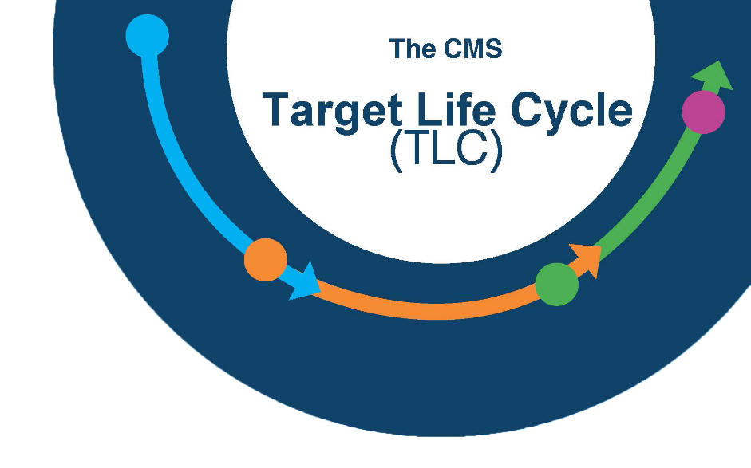

CMS IT Governance Process: Intro to the Target Lifecycle
INFORMATION NOT RELEASABLE TO THE PUBLIC UNLESS AUTHORIZED BY LAW: This information has not been publicly disclosed and may be privileged and confidential. It is for internal government use only and must not be disseminated, distributed, or copied to persons not authorized to receive the information. Unauthorized disclosure may result in prosecution to the full extent of the law.

Slide 2

Target Life Cycle Governance Process
What this course covers:
Section I: What is the TLC?
Section II: Who is the TLC?
Section III: A brief overview of the Four TLC phases

Slide 3
TLC Overview – Section I
Section I
What is the TLC?

Slide 4



Governance Framework
A framework that:
Project Team Responsibility
Promotes business flexibility
Applies situational governance reviews instead of gate reviews
Provides minimal disruption to the system development process
Requires self governance by Project Teams
Notes:
We want to leverage the Systems Development Lifecycle and Project Management methodologies that you are already using, not impose new ones.

Slide 5
Target Life Cycle (TLC)
Planning Your Project
Governance through Enablement
We’ve moved most of the external
oversight up front
You must develop your ideas and direction prior to Acquisition Planning
We’ve developed a team of IT SMEs to act as your consultants for IT planning
Ensures due diligence and sound IT Planning
Notes:
We want to leverage the Systems Development Lifecycle and Project Management methodologies that you are already using, not impose new ones.

Slide 6
Team Responsibility
Methodology Based
There are an almost overwhelming number of governance laws and guidelines with which project teams must comply. Some areas in CMS have dedicated groups to ensure compliance with their particular scope, such as:
Security
Accessibility
For other areas, project teams should follow processes in their specific methodology to fulfill the IT governance requirements

Slide 7
Potential for Audit
Many paths to success
Artifacts and documentation to support the design and development of the system must be available for Audit purposes, preferably on CMS infrastructure, so Project Teams must maintain and track it
Interfacing with other systems, either within or outside of CMS, will require documentation acceptable to both parties
A comprehensive set of templates which were developed for CMS’ previous governance framework are perfectly acceptable to use for the TLC
Those optional templates are available on the TLC website, CMS.gov/TLC

Slide 8
Proactive Governance
Proactive governance is the key!
We cannot do this without business and
system owner cooperation
Eliminating formal periodic reviews does not remove the need for the supporting work to be done
Every Systems Development Life Cycle (SDLC) has its own process of planning and documenting systems development
Project Managers are now responsible for adherence to the standards of their chosen Project Management Methodology and SDLC that support governance goals

Slide 9
TLC Overview – Section II
Section II
Who is the TLC?

Slide 10

GRT Purpose & Goals
The Governance Review Team
Governance
Review Team
Advises Project Teams:
How to proceed through the IT Governance process
What resources are available to help
How to properly develop and document their Business Case and Alternatives Analysis
How to adhere to required governance oversight
The Project Team is responsible for documenting the proposed solutions in their Business Case, for presentation to the Governance Review Board (GRB)

Slide 11
Governance Review Team (GRT)
Enterprise Architecture
Records Management
Technical Review Board
Governance
Review Team
Component representatives who have expertise in particular technical solutions may join the GRT as needed
Financial Management
Security & Privacy
GRT Governance Review Team
Acquisitions
Shared Services
Investment Management
Accessibility
Infrastructure

Slide 12
GRT Purpose & Goals (cont’d.)
The GRT:
Governance
Review Team
Reviews the business case and alternatives
analysis to ensure the application/ functionality is:
Not duplicative of another effort
Fills a need that cannot otherwise be addressed
Aligns with the CMS IT Portfolio goals
Discusses alternative approaches for implementation (if any) of the desired system functionality or new application
Makes recommendations to the Governance Review Board (GRB)

Slide 13

Governance Review Board (GRB)
The Project Team will present the Business
Case and Alternatives Analysis to the Governance
Review Board (GRB)
This should be a high level presentation of the Business Case and Alternatives, presented by the Business Owner or Manager
The GRB may ask technical questions, so there should be technical staff available at the presentation as well
Governance
Review Team
The GRB does not approve funding for a project, but is a prerequisite for requesting funding.

Slide 14
GRB Membership
Co-Chairs, Office Director or Designee | COMPONENT
CMS Chief Information Officer (CIO) | OIT
CMS Chief Financial Officer (CFO) | OFM
CMS Head of Contracting Activity (HCA) | OAGM
CMS Chief Technology Officer (CTO) | OIT
Governance
Review Board
Voting Members, Group Level or Above | COMPONENT
ACA 3021 Rep | CMMI
Exchanges Rep | CCIIO
Program Operations BDG Chair | OIT
Program Operations BDG Chair | OC
Medicaid / CHIP Rep | CMCS
Fed Admin BDG Chair | OIT/IUSG
Program Integrity BDG Chair | CPI
Program Operations BDG Chair | CMM
QIO Rep | CCSQ

Slide 15


Life Cycle ID (LCID)
Governance
Process
If the GRB approves a project, it will be
issued a Life Cycle ID (LCID)
The LCID signifies that the project/investment has been reviewed and approved by the GRB
If projects do not have a valid IT Life Cycle ID:
OFM will not allocate funding to the project
OAGM will not process contract actions

Slide 16
Project Team
The Project or Program Team:
Is led by CMS employee(s) as Project Sponsor/ Business Owner/Manager
Must have an ISSO (Information Systems Security Officer)
Will be responsible for developing and maintaining systems documentation that satisfies governance requirements
Is encouraged to maintain the documentation on CMS infrastructure so that it is not lost when contractors change
Project Team

Slide 17
TLC Phases - Section III
Section III
A brief overview of the Four TLC Phases

Slide 18
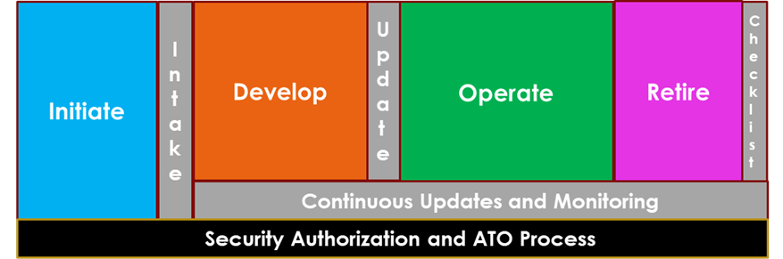
TLC Phase Summary
CMS Target Life Cycle
Phase Summary
Notes:
This illustrates the four phases of all SDLC’s. Note the Security and Authorization bar, which is continuous from project inception to end.

Slide 19
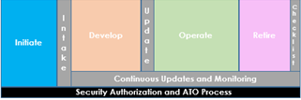
Initiate Phase
Fill out an Intake Form to start the
TLC Governance process
Document your business need
Have a brief meeting with Enterprise Architecture and the TLC administrators to kick things off
Get on the schedule for a GRT Meeting
The GRT will provide guidance and input to the Project Team in crafting the business case and alternatives analysis in preparation for the GRB meeting
Notes:
We want to know in the planning stages. You may have put out an RFI to contractors, to find out what expertise or software currently exists.

Slide 20

Initiate Phase (cont’d.)
Demonstrate Due Diligence
Document your Analysis of Alternatives
Pros and cons of each alternative
Estimate total life cycle costs for each alternative
The Project Team presents the Business Case and Alternatives Analysis to the GRB for review
The GRB may approve, disapprove, or ask for changes to the project/investment
The GRB does not approve funding for a project, but is a prerequisite for requesting funding.
Notes:
The GRT will provide information that can help develop the Business Case and Alternatives.

Slide 21
Initiate Phase Summary
Key Objectives
Clarify business needs
Incorporate GRT input on alternatives
Present Business Case to GRB
Exit Criteria
The Business Case and Alternatives Analysis are documented
An approved solution is selected by the Project Team
A Life Cycle ID is issued

Slide 22
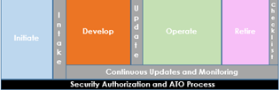
Develop Phase
When the Project Team has executed a contract action for development, the Develop Phase begins
The Project Team defines the chosen project/product management methodology and Systems Development Lifecycle Methodology in their contract and planning documentation
The Project Team creates the detailed user stories or requirements, designs and develops the solution, deploys it to a non-production environment, and tests it for compliance with technical and other Federal IT standards and requirements

Slide 23
Develop Phase Summary
Key Objectives
Satisfy information security, privacy, and Section 508 requirements
Exit Criteria
Obtain an Authorization to Operate (ATO)
Successful Testing

Slide 24
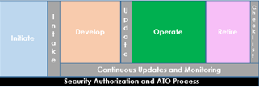
Operate Phase
Once deployed into Production, the Project Team is responsible for maintaining the availability and reliability of the system by ensuring that routine maintenance is performed and sound security practices are followed
Most projects will be in Development and Operate phases at the same time for most of their life
If major changes or development are needed, the project may have to go back to the Initiate Phase to get approval for the additional scope

Slide 25
Operate Phase Summary
Key Objectives
Maintain solution availability and performance
Exit Criteria
Decommission Decision

Slide 26
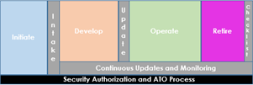
Retire Phase
The Project Team creates and executes a decommissioning plan that complies with Federal guidelines for data disposition, hardware disposition, and any other considerations that must be met based on the individual system,
Records Management (OSORA) must be consulted
Other GRT resources are available for consultation on the planning and execution of the plan
The Project Manager attests to the completion of the disposition plan when operations cease

Slide 27
Retire Phase Summary
Key Objectives
Properly retain or dispose of any system materials according to the appropriate retention schedule, including but not limited to: System data, software, hardware, and any other necessary system requirements & configurations
Close out all related contractual actions and agreements
Exit Criteria
Project Manager attestation to the completion of the decommissioning checklist
The Project Manager/Business Owner sends the attestation to the Governance Team

Slide 28
Additional TLC Resources
Governance Review Team
IT_Governance@cms.hhs.gov
Technical Review Board
CMS-TRB@cms.hhs.gov
TLC Website
IT Governance - https://www.cms.gov/TLC
Enterprise Architecture
EnterpriseArchitecture@cms.hhs.gov
Navigator
NavigatorInquiries@cms.hhs.gov

Slide 29
Questions
?
For questions about Governance or more information contact via Mail – IT_Governance@cms.hhs.gov or visit IT Governance - https://www.cms.gov/TLC

