Slide 1
CMS IT Governance Training
Business Case

Slide 2
CMS’ Target Life Cycle (TLC)
CMS is now operating under the Target Life Cycle (TLC) IT Governance Framework
The TLC brings together Subject Matter Experts (SMEs) and decision-makers from across CMS to strategically manage our IT Portfolio.
In order for these SMEs to evaluate new IT projects properly, we may require you to complete a Business Case outlining your proposal.

Slide 3
IT Business Case
When do I need one?
  New IT development or major changes to existing systems usually require a Business Case – confirmed by CMS IT Governance upon receiving your intake form in the “Initiate” phase of the TLC.
How is it used?
  The Business Case allows the Governance Review Team (GRT) and Governance Review Board (GRB) to evaluate, advise, and ultimately approve or deny your project.

Slide 4
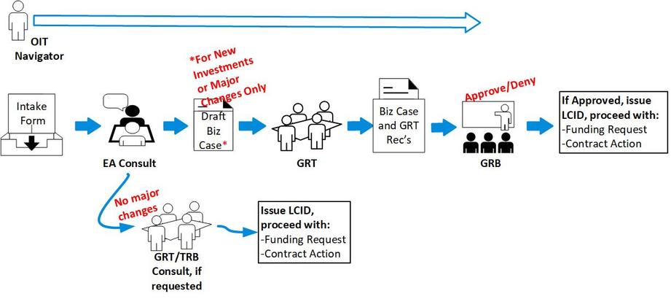
TLC "Initiate" Phase Process Flow

Slide 5
IT Business Case – What Does it Cover?
Business Need
  Description of the business need/issue/problem and why you are proposing a new IT solution to meet this business need rather than meeting the need within existing resources.
Benefits to CMS
  How this effort benefits CMS, including any information on how it supports CMS' mission and strategic goals, creates efficiencies and/or cost savings, or reduces risk.
Alignment with Organizational Priorities
  Does this effort support any Administrator priorities or new legislative or regulatory mandates?
Performance Measurement
  How will you determine whether or not this effort is successful? Here’s a good rule of thumb: State the exact data or metrics to use in support of this Performance Goal: WHO is going to do exactly WHAT, by exactly HOW MUCH, by exactly WHEN?

Slide 6
Proposed Alternatives to Meet Business Need
  This is where you identify options and alternatives to meet your business need. Your team must exercise due diligence in determining the most viable and cost effective solution.
  This includes a summary of the approaches, how you will acquire the solution, and describe the pros, cons, total life cycle costs and potential cost savings/avoidance for each alternative considered.
  Include at least three viable alternatives: keeping things “as-is” or reuse existing people, equipment, or processes; and at least two additional alternatives. Identify your preferred solution.

Slide 7
Proposed Alternatives cont’d
  Some examples of alternatives to consider may include:
    Buy vs. build vs. lease vs. reuse of existing system
    Commercial off the shelf (COTS) vs. Government off the shelf (GOTS)
    Mainframe vs. server-based vs. clustering vs. Cloud
  In your alternatives, include details such as differences between system capabilities, user friendliness, technical and security considerations, ease and timing of integration with CMS' IT infrastructure, etc.

Slide 8
Estimated Life Cycle Cost
  Estimate the total life cycle cost
  How much to develop/initialize the product or service?
  AND how long to operate after development is complete – how long until we have to replace? (a 5 year total life cycle is typical)
  Note: these estimates will likely evolve as you refine your Business Case throughout the intake process – no worries.
  Your Life Cycle Cost projections are one of the most important factors that the Board considers when making a determination on your project.
  The IT Investment Management team can assist with your cost estimates if needed

Slide 9
Highlights
Within CMS’ IT Governance Framework, SMEs use your Business Case to evaluate your proposal and ultimately approve or deny your project.
Please fill out the entire Business Case to the best of your ability and with as much precision as possible to facilitate this process. Help is available:
  EnterpriseArchitecture@cms.hhs.gov
  CMS_TRB@cms.hhs.gov
  IT_Investments@cms.hhs.gov
Our IT Governance homepage is a one-stop shop for all TLC-related information, including the IT Intake form, and the IT Business Case Template

Slide 10
  Contact Us
For questions about IT Governance or more information
email:
IT_Governance@cms.hhs.gov
or visit:
IT Governance (https://www.cms.gov/TLC)

