Slide 1


CMS IT Governance Training IT Intake Form

Slide 2
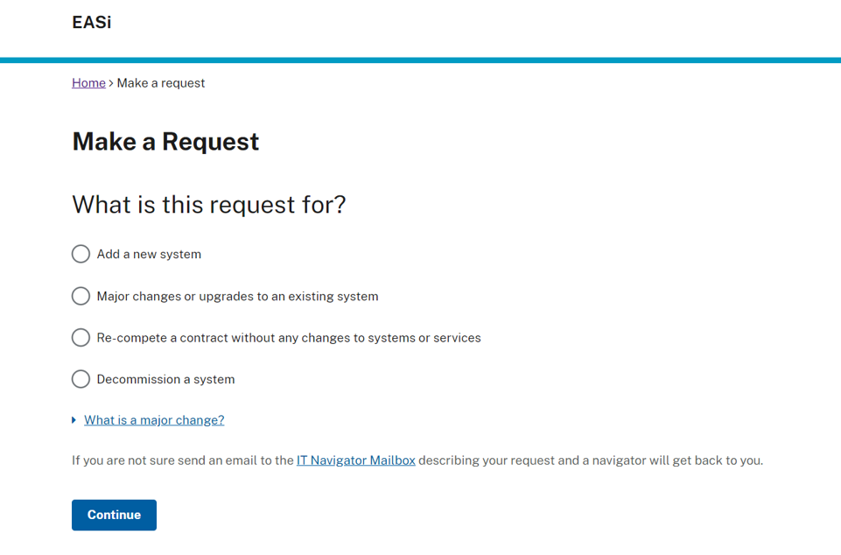
EASi – Make a Request
= New Business Need
= Modernization, Optimization, Cloud migration, etc.
= Contract re-competes and IAA renewals
= Retiring an existing system

Slide 3
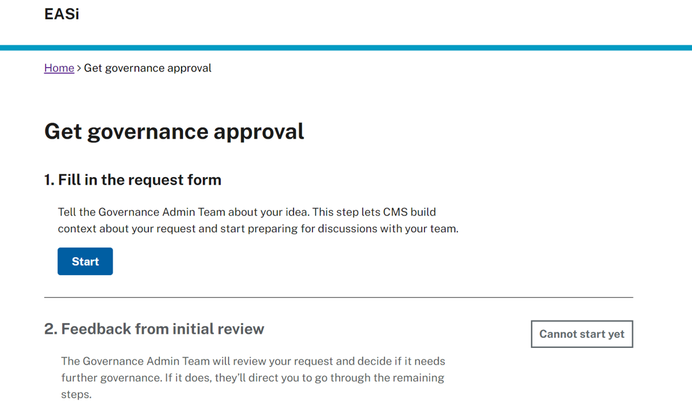
EASi Tracks Progress
EASi tracks and shows your progress as you proceed through the governance process. Filling in the request form is your first step

Slide 4

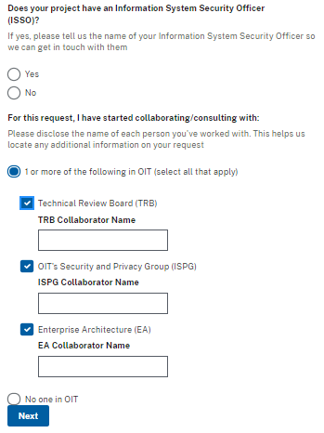
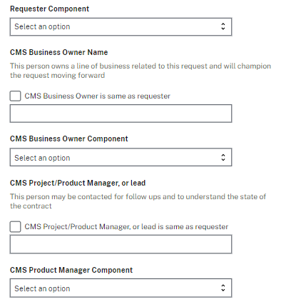
Contact Details

Slide 5
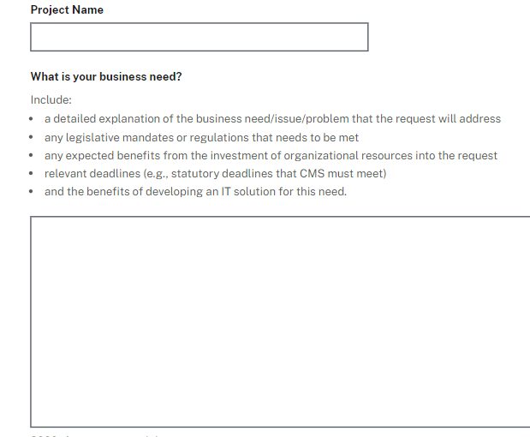
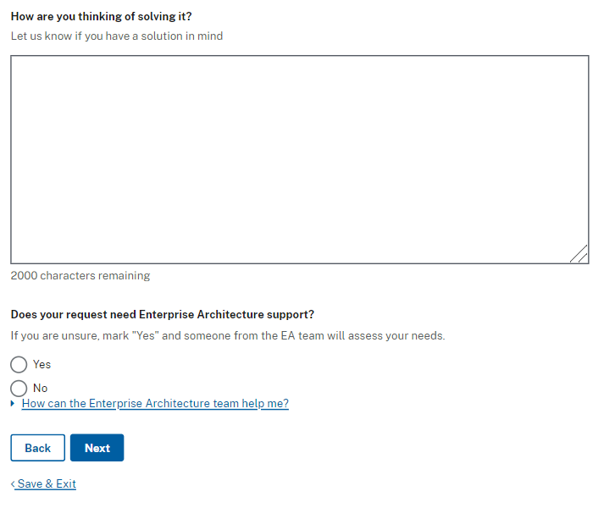
Business Need
Do you have a solution in mind?
Have you done any market research?
Have you considered leveraging an existing in house solution/shared service?
Are you planning on contracting out the work?
What is the core issue or problem that the request addresses?

Slide 6
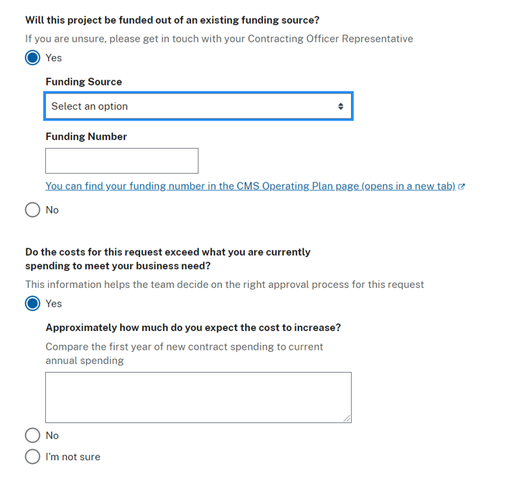
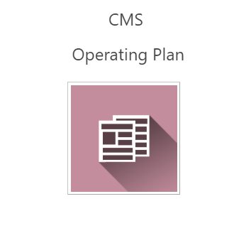
Funding Details
CMS Operating Plan (https://cmsintranet.share.cms.gov/JT/Pages/Budget.aspx)
Download spreadsheet => Go to the ‘Detail’ tab

Slide 7
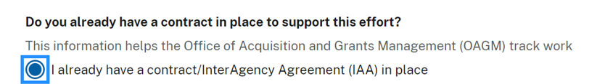
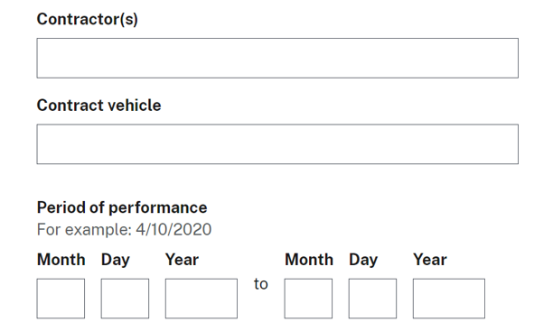
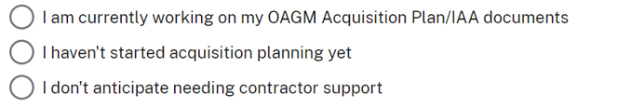


Contract Details
Include all Option Years
Check your answers before sending

Slide 8
What’s Next
An IT governance team member will review your request and reach out to you within 2 business days to provide you with a life cycle ID or provide guidance on the next steps.

Slide 9
Contact Us
For questions about IT Governance or more information
email:
IT_Governance@cms.hhs.gov
or visit:
IT Governance www.cms.gov/TLC

