Slide 1
CMS IT Governance Training
Life Cycle ID (LCID)

Slide 2
Background - IT Governance
Primary Drivers:
    Clinger Cohen Act of 1996
    Federal Information Technology Acquisition Reform Act (FITARA) of 2014
Emphasizes rigor and structure in how it approaches the selection and management of IT projects.
Requires extensive reporting to OMB that provides visibility into IT spending and performance outcomes.
Life Cycle IDs play a key role in documenting and tracking CMS IT activity.

Slide 3
What is a Life Cycle ID & What is it Not?
The record of approval for your IT planned activities, from a capital Investment and planning perspective.
Issued by the “CMS IT Governance function” during the initiate phase of the Target Life Cycle.
LCIDs have expiration dates.
A life cycle ID is NOT:
    an approval of funding. OFM manages the CMS budget and authorizes funding.
    assigned to systems.

Slide 4
What is it & What is it for?
Indicates IT Governance has evaluated the effort for technical feasibility, standards, and cost effectiveness before entering the acquisition process.
Requires CIO, CFO, and Head of Contracting Activity (HCA) approval as a worthwhile investment and addition to the CMS IT portfolio.
Loops in OFM, OIT and OAGM so that there is standard and consistent visibility into IT activity.

Slide 5
When do I need one?
New or re-competed acquisitions
    A new IAA or renewal
New system project or development
Major changes to existing systems
    Modernization efforts
    Optimization
    Cloud migration
Requests for Additional Funding

Slide 6
Why do I need one?
FITARA requires CIO approval for all IT contracts and spending.
The Governance Review Team/Governance Review Board (GRT/GRB) is the delegated body for approval.
    Bring together CMS subject matter experts
    Help teams think through their options and alternatives
    Assist with documenting the case and conducting alternatives analysis
    Identifying current and long term cost implications
You cannot proceed into the acquisition process without one.

Slide 7
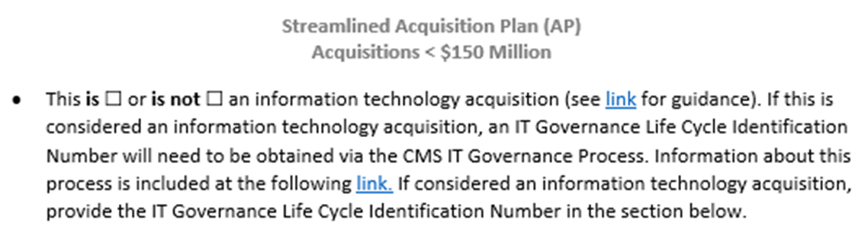
Why do I need one? (cont.)
OIT, OFM, and OAGM coordinate throughout the acquisition process using the LCID.
OAGM
OIT
OFM

Slide 8


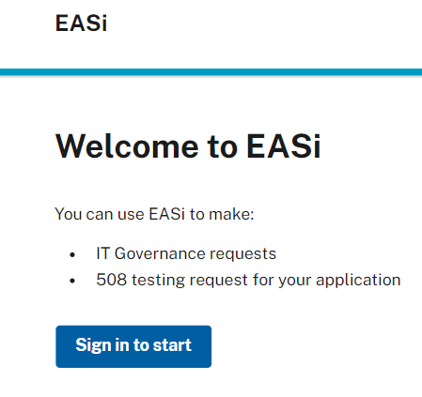
How Do I Get One?
Phases of the
Target Life Cycle:
Initiate
Phase
Development Phase
Operate Phase
Retire
Phase
Intake Request
LCID Assignment
Approval to proceed with contract and budget request
GRT Meeting & Review
GRT Meeting & Review
GRB Meeting & Review
Pathway to LCID differs based on Type and Scope of Request
  New Business Need
  Operations and Maintenance contracts
  Change to Existing Business Need
  Request for Additional Funds (RAFs)

Slide 9
How do I get one? (cont’d)
While planning for an acquisition, submit a request through the EASi system.
Expected Timeframe:
    Re-competes/O&M: Generally 1-3 days
    New IT development or $1M annual cost increase: 2–5 weeks

Slide 10
Key Take-Aways
Acquisition plans require IT Governance approval and sign-off.
Usually, a work effort will have multiple LCIDs.
LCIDs are not transferrable across contracts.
A LCID is not an approval of funding.
LCIDs have expirations.

Slide 11
  Contact Us
For questions about IT Governance or more information
email:
IT_Governance@cms.hhs.gov
or visit:
IT Governance (https://www.cms.gov/TLC)

