Slide 1
Measures Management System (MMS) Info Session
Transforming Measurement for Better Care: Lessons Learned About Patient-Centered Measurement
  Ellen Schultz, American Institutes for Research
  Derek Forfang, National Forum of ESRD Networks
  Knitasha Washington, ATW Health Solutions
  February 24, 2021
February 2021
Copyright © 2020 American Institutes for Research. All rights reserved.
2020_12/20

Slide 2



Vision and Goals
An ongoing process to engage the public in quality measure development.
Elicit feedback that will help CMS design resources that can help all of those interested in healthcare quality improvement better understand the goals of quality measurement.
  Education
  Outreach
  Dedicated Websites
  Measure Development Roadmaps
  Listserv opportunities
1
Notes:
CMS is committed to providing Education and Outreach opportunities about the quality measure development process to interested stakeholders to improve understanding of the process. CMS also seeks continual feedback to improve and/or expand its offerings to the healthcare quality measure development community and interested stakeholders.
To date, CMS has implemented an Education and Outreach webinar series and has created resource materials that break down and explain various components and challenges in the measure development process. There are dedicated websites, listservs, and roadmap documents that are available to support those working in quality measure development, or are just curious and want to learn more about how it is done.

Slide 3
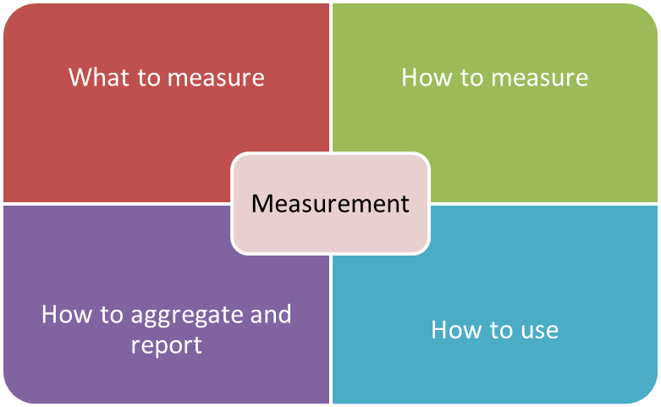
Patient-centered measurement
Patient-centered
  Driven by patients’ expressed needs—not assumptions about what matters to them
  Makes a difference for and benefits patients
  Focuses on structures, processes and outcomes that patients care about, not what the system says they should care about
Measurement that’s driven by patients’ expressed preferences, needs, and values that informs progress toward better health, better care, and lower costs.
2
Notes:
Patients in this context:
People who bring lived experience seeking care or services
Caregivers, as family members, friends or an informal support network
Communities in the context of addressing the SDOH
Patient-centered measurement should focus on the patient perspective and what truly matters to the patient’s health and wellbeing:
How are we measuring?
What data are we using?
Where do those data come from?
How are they collected?
Who controls the data and ultimately owns them?
How are we reporting out that information?
What are the ways that we are aggregating/disaggregating it?
How are we using measurement?
How is this information ultimately guiding decisions and policies and care within healthcare systems in a way that ultimately improves lives?

Slide 4
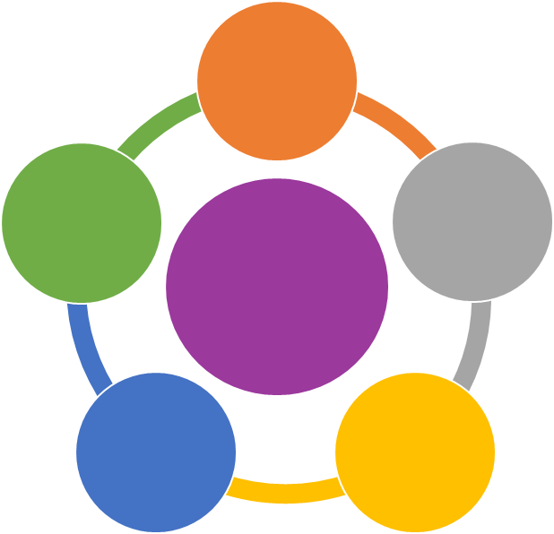
Principles of patient-centered measurement
Patients’ goals, preferences, and priorities drive what is measured and how performance is assessed.
Patient-Driven
Measurement recognizes that patients are whole people and considers their circumstances, life and health histories, and experiences within and outside of the health care system.
Patients are equal partners in measure development and have decision-making authority about how data is collected, reported, and used.
Co-Created
Holistic
Patient-Centered Measurement
Patients have access to the same data as other stakeholders and understand how data is used to inform decision-making around care practices and policies.
Patients and other stakeholders get timely, easy-to-understand data to inform decision-making and quality improvement.
Comprehensible
& Timely
Transparent
3
Notes:
To lay out a vision for this patient-centered measurement landscape, AIR assembled a diverse group of stakeholders, including patients, caregivers and patient advocates, as well as researchers, clinicians, measure developers, policymakers and payers.

Slide 5

Four Pilot Projects Put Principles Into Practice
Dialysis
Cancer
Goal-Directed Dialysis Care
Redefining Functional Status
AIR
Severe Brain
Injury
Team Listen to Caregivers
Patient Experience Team
Maternity Care
Financial support for the pilot projects provided by the Robert Wood Johnson Foundation
4
Notes:
With support from RWJF, AIR through a competitive review process selected four small-scale pilot projects, each 18 months in duration receiving around $200,000 in funding.
Three projects focused on measure development, the fourth on implementing existing measures.
One project was led by a patient advocacy organization, the other three by teams of university-based researchers.
All had at least one patient or caregiver as team members; most had multiple patients on their team.
Lessons learned:
Cocreation through equal partnerships among researchers, clinician, patients and caregivers is foundational to patient-centered measurement where there is shared decision-making within the team about how a project is conducted.
Patient and caregiver partners’ voices had equal weight among the team members through a mutual agreement in how roles were determined and carried out, including periodic check-ins to make adjustments where needed.
Flexibility in an approach to changing plans, focus and scope of a project.
Funder flexibility in scope, timeline, and compensation, i.e., in this case, purchasing laptops for caregiver partners to overcome technology hurdles.

Slide 6
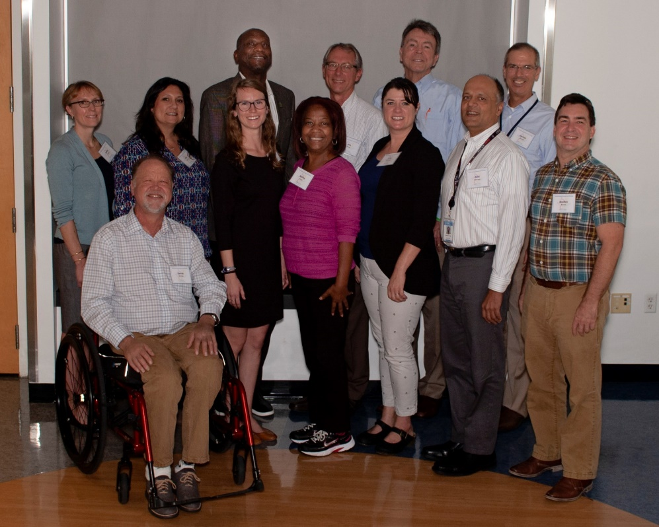
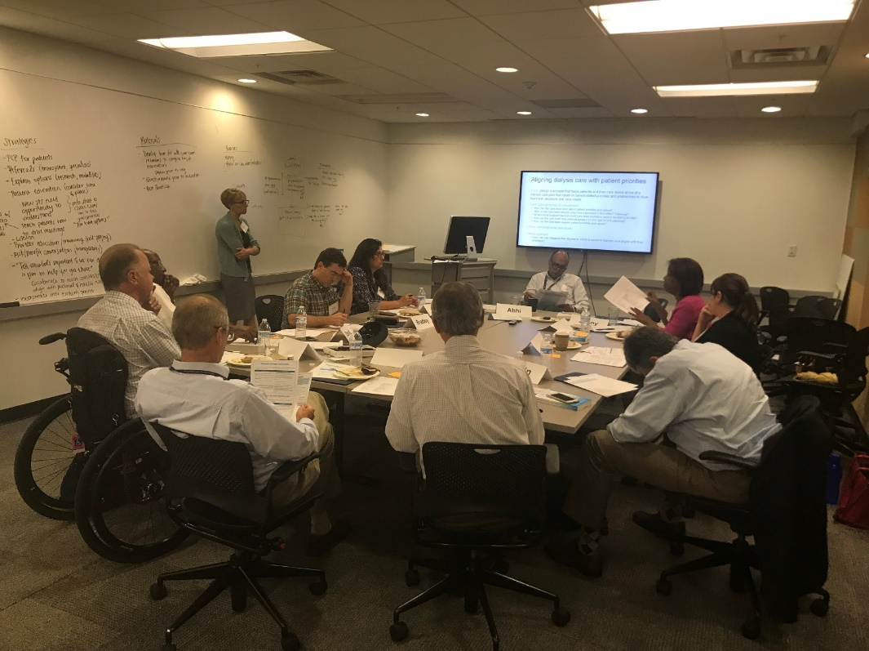
Goal-Directed Dialysis Care stakeholder panel and project team members
(Patient partner Colleen Chavis not shown)
5
Notes:
Nephrologist, Dr. Jenny Flythe from the University of North Carolina (UNC) at Chapel Hill, and Derek Forfang partnered to launch the goal-directed dialysis care project, the focus looking at delivering improved care in a dialysis facility through a focus on patient life goals and an emphasis on what is truly important from the patient’s perspective.
The hope was for improved patient engagement, patient adherence to medications and treatment that ultimately translated in a hopeful environment, given many patients were struggling both physically and emotionally through treatment—perhaps through a loss of career, loss of freedom, loss in relationships and diminished presence with a spouse or loved one. The vision was to gain back this sense of purpose and identity, and included a diverse representation of the population and culture on the project.

Slide 7
Dialysis Care Individualization Metric
Response Options: strongly disagree (1), disagree (2), neither agree nor disagree (3), agree (4), strongly agree (5)
# | Proposed dialysis measure question | Domains
1 | My dialysis care team makes me feel like my voice is important. | Empowerment Shared decision-making
2 | My dialysis care team understands what matters to me. | Whole person Communication
3 | My dialysis care team and I consider important parts of my life when discussing options for my dialysis care. | Whole person Partnership
4 | My dialysis care matches my priorities. | Individualization Partnership
5 | My dialysis care team and I work together to make decisions. | Shared decision-making Partnership
This 5-item questionnaire has undergone preliminary testing
6
Discussion Break
Notes:
“Care team considers important parts of my life…”
The dialysis facility was able to intervene on behalf of patients on various matters that came to light, i.e., a homeless patient, an issue with a patient’s driver’s license, and another patient’s desire to continue gardening that simply required additional physical therapy. The situations were all satisfactorily resolved through this intervention.
A patient’s stated “personal life goal” was a gamechanger that resulted in an uplifting atmosphere where patients had hope and a greater desire for patient engagement, medication adherence and/or physical therapy—i.e., “I want to watch my grandson graduate from college.”
“My dialysis team and I work together to make decisions…”
Decisions focus on what is meaningful to the patient, but realistic
Ensure that things are attainable and there is follow-through and progress
Are things moving towards that direction?
Have things been put into place?
Visit the UNC website by Googling UNC and “My Dialysis Plan.”

Slide 8
Equity and Patient-Centered Measurement
Equity and Patient-Centered Measurement
Objectives:
Ensuring that the teams that develop, select, implement, and use measurement work in equal partnerships with the full diversity of patients and caregivers who are impacted by a given measurement approach and;
Shifting the power in measurement toward communities.
Process:
Conduct an environmental scan to understand the perspectives of diverse patients, SMEs, funders and community leaders about equity and patient-centered measurement
Develop a strategic plan that conceptualizes a theory of change for advancing the field
7
Notes:
Year 2020 presented profound evidence to a shift in many industries with regards to how equity is viewed, much of which was attributable to COVID-19 and a level of transparency and further demonstrated by state departments stratifying results by race and ethnicity; therefore, exposing huge gaps in these subpopulations. Also, the untimely death of George Floyd resonated with Americans in terms of the sense of urgency around structural racism across many industries, including healthcare.
ATW Health Solutions is working on an environmental scan to help understand the perspective of leaders in the healthcare space — leaders in measures development and organizations like CMS, NQF, AHRQ, HRSA and patients and families.

Slide 9




Emerging Learnings
Measurement Architecture
and Design
Pockets of Excellence
Community Empowerment
and Transparency
Diversity & Inclusion
8
Funding Priorities
Notes:
Two primary research questions:
How do we make the practice of patient-centered measurement more equitable?
What is the path to shifting the power of measurement away from the interests within healthcare and towards patients, families and their communities?
The “one size fits all” approach to equity in patient-centered measurement is ineffective, when taking into account health disparities. Developing meaningful relationships brings value that shapes the way in which work is done, the way agendas are established and the way the work is evaluated, thus shifting the culture in measurement methods, and ultimately in how care is delivered.
Diversity of researcher representation presents the necessary shift of power through those who work in this space, who understand the space from a measurement standpoint and are thereby able to shape agendas.
Culture is shaped by race and ethnicity, and so adding a diverse panel of patients and families to the conversation ensures diversity throughout the process and throughout our system — and that we have measures of accountability.
Pockets of excellence:
We need to establish what we have in our repertoire that can be disseminated so that it’s more widespread and gets more measure developers activated in this work by developing a guide or roadmap that creates an evidence-based approach to a quality measurement framework and addresses equity in patient-centered measurement.
Funding priorities:
The need to pull in process measures, and in so doing make a distinction between what’s happening in healthcare delivery vs. what’s happening in all these other inputs.
What is the health system doing?
What does the health system have accountability for?
Where are those opportunities to make those outcomes more equitable?
Where are the opportunities with all these other inputs where there could be transportation issues, food disparities, so on and so forth?
With regards to equity and subpopulations, are we prepared to look at what’s important to black patients in controlling hypertension?
Is that very different from what’s important to Latino patients and/or to white patients, or any other subgroup that you name?
Diversity and inclusion:
We need to reconsider or make reconsiderations about our funding decisions and who’s influencing those funding decisions.
We need to foster stronger community engagement and empowerment of diverse participation.
We need mechanisms and tools that ensure inclusion which drive this point of accountability.
In making certain that all the things we know in the science of equity that we’ve learned over the most recent two decades, how can we take that and use that as a lens in our approach in patient-centered measurement?
How do we begin to segment and unpack it in our work such that we’re driving more meaningful change?

Slide 10

Contact and Acknowledgments
Learn More
www.air.org/PCMpilots
Ellen Schultz
eschultz@air.org
Derek Forfang
derek.forfang@gmail.com
Knitasha Washington
kwashington@atwhealth.com
Patient-Driven
Acknowledgements
Hala Durrah
Karen Frazier
Stephen Hoy
Mary Lavelle
Dilani Logan
Pam Dardess
Shoshanna Sofaer
Goal-Directed Dialysis, Redefining Functional Status, Team Listen to Caregivers and Patient Experience pilot teams
Co-Created
Holistic
Patient-Centered Measurement
Comprehensible
& Timely
Transparent
9

Slide 11

Questions

Slide 12
Announcements
Upcoming MMS Information Session:
March 24, 2021 - PROs, PROMs, and PRO-PMs: Demystifying terminology and best practices around patient-reported data

Slide 13
Closing slide

