Slide 1
Table of Contents
(naming standards)

Slide 2
<YYYY-MM-DD>_<payer or issuer name>_<plan name>_<file type name>.<file extension>
2020-08-27_cms_medicare_in-network-rates.json
2020-08-27_cms_medicare_in-network-rates.json
{
"reporting_entity_name": "cms",
"reporting_entity_type": "cms",
"reporting_plans": [{
"plan_name": “medicare",
"plan_id_type": "his",
"plan_id": "0000000000",
"plan_market_type": "individual"
},{
"plan_name": “medicaid",
"plan_id_type": "hios",
"plan_id": "11111111111",
"plan_market_type": "individual"
}],
"last_updated_on": "2020-08-27",
"version": "1.0.0",
"in_network": [{negotiation information}]
}
{
"reporting_entity_name": "cms",
"reporting_entity_type": "cms",
"plan_name": ”medicare",
"plan_id_type": "his",
"plan_id": "0000000000",
"plan_market_type": "individual"
"last_updated_on": "2020-08-27",
"version": "1.0.0",
"in_network": [{negotiation information}]
}

Slide 3
<YYYY-MM-DD>_<payer or issuer name>_<plan name>_<file type name>.<file extension>
2020-08-27_cms_medicare_in-network-rates.json
{
"reporting_entity_name": "cms",
"reporting_entity_type": "cms",
"reporting_plans": [{
"plan_name": “medicare",
"plan_id_type": "his",
"plan_id": "0000000000",
"plan_market_type": "individual"
},{
"plan_name": “medicaid",
"plan_id_type": "hios",
"plan_id": "11111111111",
"plan_market_type": "individual"
}],
"last_updated_on": "2020-08-27",
"version": "1.0.0",
"in_network": [{negotiation information}]
}
2020-08-27_cms_medicare_medicaid_in-network-rates.json
2020-08-27_cms_???_in-network-rates.json

Slide 4
In-Network/Allowed Amounts MRF
NEW TABLE OF CONTENTS FILE
{
"reporting_entity_name": "cms",
"reporting_entity_type": "cms",
"reporting_plans": [{
"plan_name": “medicare",
"plan_id_type": "his",
"plan_id": "0000000000",
"plan_market_type": "individual"
},{
"plan_name": “medicaid",
"plan_id_type": "hios",
"plan_id": "11111111111",
"plan_market_type": "individual"
}],
"last_updated_on": "2020-08-27",
"version": "1.0.0",
"in_network": [{negotiation information}]
}
{
"reporting_entity_name": "cms",
"reporting_entity_type": "cms",
"reporting_structure":[{
"reporting_plans": [{
"plan_name": "medicaid",
"plan_id_type": "hios",
"plan_id": "11111111111",
"plan_market_type": "individual"
},{
"plan_name": "medicare",
"plan_id_type": "hios",
"plan_id": "0000000000",
"plan_market_type": "individual"
}],
"in_network_file": {
"description": "In-network file",
"file": "https://www.cms.gov/cciio/medicare-in-network-file.json"
}
https://www.cms.gov/cciio/medicare-in-network-file.json
{
"last_updated_on": "2020-08-27",
"version": "1.0.0",
"in_network": [{negotiation information}]
}

Slide 5
NEW TABLE OF CONTENTS FILE
In-Network File
{
"reporting_entity_name": "cms",
"reporting_entity_type": "cms",
"reporting_structure":[{
"reporting_plans": [{
"plan_name": "medicaid",
"plan_id_type": "hios",
"plan_id": "11111111111",
"plan_market_type": "individual"
},{
"plan_name": "medicare",
"plan_id_type": "hios",
"plan_id": "0000000000",
"plan_market_type": "individual"
}],
"in_network_file": {
"description": "National network file",
"file": "https://www.cms.gov/cciio/medicare-in-network-file.json"
}
https://www.cms.gov/cciio/medicare-in-network-file.json
{
"last_updated_on": "2020-08-27",
"version": "1.0.0",
"in_network": [{negotiation information}]
}
The Table of Contents needs the naming standard, not the individual files.
The In-network/allowed amounts files can be named anything now

Slide 6
NEW TABLE OF CONTENTS FILE
<date>_<payer-name>_index.<file extension>
{
"reporting_entity_name": "cms",
"reporting_entity_type": "cms",
"reporting_structure":[{
"reporting_plans": [{
"plan_name": "medicare",
"plan_id_type": "hios",
"plan_id": "11111111111",
"plan_market_type": "individual"
},{
"plan_name": "medicaid",
"plan_id_type": "hios",
"plan_id": "0000000000",
"plan_market_type": "individual"
}],
"in_network_file": {
"description": "In-network file",
"file": "https://www.cms.com/files/in-network-file-123134.json"
}
}]
2020-08-07_cms_index.json

Slide 7
File Size Reduction Recommendations

Slide 8
Various Opportunities
Examples/Scenarios To Cover
Provider Grouping
Service Code
Multiple Plans Per File
Referenced Provider Groups
File Compression
Depending on your situation, your mileage may vary

Slide 9
Provider Groups

Slide 10
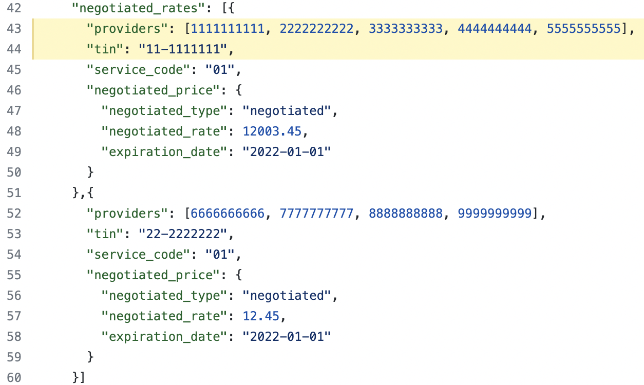
Provider Groups
Use-Case:
Providers that have negotiated rates for items and services under a single TIN.
SQL Pseudocode:
SELECT providers … GROUP BY tax-id
Previous Implementation:
Each group of providers by tin had its own negotiated price object

Slide 11
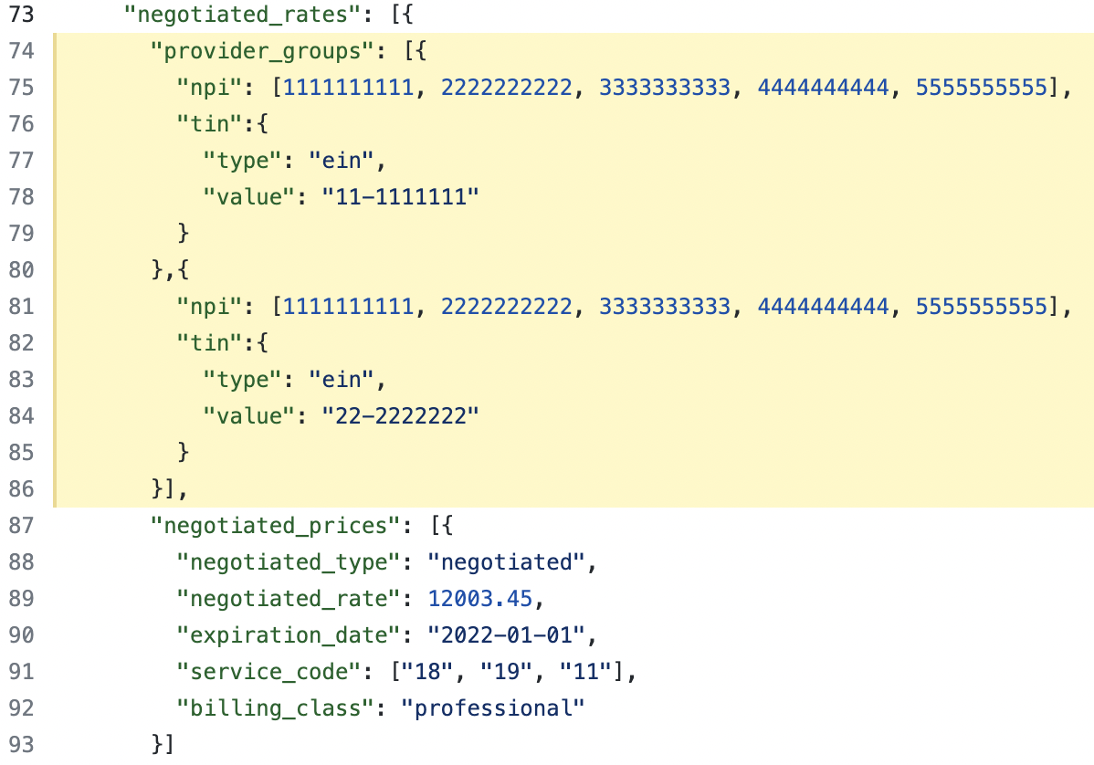
Provider Groups
Previous Implementation:
Each group of providers by tin had its own negotiated price object
Current Implementation:
Multiple provider/tin combinations can be associated to negotiated price objects.

Slide 12
Provider Groups
What you might be doing
"provider_groups": [{
"npi": [111, 222, 333],
"tin":{
"type": "ein",
"value": "11-1111111"
}
},{
"npi": [444, 555, 666],
"tin":{
"type": "ein",
"value": "11-1111111"
}
}]
What you can do instead
"provider_groups": [{
"npi": [111, 222, 333, 444, 555, 666],
"tin":{
"type": "ein",
"value": "11-1111111"
}
}]
Take Away: Group all the providers associated with a single TIN into a single provider group object

Slide 13
Service Code

Slide 14
Service Code
"negotiated_rates": [{
"providers": [111, 222, 333],
"tin": "11-1111111",
"service_code": "01",
"negotiated_price": {
"negotiated_type": "negotiated",
"negotiated_rate": 12.45,
"expiration_date": "2022-01-01"
}
},{
"providers": [111, 222, 333],
"tin": "11-1111111",
"service_code": "02",
"negotiated_price": {
"negotiated_type": "negotiated",
"negotiated_rate": 12.45,
"expiration_date": "2022-01-01"
}
}]
Use-Case:
Negotiated rates that are service code dependent.
Previous Implementation:
Each service code required a separate negotiated price object even if that negotiated price object was the same.

Slide 15
Service Code
Previous Implementation:
"negotiated_rates": [{
"providers": [111, 222, 333],
"tin": "11-1111111",
"service_code": "01",
"negotiated_price": {
"negotiated_type": "negotiated",
"negotiated_rate": 12.45,
"expiration_date": "2022-01-01"
}
}]
Current Implementation:
"negotiated_prices": [{
"negotiated_type": "negotiated",
"negotiated_rate": 123.45,
"expiration_date": "2022-01-01",
"service_code": ["18", "19", "11"],
"billing_class": "professional"
}]
Take Away: Group all relevant service codes together for the specific negotiated price

Slide 16
Multiple Plans Per File

Slide 17
Multiple Plans Per File
Use-Case:
Grouping plans together in a single file that have the same exact negotiated rates for all items and services for the same provider networks.
Impact:
Avoiding the possibility of producing hundreds of large duplicate files.

Slide 18
Multiple Plans Per File
Table Of Contents
"reporting_plans": [{
"plan_name": "medicaid",
"plan_id_type": "hios",
"plan_id": "11111111111",
"plan_market_type": "individual"
},{
"plan_name": "medicare",
"plan_id_type": "hios",
"plan_id": "0000000000",
"plan_market_type": "individual"
}],
"in_network_file": {
"description": "in-network file",
"location": "https://www.some_site.com/files/inn-123456.json"
},
"allowed_amount_file": {
"description": "allowed amount file",
"location": "https://www.some_site.com/files/aa-987665.json"
}
https://www.some_site.com/files/inn-123456.json
{
"reporting_entity_name": "cms",
"reporting_entity_type": "cms",
"last_updated_on": "2020-08-27",
"version": "1.0.0",
"in_network": [{...}]
}

Slide 19
Multiple Plans Per File
Take Away: If there are multiple plans that have the exact same negotiated rates for each item and service for each provider network, create a table of contents file that combines the plans and references the in-network or allowed-amount file.
This will absolutely decrease the total footprint size of the amount of files that are needed along with the storage needed.

Slide 20
Referenced Provider Groups

Slide 21
Referenced Provider Groups
Use-Case:
Large provider groups per TIN.
Many different provider groups.
Flat File Tweaks:
Flat files are typically denormalized views of data.
Normalized representations of data are typically found in a database or through (REST) API calls.

Slide 22
Referenced Provider Groups
Current Provider Group Implementation (taken from previous slide):
"negotiated_rates": [{
"provider_groups": [{
"npi": [111, 222, 333, 444, 555, 666],
"tin":{
"type": "ein",
"value": "11-1111111"
}
},{
"npi": [999, 888, 777],
"tin":{
"type": "ein",
"value": "22-2222222"
}
}],
"negotiated_prices": [{...}]
}
"provider_references":[{
"provider_group_id": 1,
"provider_group": {
"npi": [111, 222, 333, 444, 555, 666],
"tin":{
"type": "ein",
"value": "11-1111111"
}
}
},{
"provider_group_id": 2,
"provider_group": {
"npi": [999, 888, 777],
"tin": {
"type": "ein",
"value": "22-2222222"
}
}
}]

Slide 23
Referenced Provider Groups
"negotiated_rates": [{
"provider_groups": [{
"npi": [111, 222, 333, 444, 555, 666],
"tin":{
"type": "ein",
"value": "11-1111111"
}
},{
"npi": [999, 888, 777],
"tin":{
"type": "ein",
"value": "22-2222222"
}
}],
"negotiated_prices": [{
"negotiated_type": "negotiated",
"negotiated_rate": 12003.45,
"expiration_date": "2022-01-01",
"service_code": ["18", "19", "11"],
"billing_class": "professional"
}]
}
"provider_references":[{
"provider_group_id": 1,
"provider_group": {
"npi": [111, 222, 333, 444, 555, 666],
"tin":{
"type": "ein",
"value": "11-1111111"
}
}
},{
"provider_group_id": 2,
"provider_group": {
"npi": [999, 888, 777],
"tin": {
"type": "ein",
"value": "22-2222222"
}
}
}]
"negotiated_rates": [{
"provider_references": [1, 2],
"negotiated_prices": [{
"negotiated_type": "negotiated",
"negotiated_rate": 12003.45,
"expiration_date": "2022-01-01",
"service_code": ["18", "19", "11"],
"billing_class": "professional"
}]
}
Github Implementation Example

Slide 24
Referenced Provider Groups
Take Away: Normalize provider groups by defining them on the root object and reference them in the in-network file. Has the potential to reduce file size significantly.
Something to pay attention to: If external files are implemented, the normalized provider group schema format would be the same.

Slide 25
File Compression

Slide 26
File Compression
Use-Case:
Large uncompressed text files.
Common compression formats:
.7z, .zip, .tar.gz, .rar, etc
Take Away: Text files such as the machine-readable files will benefit greatly from being compressed. This will not only help with storage considerations but also with network bandwidth.

Slide 27
(Today’s Discussion)
External References
And
Modifiers

Slide 28
External References
Two Types
External Provider Networks
Other External Valid In-network Files

Slide 29
External Provider Networks

Slide 30
Provider Networks/Groups
{
…
"plan_name": "medicare",
"provider_references": [{
"provider_group_id": 1,
"provider_groups": [{
"npi": [2222222222],
"tin":{
"type": "ein",
"value": "11-1111111"
}
}]
}
Iterative Development
{
…
"billing_code": "27447",
"negotiated_rates": [{
"provider_groups": [{
"npi": [2222222222],
"tin":{
"type": "ein",
"value": "11-1111111"
}
}],
"negotiated_prices": [{
"negotiated_type": "negotiated",
"negotiated_rate": 123.45
…
}]
}
{
…
"billing_code": "27447",
"negotiated_rates": [{
"provider_references": [1],
"negotiated_prices": [{
"negotiated_type": "negotiated",
"negotiated_rate": 123.45
…
}]
}

Slide 31
Provider Networks/Groups
// in-network file
{
…
"plan_name": "medicare",
"provider_references": [{
"provider_group_id": 1,
"location": "https://www.cms.gov/providers.json"
}]
}
Iterative Development
// in-network file
{
…
"plan_name": "medicare",
"provider_references": [{
"provider_group_id": 1,
"provider_groups": [{
"npi": [2222222222],
"tin":{
"type": "ein",
"value": "11-1111111"
}
}]
}
// in-network negotiated rate object
{
…
"billing_code": "27447",
"negotiated_rates": [{
"provider_references": [1],
"negotiated_prices": [{
"negotiated_type": "negotiated",
"negotiated_rate": 123.45
…
}]
}

Slide 32
Provider Networks/Groups
// in-network file
{
…
"plan_name": "medicare",
"provider_references": [{
"provider_group_id": 1,
"location": "https://www.cms.gov/providers.json"
}]
}
Iterative Development
// in-network file
{
…
"plan_name": "medicare",
"provider_references": [{
"provider_group_id": 1,
"provider_groups": [{
"npi": [2222222222],
"tin":{
"type": "ein",
"value": "11-1111111"
}
}]
}
// URL to providers.json
{
"provider_groups": [{
"npi": [2222222222],
"tin":{
"type": "ein",
"value": "11-1111111"
}
}]
}

Slide 33
Implementation Example
3 things needed to use external provider networks.
Provider Reference Location Defined
External Provider Group/Network File
Reference ID in Negotiated Rate Object

Slide 34
Other Valid In-network Files

Slide 35
NEW TABLE OF CONTENTS FILE
2020-08-07_cms_index.json
{
"reporting_entity_name": "cms",
"reporting_entity_type": "cms",
"reporting_structure":[{
"reporting_plans": [{
"plan_name": "medicare",
"plan_id_type": "hios",
"plan_id": "11111111111",
"plan_market_type": "individual"
},{
"plan_name": "medicaid",
"plan_id_type": "hios",
"plan_id": "0000000000",
"plan_market_type": "individual"
}],
"in_network_file": {
"description": "In-network file",
"file": "https://www.cms.com/files/in-network-file-123134.json"
}
}]
"in_network_file": {
"description": "In-network file",
"file": "https://www.cms.com/files/in-network-file-123134.json"
}
"in_network_file": [{
"description": "In-network file",
"file": "https://www.cms.com/files/in-network-file-123134.json"
}]
"in_network_file": [{
"description": "In-network file",
"file": "https://www.cms.com/files/in-network-file-123134.json"
},{
"description": "behavioral health in-network shared file",
"file": "https://www.some_site.com/files/behavioral-health-0000.json"
}]

Slide 36
External In-Network Files
Must be valid (comply with the in-network schema) in-network files

Slide 37
Billing Code Modifiers

Slide 38
Implementation example
Pull Request Details
Allowed Amounts File: Allowed Amounts Object
In-Network File: Negotiated Price Object
https://github.com/CMSgov/price-transparency-guide/blob/develop/examples/in-network-rates/in-network-rates-fee-for-service-single-plan-sample.json#L35-L68

