Slide 1
Public Webinar
CMS Measure Development Education & Outreach
Understanding Clinical Quality Measures: How CMS is modernizing its approach to digital measurement
Presenters:
Kim Rawlings (CMS)
Brenna Rabel (Battelle)
Nicole Brennan (Battelle)
September 17, 2019
3:00-4:00pm EST

Slide 2
Introduction
Welcome! This is an annual presentation to engage the public in the work CMS is doing around quality measurement
Aim to shed light on the processes and function of quality measurement in CMS programs and initiatives
If you are new to quality measurement, stay tuned for available resources that can help navigate development and use

Slide 3
Agenda
Overview of the Measures Management System
Digital quality measurement in context
CMS Digital Measurement Strategy
Helpful resources

Slide 4
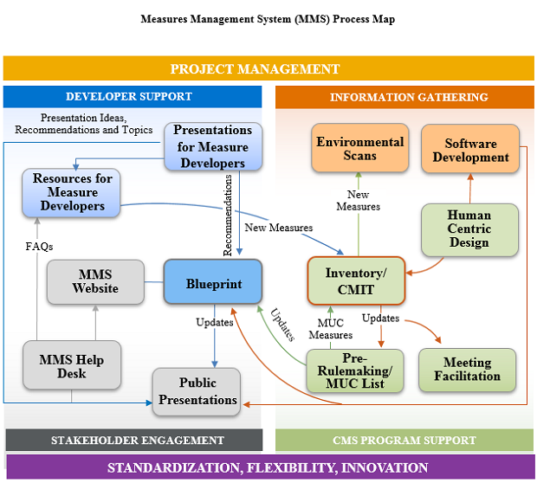
Overview of the Measures Management System
CMS developed the MMS to foster and support standardization, flexibility, and innovation in quality measurement through a series of channels
The MMS conducts stakeholder outreach and education, which includes annual public webinars, monthly information sessions, a newsletter, and other ad hoc outreach activities
https://www.cms.gov/Medicare/Quality-Initiatives-Patient-Assessment-Instruments/MMS/Index.html
Notes:
Stakeholder engagement
Developer support
CMS MMS Blueprint
Information gathering
CMS program support
Pre-rulemaking support

Slide 5
Digital Quality Measurement in Context

Slide 6
Purpose of CQMs
Goal 1: Improve the quality of healthcare provided to patients
  A tool for making “good decisions”
    One that makes it more likely that patients/providers will experience a good result and
    Makes it less likely that the provider/patient will experience an adverse result
    Low performing clinicians can choose to allocate resources to becoming high-performing
Goal 2: Empower patients to make informed decisions
  Patients can use quality measures to select high-performing clinicians
    Ex., using Physician Compare or Hospital Compare
Notes:
How CMS uses CQMs: Quality Improvement
Tracks and promotes healthcare that aligns with evidence-based practices and guidelines
Public Reporting
Informs decision-making by consumers, employers, physicians, and policy-makers
Pay-for-reporting
Increases accountability for healthcare quality
Promotes practices that will advance value-based purchasing models

Slide 7
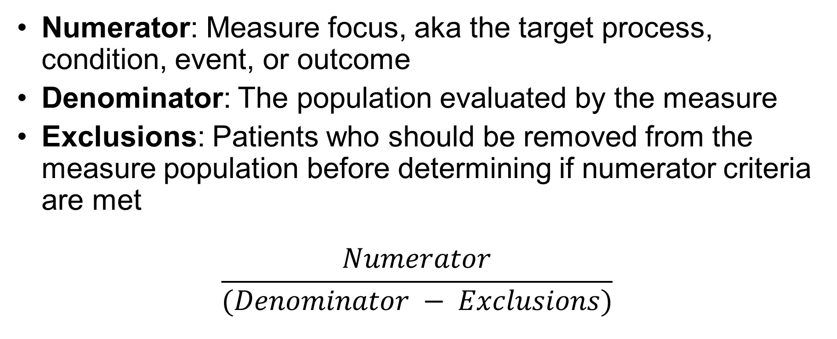
What does a CQM look like?
Numerator: Measure focus, aka the target process, condition, event, or outcome
Denominator: The population evaluated by the measure
Exclusions: Patients who should be removed from the measure population before determining if numerator criteria are met
$$\frac{Numerator}{(Denominator − Exclusions)}$$

Slide 8
Example of a Clinical Quality Measure
Measure Title: Cataracts: 20/40 or Better Visual Acuity within 90 Days Following Cataract Surgery
Numerator: Cataract surgeries with best-corrected visual acuity of 20/40 or better (distance or near) achieved in the operative eye within 90 days following cataract surgery
Denominator: All cataract surgeries for patients aged 18 years and older
Exclusions: Cataract surgeries in patients with significant ocular conditions impacting the visual outcome of surgery
Notes:
Will show full eCQM specs later in presentation

Slide 9
Example CQM Calculation
Cataract surgeries with best-corrected visual acuity of 20/40 or better (distance or near) achieved in the operative eye within 90 days following cataract surgery
Proportion of patients with 20/40 or Better Visual Acuity within 90 Days Following Cataract Surgery
All cataract surgeries for patients aged 18 years and older
Cataract surgeries in patients with significant ocular conditions impacting the visual outcome of surgery

Slide 10
Data Sources
Administrative data
Pros: Readily available, standardized, less burdensome to collect, large sample population
Cons: Limited to info recorded for billing purposes, varying degrees of clinical detail
Electronic clinical data
Pros: Reduced cost of accessing clinical info from the EHR or medical device
Cons: Data extraction requires expertise, time, and money; paper notes for point of care documentation are still the norm at some facilities
Instruments/PROMs
Pros: Validated and tested
Cons: May be proprietary, potential bias due to varying participation rates between sites
Medical Records
Patient Experience Surveys
Registries
Pros: Clinically relevant data, may be coded to allow for electronic submission
Pros: Established way of collecting patient perspective; structured
Cons: Limited scope, may be labor-intensive and costly to implement
Pros: Detailed clinical info in structured fields, may be available for electronic upload
Cons: High cost of use, typically limited to specific clinical areas; data requirements vary between registries
Cons: Time-intensive abstraction (unless automated, as with eCQMs), not as widely available as claims data)
Notes:
Administrative Data (i.e., claims): Includes demographic information about the patient and usually includes claims information (that is, information used for billing purposes) such as diagnosis and procedure codes. Non-patient data, such as staffing information or organizational policies, may also be included.
Electronic Clinical Data: Includes patient-level information that can be extracted in a format that can be used in a measure, such as data from personal health devices, which may be uploaded to the EHR.
Instruments/Standardized Patient Assessments: Data collected from standardized instruments. Examples are the Long-term Care (LTC) Facility Resident Assessment Instrument (RAI), the Outcome and Assessment Information Set (OASIS), and the Minimum Data Set (MDS).
Patient Medical Records: A traditional source of clinical data for measures. Data may be documented on paper or electronically (i.e., electronic health records [EHR]) and may include data from the clinical laboratory, imaging services, personal health records, and pharmacy.
Patient Experience Surveys: Often collected via surveys or standardized instruments. The different Consumer Assessment of Healthcare Providers and Systems (CAHPS®) surveys are used in many CMS programs. Patient or caregiver-completed standardized instruments assessing things such as health-related quality of life, functional status, and symptoms are becoming more common.
Registries: Collections of information often used to collect disease-specific data for public health purposes, such as immunization registries. The National Quality Registry Network states a clinical registry “records information about the health status of patients and the health care they receive over varying periods of time.” CMS is using data from qualified clinical data registries (QCDRs) and qualified registries in the Quality Payment Program.

Slide 11



Defining an eCQM
Just a reminder that the lower case ‘e’ in eCQM means electronic!
      Electronic specification means creating a machine-readable set of measure files using agreed upon standards
      Historically, CQMs have typically been paper-based, requiring a time-consuming manual process to report
      Potential advantages of eCQMs include:
        time savings
        ease of access to clinical EHR data
        consistency and uniformity
        error reduction
Notes:
Reference previous slide by saying that eCQMs typically rely on patient medical record data that MUST come from an EHR.

Slide 12
Key eCQM Tools
Measure Authoring Tool (MAT): A web-based tool used to author eCQMs
Value Set Authority Center (VSAC): The authoritative source for value sets to define clinical concepts in measures
Bonnie: A tool to evaluate the underlying logic of eCQM specifications

Slide 13
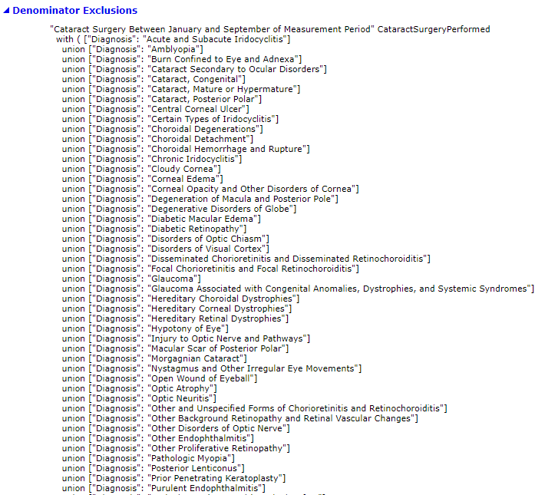
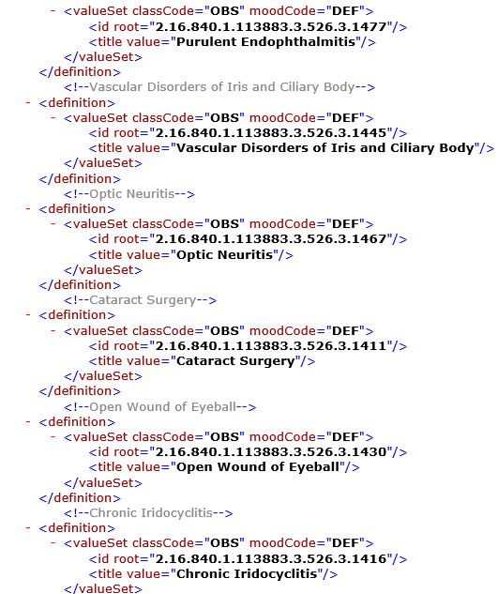
Example eCQM Specifications
Human-readable
Machine-readable
Notes:
eCQM specifications are actually a compilation of several file types. On this slide, we’re showing how some of the denominator exclusions are specified—on the left, the human-readable language shows us which types of conditions are excluded from the measure denominator. In the XML file on the right, you can see how this information has been translated into an electronic file.
You’ll see that in the machine-readable file, each clinical concept is defined using a value set ID—this information is included in the human readable file, further down in the specification, but it’s this value set ID that ensures the measure is looking for the right codes in the right places of the EHR to collect information about that clinical concept.

Slide 14


Digital Measures
Digital quality measures (dQMs) automatically pull data that are generated during the normal course of care
  eCQMs are the most recognizable of the digital measures. They rely on data entered into the EHR
Other types of digital measures include, but are not limited to:
  Information generated from medical devices, such as ventilators
  Digitized information from patient portals or other modules
Notes:
dQMs allow for more efficient capture, retrieval, and sharing of patient data, therefore encouraging:
Coordinated care
Improved health outcomes
Lower costs
Greater transparency

Slide 15

Special Considerations for eCQMs and other Digital Measures
Availability and accuracy of standardized data elements
Different testing requirements
Interoperability issues

Slide 16

Availability and Accuracy of Standardized Data Elements
EHR data is a rich source of information, but data is not collected specifically for the purpose of quality measurement
  Information may appear in free text fields or other formats that aren’t compatible with measure reporting
  Even information in structured fields needs to be coded to a standard terminology
  Information may be stored in fields other than those detected by the technical specification

Slide 17

Different Testing Requirements
As part of testing, measure developers assess feasibility issues
For an eCQM to be valid, scores from electronically collected data need to match scores from manually collected data
Can be difficult and time-consuming

Slide 18

Interoperability Challenges
Healthcare is complex; CMS and its measure developers are working to develop measures that capture that complexity
Tracking care that’s coordinated across providers is challenging, and relies on availability of interoperable EHR systems
  How do you track care from one provider to another, when those providers don’t belong to the same EHR system?
Notes:
Speaker notes will need to include a definition of what we mean by interoperability; Another general point to bring up about digital measures will be “linking” – making sure information from each data source can be tied to the same patient/provider (depending on the level of analysis). I don’t think it needs to be on this slide, but should mention it verbally.

Slide 19
CMS Digital Measurement Strategy

Slide 20
Meaningful Measures 2.0: Key Themes
Rapid performance feedback to providers
Accelerate move to fully electronic measures
Unleash voice of patient through use of patient reported outcome measures
Use measures that will advance innovative payment structures
Increase alignment of measures
Promote use of all payer data (where feasible)
Focus on major domain outcomes

Slide 21
Evolution of Quality Measures
The Journey from Paper to Digital
Traditional
eCQMs
dQMs
Paper Quality Measures
Data from claims, manual chart extractions and patient experience surveys.
Electronic Clinical Quality Measures (eCOMs)
Data primarily from electronic health records (EHRs).
Digital Quality Measures (dQMs)
Data from EHRs, registries, HIEs, claims, patient experience surveys, etc.

Slide 22
Program Impacts: Hospital IQR
Changes to HIQR portfolio since FY17, when Meaningful Measures launched:
  Decrease in total # of measures (from 63 to 23)
  Reduction of chart-based measures (from 15 to 2)
  Increased percentage of claims-based/eCQMs (78% to 83%)
  Elimination of structural measures (from 2 to 0)
  Elimination of redundant measures
    In FY17, there were at least 11 measures that were included in both their chart-based and eCQM formats; no longer the case in FY22

Slide 23
Digital Measurement Goals
Promote fully interoperable and digital measures with a goal of 100% of quality measures being digital by 2030.
Finalize a digital measure strategy.
Develop more APIs for quality measure data submission
Prototype the use of the FHIR standard for quality measurement
Incentivize use of interoperable electronic registries
Harmonize measures across registries
Give timely and actionable feedback to providers
Work across CMS on the use of artificial intelligence to predict outcomes
Notes:
Moving forward, CMS has identified opportunities to improve its digital measurement strategy, including:
Address confusions regarding misaligned programs, measures, and protocols
Be inclusive of all care settings and representative of patients across CMS programs
Reduce burden and improve interoperability

Slide 24
Roadmap to Modernization
Develop new approaches to quality measurement and improvement by leveraging advanced technology to mine data from multiple sources through various approaches to enable predictive modeling and machine learning
Create novel electronic testing beds to speed up and streamline digital measure development
Promote interoperability, prevent data blocking, support data aggregation and electronic prior authorization through appropriate legislation for comprehensive patient information to increase accuracy and coordination, as well as comprehensive reporting.
Notes:
Moving forward, CMS has identified opportunities to improve its digital measurement strategy, including:
Address confusions regarding misaligned programs, measures, and protocols
Be inclusive of all care settings and representative of patients across CMS programs
Reduce burden and improve interoperability

Slide 25
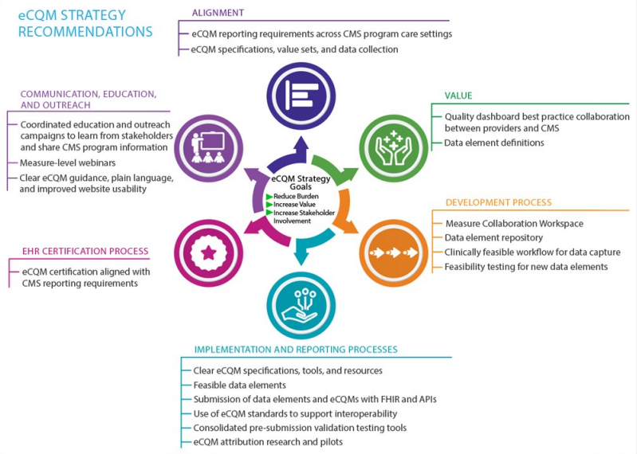
eCQM Strategy Project
Source: eCQM Strategy Project Outcomes Report, August 3, 2020
https://ecqi.healthit.gov/sites/default/files/eCQM-Strategy-Outcomes-Report-August-2020-v1.pdf
Notes:
Talk about eCQI Resource Center
Goals: to drive Alignment and Value, streamline the development process, improve implementation and reporting processes, align the EHR certification process with other CMS reporting requirements, and increase emphasis on communication, education, and outreach.

Slide 26
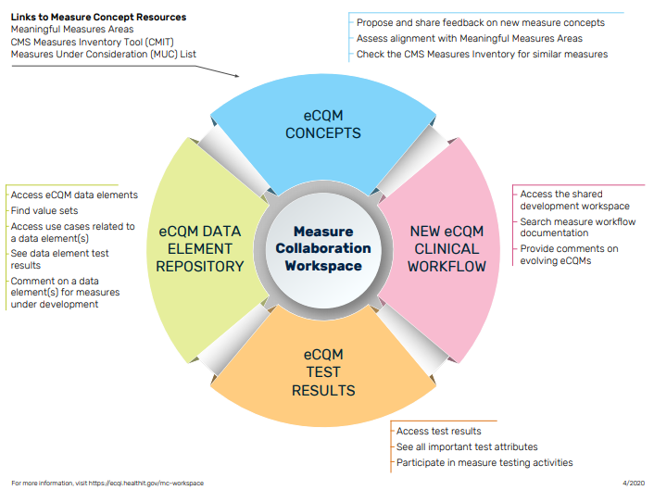
Measure Collaboration Workspace
Brings together a set of interconnected resources, tools, and processes to promote transparency and better interaction across stakeholder communities that develop, implement, and report eCQMs

Slide 27
Tools for Improving Development and Implementation Processes
CMS Measures Inventory Tool (CMIT) Environmental Scan feature
Data Element Repository (DERep)
Aids in conceptualization phase by shortening the time it takes to run an environmental scan and review similar or competing measures for harmonization
Consolidates information from the eCQM specification, quality data model, and value set authority center
Provides information about data elements for all eCQMs in CMS programs

Slide 28
EHR Data Quality
NQF convened a technical expert panel (TEP) to identify the causes, nature, and extent of EHR data quality issues and recommend best practices for addressing these issues to increase scientific acceptability (i.e. reliability, validity), use and usability, and feasibility of eCQMs.
EHR Data Quality Project Page
Final Environmental Scan
Draft Recommendations Report open for public comment starting September 30th

Slide 29

Fast Healthcare Interoperability Resources (FHIR)
FHIR is a healthcare data exchange framework to advance interoperability
  Provides a means for representing and sharing information among clinicians and organizations in a standard way
  Supports the delivery of care and quality measurement
  Reduces burden, simplifies data mapping, improves alignment, and promotes interoperability
Notes:
FHIR is a Health Level Seven International (HL7®) standard for exchanging healthcare information electronically. It is the next generation exchange framework being adopted by the healthcare community to advance interoperability. Electronic health records (EHRs) represent patient data in different ways (e.g., medications, encounters). FHIR provides a means for representing and sharing information among clinicians and organizations in a standard way regardless of the ways local EHRs represent or store the data. FHIR combines the best features of previous standards into a common specification, while being flexible enough to meet needs of a wide variety of use cases within the healthcare ecosystem. FHIR focuses on implementation and uses the latest web technologies to aid rapid adoption.

Slide 30
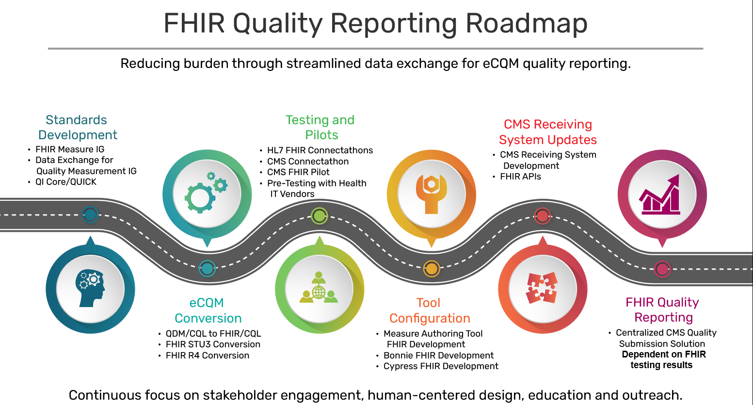
FHIR Quality Reporting Roadmap

Slide 31
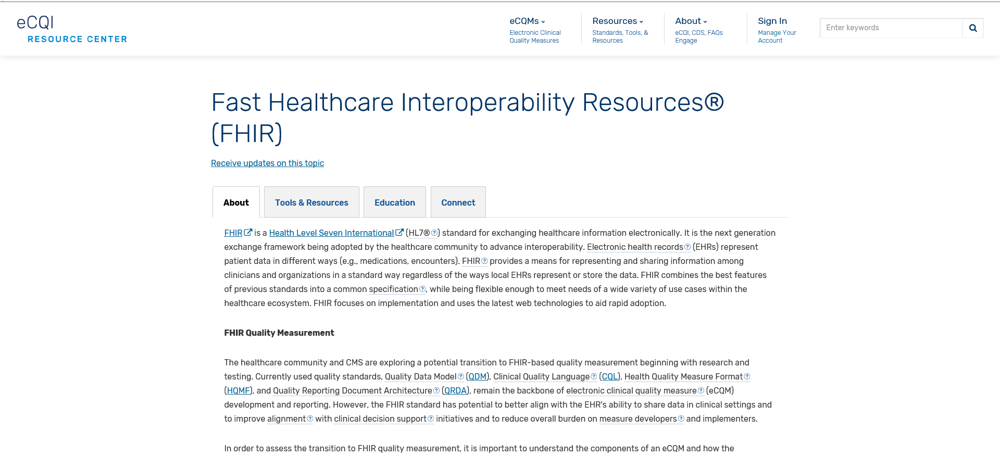
eCQI Resource Center: FHIR Homepage
https://ecqi.healthit.gov/fhir

Slide 32
Resources for More Information

Slide 33
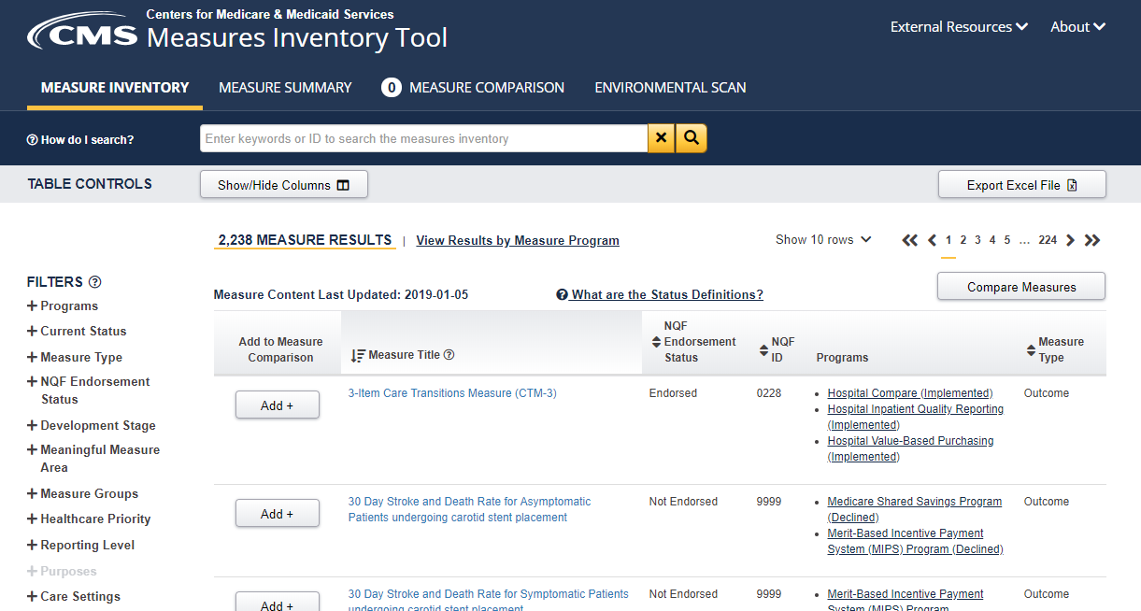
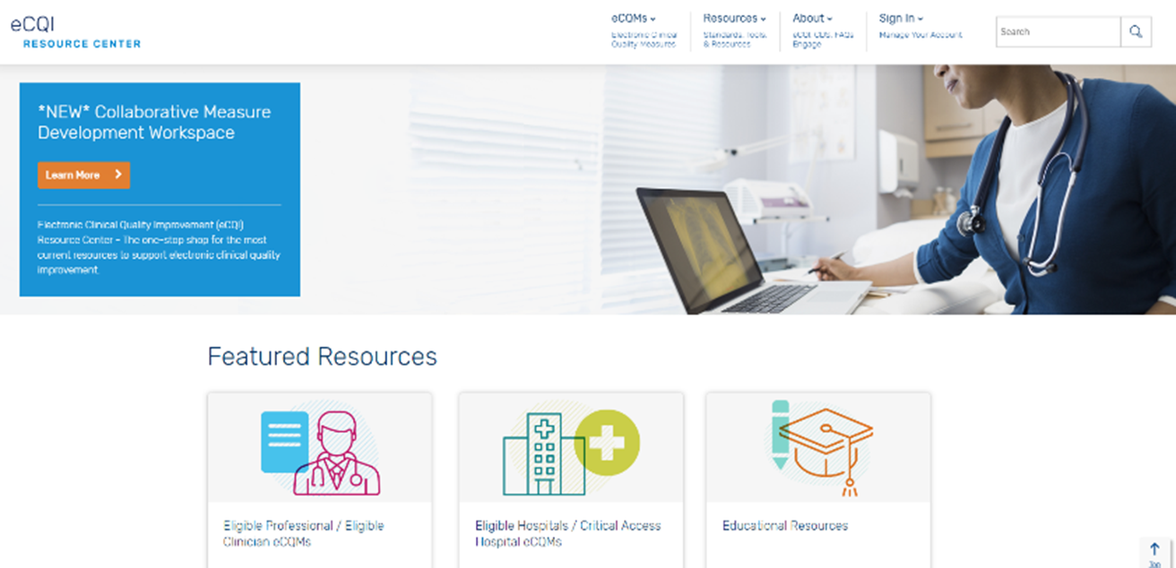
Websites with Key Resources
CMS Measures Inventory Tool (CMIT)
eCQI Resource Center
Provides a centralized location for news, information, tools, and standards related to eCQI and eCQMs
Searchable repository of the measures used across CMS quality programs and initiatives.

Slide 34

Quality Measures 101
Describes why and how CMS invests in quality measures
Includes:
  detailed descriptions of processes and considerations for development
  explanations of legislative mandates
  context for how measures fit into CMS’s broader priorities around health care quality

Slide 35
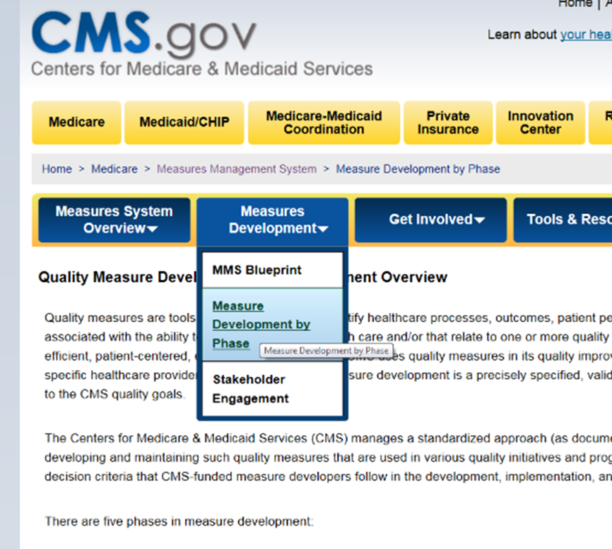
CMS MMS Website and Blueprint
The MMS website provides a link to the Blueprint, measure development tools and resources, and is easily navigated for all measure development needs
The Blueprint is a helpful resource whether your interest is in developing measures or in understanding the measure development process.
9/16/2020
Notes:
The website has:
Highlights best practices
Quick reference guides and deep dive webinars
Forms and templates
The BP:
Six sections to guide measure development
Measure lifecycle
In-depth look on each step of the process
Forms and templates

Slide 36
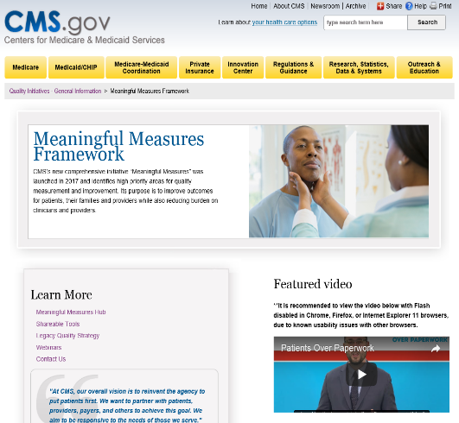
Meaningful Measures Website
This website serves as a hub for information on the Meaningful Measures Framework. There are several resources including videos, fact sheets, and Q&As which provide more detail on the 19 Meaningful Measure Areas.

Slide 37

Discussion Questions

Slide 38
Closing slide
Battelle
Measures Manager
Contact: MMSsupport@Battelle.org
CMS
Kimberly Rawlings (CMS COR)
Contact: Kimberly.Rawlings@cms.hhs.gov
9/16/2020

Slide 39
Contact Information
Measures Manager: mmssupport@battelle.org
eCQI Resource Center: ecqi-resource-center@hhs.gov or ecqi.healthit.gov
QualityNet: qnetsupport@hcqis.org
  This is also where the Hospital IQR program information can be found
ONC Project Tracking System (Jira): https://oncprojectracking.healthit.gov/
NQF: info@qualityforum.org

