Slide 1
From Coverage to Care: A Roadmap to Better Care and a Healthier You
Notes:
Hello Everyone and thank you for joining me today to learn about From Coverage to Care, and the Roadmap to Better Care and a Healthier You.
(Introduce self.)
(NOTE: Before going any further, make sure everyone has a copy of the handout.)

Slide 2
Icebreaker
Do you have new health coverage but don’t know what to do next?
Do you have a hard time explaining the difference between a copayment & coinsurance?
Do you know what services are covered by your health plan?
Do you have insurance but have not used it because you aren’t sure how much you have to pay?
Do you want or need to see a doctor, but do not know how to find one?
Do you have difficulty remembering when you last had a physical, had your blood pressure checked or received an immunization?
Notes:
Before we get started, I wanted to ask a few questions. It’s ok if you don’t want to raise your hand, but I’m sure others in the room would like to know they are not alone.
(Read all of the questions)
If you answered yes to any of these questions, then you are in the right place. And, you are not alone.
I’d like to ask one more question. What brought you here today, and what are you hoping to learn?
(NOTE TO PRESENTER: If you can, please write down the reasons and the things they wish to learn and share them with coveragetocare@cms.hhs.gov afterwards. This will help us refine our materials.)
Today we are going go over a resource you can use to help change some of those Yeses to Nos, and will cover many of the things you said you want to learn.
Throughout our discussion, I’m going to share some websites that can help you along your journey. Don’t worry about writing them all down. They are all listed on the handout you have, along with a few others.
By the end of the session, you should be more familiar with key insurance terms, know how to find a primary care provider, and know where to go should you have questions about your coverage. We’re going to cover a lot of information today. I don’t expect that you will be able to remember every detail, but hopefully, you will figure out where you are on your journey from coverage to care, you will take away a few pieces of information to help you and your family get the care you need, and you will refer to the Roadmap as you continue on your path to better health and wellbeing.

Slide 3
From Coverage to Care (C2C)
Visit http://marketplace.cms.gov/c2c
Print copies are available for free.
Notes:
Millions of people like you have obtained coverage from the Marketplace, Medicaid, their employer, or Medicare. Some, for the first time. For many, they are unsure of what they signed up for, unsure how to use it to get the care they need, and unsure where to go for answers.
From Coverage to Care is an ongoing initiative started by the Centers for Medicare & Medicaid Services (CMS). It was designed to help individuals understand their health coverage and connect with the primary care and preventive services that are right for them so they can live long, healthy lives.
A number of resources have been created through C2C, the main one being the Roadmap to Better Care and a Healthier You, which we will focus on today. You can order copies for free in seven languages other than English, and view other resources such as videos by visiting marketplace.cms.gov/c2c. These are available online but also in print copy.
NOTE: (Other languages = Spanish, Chinese, Arabic, Haitian Creole, Korean, Russian, and Vietnamese. These languages represent the most frequently requested languages to the Marketplace Call Center, and the languages with the highest percentage of speakers with limited English proficiency among the top languages spoken at home other than English across the country.)

Slide 4
Before You Begin the Roadmap
Confirm your coverage.
Pay your monthly premium.
Review plan materials to learn about benefits.
Continue to receive treatments or refill prescription drugs you need.
Keep your information on HealthCare.gov current.
Resources:
To contact the Marketplace, go to www.HealthCare.gov or call 1-800-318-2596.
Contact the state Medicaid or CHIP office.
Notes:
Before we start going through the Roadmap, let’s talk about what you should do if you just signed up for coverage.
If you have not received your insurance card or are unsure if your enrollment in a health plan is complete, you may want to confirm your coverage. You can do this by logging on to your profile at healthcare.gov (or state website) or by calling the Marketplace at 1-800-318-2596 (or state number).
Once enrolled, you want to make sure to pay your premium. The premium is due each month. If you don’t pay it, you could lose your coverage. So set a reminder to make sure you pay. If you have Medicaid, you will not have to worry about a premium.
In addition to your insurance card, your plan may have mailed you, or posted online, a booklet of information about your benefits. Look through this and see what they offer, what your payments would be, and see what other resources they may suggest.
If you are taking prescriptions right now, make sure you know what they are and how long your current prescription will last. You might need to order a refill or see a doctor again soon to make sure you don’t miss any doses.
Finally, throughout the year, remember to keep your information updated with HealthCare.gov (or state Exchange). This includes your address, changes in your family size, changes in household income, or if you lose a job or start a new one. These changes can affect the amount of money you are eligible for in tax credits and cost-sharing subsidies. They can also effect if you are eligible for a special enrollment period.

Slide 5
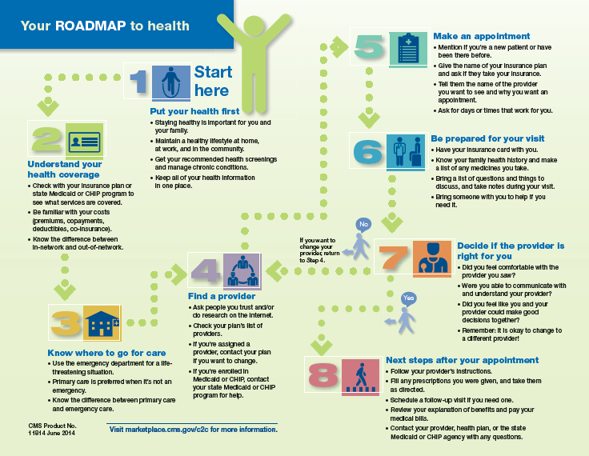
From Coverage to Care Roadmap
Online at marketplace.cms.gov/c2c
Notes:
As you can see, the Roadmap lays out a path for the newly covered to connect to care, starting with Step 1, Put your health first, and ending with Step 8, Next steps after your appointment.
Today we’ll walk through each step together.

Slide 6
Step 1: Put Your Health First
Staying healthy is important for you and your family.
Maintain a healthy lifestyle.
Get recommended health screenings & manage chronic conditions. Many screenings are available with no cost sharing.
Keep all of your health information in one place.
STEP 1 | 2 | 3 | 4 | 5 | 6 | 7 | 8
Notes:
The first step in the Roadmap, and our first step to better care and a healthier you, is to put your health first. Many people think about health insurance as something to be used only when you get sick, but you can and should use your coverage to stay healthy. Regular care and healthy habits will help you live a long and healthy life.
I encourage you to get the preventive services that are right for you. As a result of the Affordable Care Act, many of them are available with $0 copay. Talk to your health provider about the preventive services that are right for you.
It is easier to live a healthy lifestyle when your family and friends are doing the same. Talk to friends and family about staying healthy and getting recommended preventive services.
There are four parts to putting your health first: 1) physical activity, 2) healthy eating, 3) managing stress, and 4) taking an active role in your health. Let’s talk about each of them.

Slide 7
Put Your Health First: Physical Activity
Regular physical activity increases your chances of living a longer, healthier life.
It’s not all or nothing! Even 10 minutes of activity is better than nothing!
Resources:
Be Active Your Way
Physical Activity Basics
Notes:
Let’s take a closer look at putting your health first.
Part of Step 1, as we said, is recognizing that staying healthy is important for you and your family. Having health insurance and getting good health care are important, but there is no substitute for a healthy lifestyle.
The first important thing you can do is to make time for physical activity. Being physically active is important for living a long, healthy life. Whether that is running each day, taking your dog for a walk, working in your garden, dancing with your friends, or playing a team sport, you can find lots of ways to fit in activity on a regular basis. You don’t have to run a marathon, or workout for an hour. Even a little activity is better than nothing!
The resources listed provide information about how much physical activity is recommended and tips on how to be active in a way works for your life. The websites for them are available on your handout.

Slide 8
Put Your Health First: Healthy Eating
A healthy diet can help protect you from heart disease, type 2 diabetes, and some types of cancer.
Make small changes to your eating habits to make a big difference for your health.
Resources:
My Plate
www.choosemyplate.gov
Nutrition Basics
Notes:
We all know we need to eat better. A healthy diet not only makes us look and feel better, it can actually help protect us from heart disease, diabetes, even cancer!
A few changes to the way you snack or have a family meal can make a big difference! Switch out soda for water. Mix in fruits and vegetables to your meals and snacks. If you want to treat yourself, eat one cookie instead of two. These little changes can really add up!
For information on how to eat the right amount of different types of food, visit choosemyplate.gov. This website provides information for people of all ages, recipes, and other tips for better eating. The handout provides a link to the Centers for Disease Control and Prevention (CDC) website for information on nutrition basics.

Slide 9
Put Your Health First: Relaxation
Preventing and managing stress can help lower your risk for health problems like heart disease, high blood pressure, and depression.
Being prepared and in control of your situation will help you feel less stressed.
Resources:
www.healthfinder.gov
www.mentalhealth.gov
Notes:
We all get stressed sometimes. But did you know stress can lead to serious health problems? I know you may not be able to get rid of your stress, but managing ongoing stress – what is called chronic stress – can actually lower your risk for diseases.
Think about how you can feel in control. What helps you to feel less stressed? Is it being prepared and organized? Maybe a relaxing activity?
It’s also important to know how you handle stress, as that can also affect your health. For example, when you are stressed, do you eat more than normal, or less than normal? Do you get less sleep? Do you go shopping?
Remember, it’s normal to feel to stressed, and it’s ok to ask for help!
If you go to www.healthfinder.gov, and type stress in the search window, or lookup stress management under health topics A to Z, you will find some resources to help you manage your stress. Information is provided in English and Spanish.
If you need additional help, you can visit www.mentalhealth.gov to search for a mental health provider in your area to help you deal with anxiety, stress, or depression.

Slide 10
Put Your Health First: Take an Active Role in Your Health
Being active in your health can lead to better care and better health for your and your family.
Keep track of health information.
Ask questions.
Resources:
My Family Health Portrait
https://familyhistory.hhs.gov
My Medicine Record
Notes:
All of these points allow us to take an active role in your health. When you are proactive, it can truly improve the quality of care you and your family receive.
Another thing you can do is to keep track of your health information. Know where you insurance cards are, keep a list of current medications. And ask questions at the doctor’s office! Write them down before you go so you won’t forget Do this for you and your family members!
You should also know about your family’s health history.
The resources listed here allow you to create and print your own health history and medicine records.

Slide 11
Step 2: Understand Your Health Coverage
Understand key insurance terms
Review your plan to see what services are covered.
Know the difference between in-network and out-of-network.
Understand your out of pocket costs.
1 | STEP 2 | 3 | 4 | 5 | 6 | 7 | 8
Notes:
Step 2 is understand your health coverage. You won’t need to know every detail, but it’s good to understand what services are covered, and how much you can expect to pay should you get care, especially the ones that are important to you. Most importantly, know where to find this information when you need it.
A set of terms you’ll see on this slide is in-network and out-of–network. In-network means a provider work with your health plan and it will cost you less to see them rather than an out-of-network provider. Your plan keep a directory of providers who are in-network. You can generally find it on the plan’s website, or you can request a copy.
Be familiar with terms like premium and co-pay. The back of your Roadmap has a list of health terms and what they mean. Use this to help remind you of the differences between copay, premium, and deductible.
Your insurance provider and even your insurance card should be able to help you understand the exact cost of your premium, copay, and deductible.

Slide 12
Step 2: Understand Your Health Coverage
Premium is a payment made, usually monthly, to an insurance company for your coverage.
Deductible is the amount you owe for health care services before your plan will start paying for your care. Note: May not apply to all services.
Copayment (Copay) is a fixed amount you pay for a covered health care service or supply. For example, $15 for a doctor visit.
Coinsurance is your share (a percent) of the costs of a covered service. For example, if your coinsurance is 20%, and the service cost $100, you pay $20.
(See the glossary at the back of your Roadmap for more definitions.)
Notes:
Let’s take some time to go over some of these key words.
Premium are payments generally made every month to your insurance company to maintain coverage. It’s important to pay your premium, regardless of whether they use any health care services. This will ensure you keep your coverage.
Deductible is the dollar amount consumers have to pay for health care services before their plan will start paying for their care. The deductible may not apply to all health care services. For some plans, you do not need to pay the deductible before your plan will pay for primary care or prescription drugs. Deductibles differ by plan, so look through your insurance information to see what your is. You should also keep track of how much you’ve paid toward the deductible. Each year, your deductible is reset.
Copayment (or Copay) is the fixed amount you’ll pay for a covered health care service or supply. Copayments are usually a set amount, for example $15 for primary care visits and $35 for specialty care visits. The amount of the co-pay will differ based on the type of care or service. Some services won’t have a copay, such as preventive services. Also, if you have Medicaid, you may not have a copayment.
Coinsurance is the consumer’s share of the costs of a covered health care service. For example: if the cost of a visit to a specialist is $100, and the consumer is responsible for paying 20% coinsurance, he or she would pay $20.

Slide 13
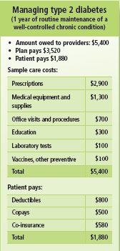
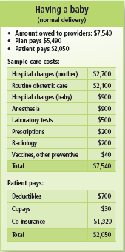
Sample Cost Tables
Cost scenarios, like managing Type 2 Diabetes and having a baby, help us understand what care may cost, and how the plan may divide these costs.
NOTE: These are not real costs.
Notes:
These are cost tables. You’ll find these in the Roadmap booklet under Step 2. They are examples of what you might pay. These are just samples, so your plan may be different, but it helps show you what we’ve been talking about.
The first part in green shows all the costs for a service. You can see on the having a baby example, it includes the hospital stay, tests, vaccines, and more, and provides a total. Likewise, the diabetes example shows prescription costs, equipment cots, and office visits and tests. A total is provided. Then each shows what you pay. The deductible amount. A copay, or maybe co-insurance, depending on your plan, and then the total you pay out of pocket.

Slide 14
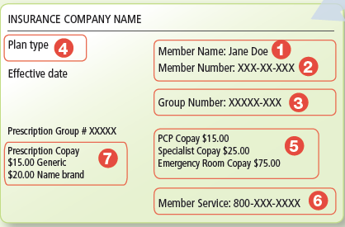
Key Terms On An Insurance Card
Key terms
1) Member Name
2) Member Number
3) Group Number
4) Plan Type
5) Copayment
6) Phone Numbers
7) Prescription Copayment
Notes:
This slide shows what an insurance card might look like. You can actually have this information on its own handout from Coverage to Care, if it helps you, or find it in Step 2 of your Roadmap. A few key terms are highlighted.
While we are thinking about insurance cards and personal information, this is a good time to remind you not to share your insurance information with anyone and to keep it in a secure location.
Many of you may have your insurance card at this point, and maybe even have it on you. If you don’t, your insurance plan should be able to provide you this information until you receive your card.
Audience Participation
Let’s pull out our insurance cards, if you have yours available, and see if we can identify the information listed. You’ll see where it has your name and the plan information, the member number, group number, plan type. Do you see the amount for your co-pay for a primary care visit? Or prescription? Does your card show how much your deductible is?
Next, turn your card over. Usually this is where your plan’s contact information is located. If you have questions about your coverage or a claim, call that number for help. Can everyone find their plan’s contact information?

Slide 15
Step 3: Know Where To Go For Care
Primary care is preferred when it isn’t an emergency.
Only use the ER in a life-threatening situation.
Know the difference between primary care and care received in the ER, and how costs may differ.
1 | 2 | STEP 3 | 4 | 5 | 6 | 7 | 8
Notes:
Step 3 is to Know where to go for care. There are a few places you could go. You have your primary care provider, the emergency room, and others. But we want to help you know when to use which place.
The emergency room should be used for life-threatening illnesses and injuries.
Remember that a primary care provider is where you go when are well and when sick. They provide routine primary care and preventive services.
The emergency room in your local hospital is not for primary care. The emergency department should only be used if you or a family member has an emergency, life-threatening illness, or injury.
Audience Participation
Ask consumers to talk about different health situations, and ask the group to decide whether it is something for which they should see their primary care provider, or go to the emergency room.

Slide 16
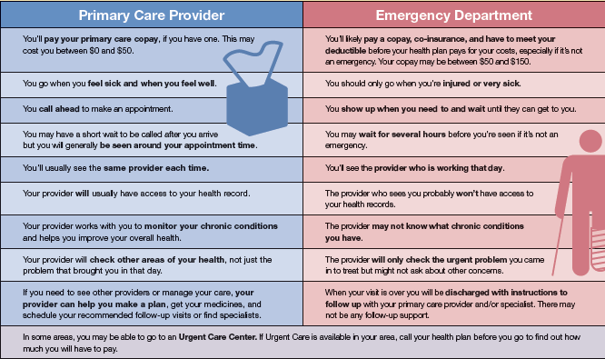
Primary Care vs. Emergency Care
Notes:
In your Roadmap you’ll see a table that highlights some of the differences between primary care and emergency care. This table is also available as its own handout from Coverage to Care.
One of the first things to note is that if you use the emergency room for a non life-threatening illness or injury, you will likely pay more. Typically, the co-pay for an ER visit is higher than for a primary care visit.
Another difference is that you can call for an appointment with your primary care provider. But in the ER you will wait to be seen based on the severity of your condition and the seriousness of the other people waiting.
When you see your primary care provider, they’ll get to know you and your health history, and can be able to access your health records. At the ER, they will not be able to look at your health records.
Many people will ask about urgent care as well. I’m sure many of you have seen an urgent care center. Urgent care is care for an illness, injury or condition serious enough that a reasonable person would seek care right away, but not so severe it requires emergency room care. Urgent Care Centers may offer more accessible hours than a primary care provider and seem more accessible than an ER. But you’ll want to check with your plan about what this may cost.

Slide 17
Step 4: Find a Provider
Check your plan’s directory to find providers in your network.
Ask people you trust or do research on the Internet.
If you were automatically assigned a provider, contact your plan if you wish to change.
Resources:
Find a health center near you: http://findahealthcenter.hrsa.gov.
Find a mental health provider: http://findtreatment.samhsa.gov.
1 | 2 | 3 | STEP 4 | 5 | 6 | 7 | 8
Notes:
Step 4 is to Find a Provider.
This is important to do when you’re feeling well. You want to develop a relationship with this person so that over time, they know what is normal for your body, and what is not. And when you are not feeling well, I’m sure you’ll agree that you would feel more comfortable with someone you know examining you, rather than a complete stranger.
Your primary care provider can work with you to make sure you get the preventive services that are right for you.
A primary care provider doesn’t have to be a doctor. They could be a doctor, nurse, physician assistant or another type of health professional, and they can be found in many places such as private offices, community health centers, or hospitals, just to name a few.
If you already have a provider, and you want to keep seeing them, contact their office to see if they accept your insurance.
If you don’t have a primary care provider in mind, a good place to start is with the provider directory from your insurance company. You’ll want to look for providers in family practice, general practice, internal medicine, or general medicine.
You may also want to ask your friends and family for a recommendation, or use other online resources for help, but remember to pick a provider who is in your network. If they are out-of-network, you may pay more to see them.
If you need to see a specialist, you can use this same approach. But remember that some specialists require a pre-authorization from your insurance or a referral from another doctor.
Audience Participation
Ask the audience to raise their hand if they have a primary care provider.
For those who do have a provider, ask them how they found them.
For those who do not, ask them why they don’t have one.

Slide 18
Step 5: Make an Appointment
Call for an appointment.
Tell them if you are sick.
Have your insurance information available.
Confirm they accept your coverage.
Be prepared with a few available dates and times.
Key questions to ask.
What do you do if you need to change or cancel your appointment?
Will you pay a penalty for cancelling with less than 24 hours notice?
Are there any forms you need to complete before your visit?
1 | 2 | 3 | 4 | STEP 5 | 6 | 7 | 8
Notes:
Step 5 of our Roadmap is simple. Now that you found a provider, it’s time to make an appointment.
When you call, let them know the reason for your visit, such as annual exam, or an illness. If you are sick and need care right away, let the office know. They may be able to see you that day.
If you are calling the office for the first time, ask them if they are accepting new patients. It may take some time to get and appointment if you are a new patient.
You also want to confirm that they accept your coverage. Remember, you will pay more if you see a provider who is out-of-network.
Also let them know if you have any specific needs, like translation services or accessible medical equipment.
Be prepared to provide them with your name, date of birth, address, and insurance information.
Ask them what you should bring with you to the appointment. Ask what their cancellation policy is, in case there are fees for late cancellations or missing an appointment.
Be sure to write the date and time of your appointment on a calendar, and set a reminder to will help you remember.

Slide 19
Step 6: Be Prepared for Your Visit
Take your insurance card, and any forms.
Be prepared to pay the copayment or coinsurance.
Ask questions.
Bring a list of your medications.
Bring someone with you if you feel more comfortable.
1 | 2 | 3 | 4 | 5 | STEP 6 | 7 | 8
Notes:
Step 6 is to Be Prepared for you visit.
Make sure to take your insurance card, photo ID, your list of medications, and any forms or information they asked you to bring. Remember to bring enough money for your co-pay.
A list of your current medications is helpful to make sure you and your provider are on the same page, and they’ll know if you need any refills. Include the name of the medication as well as the dosage amount and how often you take it.
Try to show up early as there may be additional forms to fill out.
Remember to take an active role in your health. Think about any questions you have for your appointment and write them down so you don’t forget.
Also remember that you should feel comfortable with your provider. You have the right to be respected and for your information to be kept private.
Audience Participation:
Bring copies of My Medicine Record and ask participants to fill it out as best they can. http://www.fda.gov/downloads/AboutFDA/ReportsManualsForms/Forms/UCM095018.pdf
Ask the audience to share some of the questions they want to know when they are going to see their health care provider.
Ask the audience to think about their family histories, and write down any conditions their parents, siblings, or grandparents have/had. If they don’t know, encourage them to talk to their family about it. Remind them that many conditions are preventable, and with this information, they can work with their provider to prevent them or catch them early when they have the best chance for a cure.

Slide 20
Step 7: Decide if the Provider is Right For You
Finding a provider you trust, and can communicate with, is important.
Key questions to ask.
Is this provider someone you can work with over time?
Did you feel that you were listened to and your health needs were addressed?
Did you feel you were treated fairly by your provider and the office staff?
It is okay to change providers.
1 | 2 | 3 | 4 | 5 | 6 | STEP 7 | 8
Notes:
Step 7 is to Decide if the provider is right for you. So after your visit, think about how it went. Did you feel comfortable talking to your provider? Is this someone you could work with over time to achieve your health and wellness goals?
Did you feel that you were listened to and your health needs were addressed? Did you feel you were treated fairly by your provider and the office staff?
If you need an interpreter, or need accessible equipment, was your provider able to accommodate you?
If you answer no to any of these questions, you may want to talk to your provider or office staff about some of your concerns, in case they can be resolved. If you still have concerns, it’s ok to change providers. Return to Step 4 and find another provider in your network. Check with your plan to see if they will cover a visit to a different provider, or whether you need to wait a certain amount of time before scheduling your visit.

Slide 21
Step 8: Next Steps After Your Appointment
Write down your providers’ instructions and healthy living tips.
Schedule any follow-up or other visits and fill prescriptions.
Review any documents or bills you receive and contact your plan or state Medicaid or CHIP program if you have questions.
Keep your information current. Log on to your account with www.healthcare.gov or your state Marketplace.
Check your plan during Open Enrollment to make sure it still meets your needs.
1 | 2 | 3 | 4 | 5 | 6 | 7 | STEP 8
Notes:
The last step of the Roadmap is to think about “Next Steps After Your Appointment”.
It’s a good idea to write down any instructions or tips you received before you forget them. Before you leave your provider’s office, make sure you know how to answer the following questions:
Do you need additional tests?
Do you need to fill a prescription?
What to do now to keep yourself healthy?
What number do you call if you have a question when you get home?
When should you see your provider again?
You may receive a bill, statement, or other document after you visit. It’s important to read this and make sure your service was covered and check whether anything is owed.
Plans can change and so can your health care needs. Review your coverage options during each open enrollment period to make sure they one you selected still meets your needs.
Remember that if you move, get married, have a baby, or lose your previous coverage, you may be eligible for a special enrollment period, and if you qualify for Medicaid, you can enroll at any time.

Slide 22
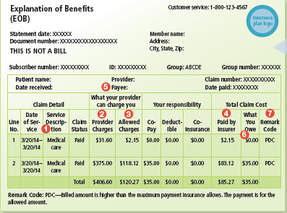
Explanation of Benefits (EOB)
It’s a summary of health care charges from the care you or those covered under your policy received. It is NOT A BILL!
Notes:
One document you may be sent after a visit is an Explanation of Benefits, like the one shown here. You can find this image in Step 8 of your Roadmap booklet. But you may also obtain it as a one page handout as well.
This paper describes the services you received, what your provider charged, what your health plan paid, and what you owe. It is not a bill. You may not owe anything additional after the co-pay. However, you could be billed later on, so continue to read notices just in case. If you have Medicaid or CHIP you may not receive an explanation of benefits.
If you have any questions about the services or the charges, contact your insurance plan.
If your care was denied or you disagree with a policy or payment decision their coverage plan made, you can appeal or file a grievance to try and change the decision. Contact your plan if you have questions about appeals or grievance claims.
Remember after your visit that you must continue to pay premiums and bills – to providers and the plan – to ensure you stay covered continuously.

Slide 23
Premium Credits & Cost-Sharing Reductions
Premium tax credits
Can be applied to your monthly premium or received as part of your tax refund.
You must file federal taxes to get this subsidy.
The amount of premium tax credit received during the year will be reconciled with your eligibility based on actual household income for the year.
Cost-sharing reductions
Reduces your out-of-pocket costs like deductibles, copayments and coinsurance.
Eligible consumers can receive them if enrolled in a Silver plan.
Notes:
Coverage will affect your income taxes when you file federal income tax returns.
Advance payments of the premium tax credit can lower monthly premium costs. You can apply the credit when coverage starts and pay less per month, or claim the credit when filing taxes. However, you must file federal taxes to get this subsidy. When you file your annual federal income tax return, the amount of premium tax credit received during the year will be reconciled with your eligibility for the premium tax credit based on actual household income for the year. If you received too much premium tax credit, you may have to repay the excess amount.
Cost-sharing reductions reduces the consumer’s out-of-pocket costs when they use health care services, and it applies to their deductibles, copayments and coinsurance.
It is available to some consumers who enroll in Marketplace plans and have household income is between 100% - 250% of the Federal Poverty Level and who don’t qualify for Medicaid, if they enroll in a Silver plan. (ADD THE CURRENT YEAR DOLLARS).

Slide 24
Understanding Tax Information
To Avoid the Shared Responsibility Payment:
Maintain your coverage or
Qualify for an exemption
Keep your information current to lower your risk of being overpaid on your tax credits.
If you enrolled in a health plan through the Marketplace, you’ll receive Form 1095-A from the Marketplace.
Notes:
Health insurance now has a role with taxes. The good news is this may help a lot of people receive assistance in paying their premium and other bills. But there are a few terms to know.
First is the Individual Shared Responsibility: Starting in 2014, the individual shared responsibility provision requires each individual to maintain health coverage (known as minimum essential coverage), qualify for an exemption from the requirement, or make a shared responsibility payment when filing a federal income tax return. During tax season, most tax filers will just need to check a box on their tax return to indicate that they had coverage all year. These people met the Minimum Essential Coverage requirement, which means that they had the health coverage necessary to meet the Affordable Care Act’s requirement. These individuals and families will not receive any new forms in the mail and they will not be required to fill out new forms when they file their 2014 income tax returns.
1095: If you enrolled in a health plan through the Marketplace, you’ll receive Form 1095-A in the mail from the Marketplace by early February each year. You can also download it from your Marketplace account. Keep this form with your other important tax information, like your W-2 and other tax records, to use when you file. You won’t get this form if you have health coverage through Medicaid, Medicare, or the Children’s Health Insurance Program (CHIP).

Slide 25
Other Information in the Roadmap
Glossary of health coverage terms.
Resource list.
Personal health tracking checklist.
Health information page for coverage and provider information.
Notes:
Aside from information on the 8 steps we just covered, the Roadmap includes some additional information.
There is a glossary of health coverage terms to help define copays, premiums, deductibles, formulary, out-of-network, and more.
You can also keep track of your health with the tracking checklist. There’s a spot to record your blood pressure, weight, and what screenings you’ve had.
Finally, there is room to write down important information like your provider’s name and phone number, or the phone number and website for your insurance plan. Since we covered a lot of information, today you may wish to review the Roadmap and keep it available to reference as you need navigate the health care system.

Slide 26
Contact Information
Contact C2C
coveragetocare@cms.hhs.gov
Order Resources
http://marketplace.cms.gov/c2c
Notes:
Here is how to reach From Coverage to Care, by using their email coveragetocare@cms.hhs.gov (repeat).
You can also download or order the Roadmap that we discussed as well as a number of other products on the Coverage to Care website, marketplace.cms.hhs.gov/c2c (repeat).
Remember, we’re here to help you, too. You can contact us by …. (Add your or your organization’s contact information.)

