Slide 1
SNP Approval Model of Care Training Elements 3 – 4 January 14, 2016 3:00 – 4:30 PM EST
Brett Kay, NCQA ~ Susan Radke, CMS
Sandra Jones, NCQA ~ Nidhi Dalwadi Mehta, NCQA

Slide 2
Objectives of Special Needs (SNP) Model of Care Review
Comply with statutory requirements of Affordable Care Act
Ensure SNPs have robust Models of Care
Establish frequency for approval review cycle (1-3 years)
Notes:
As a refresher, the goals of today’s training are threefold:
Comply with the statutory requirements of the Affordable Care Act. As you know, there is language in the ACA that states, “SNPs must be approved by NCQA.”
The second goal is to ensure that SNPs and MMPs fully understand what the MOC requirements are and how to develop an MOC that not only meets the requirements, but more importantly, provides high quality care for beneficiaries.
The statutory requirements established an approval timeframe for plans scoring at certain levels, and this review helps to determine the approval review cycle for each SNP and MMP, from 1 to 3 years.

Slide 3
MOC Elements
MOC 1: SNP Population
MOC 2: Care Coordination
Care Transitions Protocol
MOC 3: Provider Network
MOC 4: Quality Measurement
Notes:
Noted on the screen are the 4 MOC Elements. We will get into detailing the subcategories of each element after the introduction.
MOC 1: SNP Population incorporates vulnerable populations
MOC 2: Care Coordination includes the requirements around the HRA, ICP, ICT, and communication network
MOC 3: Provider Network addresses the provider network and MOC training components
MOC 4: Quality Measurement addresses the measureable goals and outcome measurement requirements.

Slide 4
How will NCQA Score the MOC?
MOC elements worth 0-4 points, based on # of factors met.
Total of 60 points (15 elements)
converted to percentage scores
E.g., 50 points = 83.33% (2-year approval)
85%+ --3-year approval
75-84%--2-year approval
70-74%--1-year approval.
Plans scoring <70% after the initial review will have one Cure process. Plans that undergo the Cure, will only receive a 1-year approval, regardless of their final score.
Notes:
The MOCs will be scored on a scale of 1-4 for each element. There are 15 elements, so the maximum score a SNP can receive is 60 points.
Those points will be converted to a percentage score that determines the approval cycle:
85%+ --3-year approval
75-84%--2-year approval
70-74%--1-year approval.
Plans scoring <70% after the initial review will have one Cure process. Plans that undergo the Cure, will only receive a 1-year approval, regardless of their final score.

Slide 5
Project Time Line
February 9 – Technical Assistance call prior to submission
February 17 – SNP and MMP applications submitted to CMS via HPMS
April 18 – CMS issues Notice of Intent to Deny
April 21– TA call for Plans scoring <70%
April 28 - Cure apps due in HPMS
May 25 – CMS issues Denial Notices
June 6 - Bids due to CMS
Notes:
Please note these important dates:
We will hold a call with plans on Feb.? to answer any questions you have about the MOC scoring guidelines prior to submission.
All MOC submissions for plans seeking to add new SNPs, renew existing ones prior to their SNP approval expiration or for plans seeking to expand service areas must submit their MOC no later than 8:00pm on February 17 via HPMS
You will receive your results from the initial MOC reviews on April ?. For plans scoring <70%, you will have a cure opportunity
All revised MOCs for the cure are due to HPMS on April 28
Final notices of results will be sent on May 25
Final bids are due to CMS on June 6.

Slide 6
Updates for this Review Period
Discontinuing Dual Eligible Special Needs Plans Sub-type Categories
Current D-SNPs under a MA-PD contract do not have to submit separate applications or MOC narratives to offer a different subtype category type.
Current SNPs under a MA-PD contract do not have to submit a MOC for a Service Area Expansion
Notes:
Since this information is already captured in the SMAC, CMS can determine the D-SNP’s enrollment categories independent of any MAO action.

Slide 7
Keep in Mind
SNPs must identify all of the H-numbers that fall under the same MOC on the SNP MOC Matrix Upload document
While the MOC is the same – we want to see specificity on the target population at the local service area (PBP) level, not the national level. Make data and analysis relevant to specific populations in each service area
Expectation is for SNPs to submit a new MOC each renewal period with process updates and changes (e.g., changes to goals as a result of analysis of outcomes or process improvements), and not the same MOC previously approved
MOC will receive a new score
Target population description is not your overall/national population
Notes:
When preparing your MOC narrative, here are some points we think you should keep in mind.
If you are submitting multiple SNPs that share a common MOC, please list all of the H-numbers on the Matrix Upload document. This will allow us to group them together during reviews and maintain consistency in scoring.
Each renewal year will be considered a review of a new MOC and as such, it will receive a “new score”. Note that if the health plan submits the same MOC, it may not receive the same score as the previously approved narrative in the event of changes/deletions in the requirements.
If the plan is submitting the same or similar MOC as in previous years for an initial application or a SAE, you should note the H number of the previous submission and realize that you will not necessarily receive the same score on that MOC. Remember, the narrative must detail the target population for that plan.
Your narrative for these elements builds on the target population identified in the MOC 1 discussion on target population and provides the foundation for descriptions in MOC 3 and 4.

Slide 8
MOC 3: Provider Network
Nidhi Dalwadi Mehta

Slide 9
MOC 3, Element A: Provider Network
Intent: demonstrate how the network is designed to address the needs of the SNP’s target population
Focus:
Plan-level information for the provider network
Notes:
MOC 3 is about the provider network. The intent is to describe the provider network and how it is designed to address the needs of the SNP’s target population.
The focus for this element is on the plan-level oversight information for all of its network providers overall; which includes all facilities as well as practitioners. Please note that, in factor 3, we removed language on credentialing last year.
This element has four factors and the organization must meet all 4 factors to receive a score of 100%.

Slide 10
MOC 3, Element A: Specialized Expertise
The specialized expertise in the provider network addresses the needs of the target population as described in MOC 1
How the SNP oversees the licensure and certification of providers
Documentation of provider information
Collaboration between the providers and ICT to provide necessary specialized services
Notes:
The SNP must describe how the specialized expertise in the provider network address the needs of the SNP’s target population identified in MOC 1. The specialized expertise includes but is not limited to internal medicine, endocrinologists, cardiologists, oncologists, mental health specialists and other specialists. Additionally, the organization must describe how it determines that its providers have active licenses and certification and are competent to provide the specialized health care services. In addition, the SNP should describe how it documents and maintains current information on the providers. The SNP must also describe how the network providers collaborate with ICT members to provide the necessary specialized services to the members and contributes to each beneficiary’s ICP.

Slide 11
MOC 3, Element A Example- Factor 1
The network includes contracted providers with specialized clinical expertise pertinent to the targeted C-SNP membership. This includes: practitioners specializing in geriatric medicine, internists/primary care physicians (PCP), and endocrinologists to manage diabetes as well as specialist to manage member comorbidities such as cardiologists, nephrologists and orthopedic surgeons. The network is not limited to the aforementioned providers and includes other specialist as determined by member diagnosis: nurses, behavioral health specialists, social workers for care coordination, benefit and housing needs, social or medical equipment and resources as applicable. Available facilities for our chronic DM SNP includes acute care hospitals and tertiary medical centers, dialysis centers, acute care rehabilitation facilities, laboratory providers, skilled nursing facilities (SNF), pharmacies, radiology facilities, outpatient diabetes management and cardiac rehabilitation centers and wound care centers...
Notes:
In this example, the organization has described who is included in their network. The contracted staff and what type of specialized expertise are utilized to assist the Chronic member population. Examples can be nurses, behavioral health specialist, social workers and facilities such as hospitals and tertiary medical centers.

Slide 12
MOC 3, Element A Example- Factor 4
At SmartHealth, we recognize that the primary care physician (PCP) is the ICT member who determines ultimately which services the member will receive. The member is at the center of the ICT and the PCP is the clinical driver of all the care the member receives. The PCP works collaboratively with the Care Manger, who is the single point of contact for all ICT members involved in the care of a member. The member’s Care Manager acts as the coordinator of services and is the person who executes/authorizes services for the member with ongoing input from the other ICT members. The Care Manager helps to ensure member access to specialists and other needed services. The other ICT members contribute to care planning and utilization as the members care needs change over time. The Care Manager documents all communication regarding clinical needs of the member in the system. Reports on services delivered are incorporated into the care management record to maintain a complete and up-to-date member record and disseminated to applicable ICT members…
Notes:
As a main component of the ICT, the PCP may be the one who determines which services should be utilized by the member. The Information obtained from specialists, hospitals and other providers may be incorporated into the individual plan of care, which is sent to the PCP electronically, via fax or written correspondence. This ultimately is then added to the ICP as an update to member records and then disseminated to the ICT.

Slide 13
MOC 3, Element B: Use of Clinical Practice Guidelines and Care Transition Protocols
Intent: Describe how the SNP ensures that beneficiaries receive appropriate, evidence-based care and services
Focus:
Population-level decision making, not individual clinician level
Identify challenges to using CPGs and protocols
Notes:
Element B is looking at use of Clinical Practice Guidelines and Care Transition Protocols.
The intent is to describe how the plan ensures that beneficiaries receive appropriate, evidence-based care and services.
The focus for this element is to describe how plans follow the Clinical Practice Guidelines to provide evidence-based care. We recognize that the Clinical Practice Guidelines may not be appropriate for all members. In those types of situation, the plan should explain how it handles them and provide a rationale for not always following the guidelines. In addition, the plan should identify challenges to using Clinical Practice Guidelines and protocols. Please note that this element is broken down into 4 factors and the organization must meet all the factors to receive 100%.

Slide 14
MOC 3, Element B: Use of CPGs and Care Transition Protocols
Monitoring how providers utilize CPG and nationally-recognized protocols appropriately
Identify challenges where CPG and protocols need to be modified
Decisions to modify CPGs and acted upon by the ICT
Oversees the use of care transition protocols to maintain continuity of care
Notes:
For factor 1, the SNP must monitor how network providers utilize evidence-based clinical guidelines and protocols, when appropriate.
For factors 2 and 3, the organization must identify the challenges of using Clinical Practice Guidelines and nationally-recognized protocols for certain members with complex health care needs and detail on how the decision to modify or ignore the guidelines are made, incorporated into the member’s ICP, communicated with the ICT and acted upon by the member’s ICT or other providers.
Lastly, factor 4 requires the organization to explain how it oversees network providers to ensure that they follow the required care transition protocols outlined in MOC 2, Element E.

Slide 15
MOC 3, Element B Example- Factor 2
To assist providers to use appropriate clinical practice guidelines, SmartHealth conducts ongoing data mining of pharmacy and medical/behavioral health claim data and medical record information to identify gaps in care. Results of the analysis produces clinically recommended services derived from evidence-based clinical practice guidelines for which there is no claim evidence that the member received the service. We evaluate claims data at least monthly for all members. Select clinical practice guideline measures are incorporated into a PCP report card, which are distributed twice a year, contain the physician’s performance on the identified guidelines, compared to the risk-adjusted performance of a specialty-matched peer group. On an annual basis, the QM team collects data and reports on provider compliance with clinical practice guidelines. The data collected is used to identify opportunities for provider education or program changes to improve performance…
Notes:
The use of updated and appropriate clinical guidelines must be described as seen here in the example. How an organization determines which CPGs are appropriate should be described. For example, is data mining used? If so, how are the results analyzed to determine whether these services were rendered to the member? Specifically explaining these details will assist the providers in identifying any challenges and the need to update protocols.

Slide 16
MOC 3, Element B Example- Factor 4
Physicians and providers involved in the ICP are directed to use the plan of care as a tool to maintain alignment and consistency with treatment goals. They are also directed to communicate updated information related to the plan of care directly to the beneficiary’s care manager or by entering information through the provider web portal as a care plan note. The SmartHealth provider network management policies and procedures document the process for linking members to services including care transitions. The plan oversees care transitions by adhering to the Transition of Care policy and procedure and the Transition of Care program description outlined in MOC 2 Element E. All members admitted to an acute hospital or sub-acute facility (i.e., SNF or rehabilitation facility), must meet the clinical guidelines for admission. SmartHealth network providers are made aware of these requirements in the Provider Manual, received during provider orientation and available electronically on the website. Planned transitions from the members’ usual setting of care to another setting, such as elective inpatient admissions, require prior authorization by the plan…
Notes:
In this example, the providers that are involved in developing the ICP are directed to review the ICP to maintain and keep the member on track to avoid any care transitions. There may be times where a care transition is needed in order to maintain the members health and therefore, the provider may oversee the transition and update the ICP for care managers. The example above further describes how a member must meet the transitions of care clinical guidelines prior to being admitted for a planned transition.

Slide 17
MOC 3, Element C: Provider Network Training
Intent: describe how the SNP provides training for its provider network
Focus:
How SNPs make training available to all network providers
Notes:
Element C focuses on the provider network training. The intent is to describe how the SNP provides MOC training to its provider network. The plan should describe how they make trainings available to all network providers and how they communicate with the providers to let them know where the trainings are located and available. Element C includes 4 factors and the organization must meet the intent of all the factors to receive 100%.
For this element, the clarifications addressed how a SNP should show how they make trainings available and how they notify providers about those trainings. We want to emphasize that the expectation is not that the plan documents the training of every provider, but that they offer training to all providers and all providers are made aware of how to obtain such trainings.

Slide 18
MOC 3, Element C: Provider Network Training Cont’d.
Initial and annual trainings for network and out-of-network providers seen by members on a routine basis
Offering MOC trainings to all network providers
Challenges associated with completion of MOC trainings
Actions taken when training is not complete
Notes:
The network of providers in the organization must be trained initially and annually thereafter. This applies to both in and out of network providers as these providers may see members on a routine basis. The description must include how the organization documents and maintains records as evidence that it makes training on the MOC available and offers it to all network providers. We would emphasize that the training should be easily accessible. It should also describe the challenges that may be associated with completing and actions taken for when the training is not complete.

Slide 19
MOC 3, Element C Example- Factor 2
During the new and annual provider orientations, in which providers are given the Model of Care training, provider manual, drug formulary, provider directory, and referral authorization form, providers complete the Provider Orientation sign-in sheet and an attestation of training. Similarly non-network providers, who have seen over 5 SmartHealth members or who have 5 encounters with members are also sent the MOC training information by mail and asked to submit an attestation confirming their review of the information. The Provider Network Management Department supports the Manager of Medicare Initiatives in tracking completion of provider trainings by keeping a copy of the signed attendance sheet and attestation, copies of which are preserved in the SmartHealth systems database.
Notes:
In the example above, it explains how the new and annual providers are given MOC training, given provider manuals, drug formularies, sign-in sheets for orientation and the attestation for training. It further describes how there is a minimum threshold for out of network providers and how they are required MOC training...they are mailed the training and required to submit an attestation stating they completed the training which are saved into the plans database .

Slide 20
MOC 3, Element C Example- Factor 3
SmartHealth identified the following potential challenges associated with completion of MOC training by network providers e.g. large volume of providers across the service area; capturing modifications to physician rosters by hospital system and/or large physician group practices; provider participation on multiple health plan panels leading to administrative issues of proper compliance. In addition, providers may miss scheduled training sessions due to time limitations, sudden increase in member needs and plan scheduling or staffing resources.
Notes:
This example explains the type of challenges that would hinder provides from completing the MOC training. This could be large volume of providers across a service area, modifications to rosters in the hospital system, It could also be due to administrative issues or missing scheduled training's due to members needs .

Slide 21
QUESTIONS

Slide 22
MOC 4: MOC Quality Measurement and Performance Improvement
Sandra Jones

Slide 23
MOC 4, Element A: Quality Performance Improvement Plan
Intent: Describe how the SNP conducts quality improvement related to its overall MOC
Highlights:
Plan-level information focusing on goals that measure overall plan performance related to all aspects of the MOC
Notes:
The intent of MOC 4, Element A, is for plans to be able to describe the process for improving its ability to deliver high-quality services and benefits. The MOC should contain information that shows how the SNP develops a quality performance improvement plan to achieve a goal of increased organizational effectiveness and efficiency and organizational change.
Element A focuses on overall quality improvement related to the plan’s MOC activities. These are plan-level goals that measure whether the plan is addressing the key elements of its overall MOC and is able to measure if it is improving.
This element has been broken into four factors and to receive a score of a 100%, the organization must meet all four factors.

Slide 24
MOC 4, Element A: Quality Performance Improvement Plan Cont’d.
Overall quality improvement plan as it relates to the MOC and how the organization provides appropriate services to SNP beneficiaries, based on their unique needs
Specific data sources used to continuously analyze, evaluate and report MOC quality performance
Key personnel involved with the internal quality performance process
SNP-specific goals and health outcomes objectives are integrated into the overall plan (described in MOC 4, Element B)
Notes:
Factor 1: a SNP must describe how the quality performance improvement plan specific to the MOC, is devised to determine whether the overall MOC structure effectively delivers appropriate services that are unique to its SNP beneficiaries.
Factor 2: a SNP must describe the specific data sources used for continuous collection, analysis, evaluation and reporting on quality performance of its MOC. This must also include the frequency of these activities.
Factor 3: a SNP must describe how key personnel are involved with the internal quality performance process. This includes their role and decision-making authority for analyzing the performance.
And lastly, factor 4: a SNP must analyze and clearly identify methods used to determine if goals or outcomes are achieved. The measures must have a benchmark or goal, specific timeframes for achieving outcomes and a plan for re-measurement if the goal is not met.

Slide 25
MOC 4, Element A Example- Factor 2
In order to carry out processes for continuous collections, analyses, evaluation and reporting on quality performance, the Quality Improvement Department (QID) has designed an MOC evaluation protocol. Specific data sources used to analyze, evaluate and report MOC quality performance include: inter-departmental reports (such as utilization reports), MOC internal audit tool and the data collected for such, MOC evaluation, CMS MOC audit results, etc. Measurements relevant to identifying MOC performance measures include the outlined MOC goals and their identified benchmarks. Quarterly, the QID will use the audit tool described above, to assure that processes relevant to the MOC are carried out accordingly. All perspective departments are given a 1-3 week time frame to provide the required data. After collection of this data (usually via email or inter-office delivery), the QID uses the audit tool, approved MOC and CMS guidelines as a guide to analyze and evaluate performance. Departments will be advised, individually, regarding results of MOC audit and given recommendations by the QID. The quarter following the internal audit, reports/results of quality performance as discovered during audit will be presented during the Quality Improvement Committee. At this time the chief medical officer and/or medical directors will provide additional feedback to departments, as necessary. Additionally, key departments servicing the C-SNP members are required to participate in the Quality Improvement Committee in order to raise questions or concerns regarding processes and to provide relevant reports and results. The QID provides feedback and support, as needed.
Notes:
As previously stated, in factor 2: a SNP must describe the specific data sources used for continuous collection, analysis, evaluation and reporting on quality performance of its MOC. This must also include the frequency of these activities. While cumbersome, you can note how the SNP provided details of the process, reporting and committee involvement .

Slide 26
MOC 4, Element A Example- Factor 3
The Quality Assurance and Performance Improvement (QAPI) department, along with various departmental directors, are involved internal quality performance process. The Director, QAPI works with the plan departments to collect, analyze, report on data for evaluation of the MOC. Different reports are generated based on the specific needs at the time. The QAPI department in consultation with the Medical Director and staff performs analysis. These analyses are brought before QAPI Committee on a monthly basis. Additionally, other resources that we involve could be:
the Medicare Quality Improvement Organization (QIO) that provides reports on Medicare Part D and provides assistance with some state requirements
Contracted vendor that conducts surveys and provides analysis on the CAHPS and member satisfaction surveys.
Contracted vendor that conducts patient record surveys to report on HEDIS measures and conducts the annual data validation audit.
Pharmacy Benefit Management (PBM) - Part D resource supporting collection and analyses of pharmacy utilization management and medication therapy management program data as well as patient safety reports.
Care manager and/or care manager supervisors, reviews, generates, and analyzes all reports related to the evaluation of the Model of Care. Care managers and/or supervisors makes recommendations for action to appropriate committees and provides the follow-up in the quality work plan to ensure the recommendations are implemented as approved and appropriate.
Notes:
Factor 3: a SNP must describe how key personnel are involved with the internal quality performance process. This includes their role and decision-making authority for analyzing the performance. The SNP detailed its response to the factor discussing describing the roles of pertinent staff as well as the specific tasks.

Slide 27
MOC 4, Element B: Measureable Goals and Health Outcomes for the MOC
Intent: identify and define the measureable goals/health outcomes for the target population, and how the SNP determines if goals are being met
Focus:
Plan-level measures and goals for the target population
Health/clinical goals (e.g., controlling diabetes, mental health screening)
Notes:
The intent of Element B is to define specific measureable goals and health outcomes for the target population. Here, the focus is on health and clinical measures such as controlling diabetes or reducing hospital readmissions, as opposed to measures focusing on plan operations, which is the focus of Element A.
All measureable goals must include benchmarks, specific timeframes and how meeting the goals are determined. Please note that this is also on an organizational level and not member or individual level.
This element has been broken out into five factors. All of which must be met to receive a 100%.

Slide 28
MOC 4, Element B: Measureable Goals and Health Outcomes for the MOC Cont’d.
How they are utilized to improve the health care needs of SNP beneficiaries.
Describe how health outcome measures evaluate the overall SNP population health outcomes at the plan level.
Describe how the SNP establishes methods to assess and track the MOCs impact on SNP beneficiaries’ health outcomes.
Describe the processes and procedures the SNP will use to determine if health outcome goals are met.
Describe the steps the SNP will take if goals are not met in the expected time frame.
Notes:
Factor 1: Responses should include, but not be limited to:
Specific goals for improving access and affordability of the healthcare needs outlined for the SNP population described in MOC 1.
Improvements made in coordination of care and appropriate delivery of services through the direct alignment of the HRAT, ICP and ICT.
Direct alignment would mean that services delivered to SNP beneficiaries are based upon the beneficiaries’ assessments.
Enhanced care transitions across all health care settings and providers for SNP beneficiaries.
Ensuring appropriate utilization of services for preventive health and chronic conditions.
Factor 2: For the stated health outcome measures, the organization must include the specific data sources it will use for measurement. The MOC should describe the specific measures the organization will use to meet the overall quality goals detailed in factor 1, including expected timeframes for meeting those goals.
Factor 3: The MOC must describe the methods the organization uses to assess and track how its overall quality program, including the goals and specific measures it uses to affect the health outcomes of its beneficiaries. This may include the data collected, how it is collected and analyzed and how often it is collected and analyzed.
Factor 4: The MOC must describe how it determines if the goals described in factor 1 are met.
Factor 5: The organization must describe in the MOC, the actions it will take if it determines that goals are not met within the specified timeframes.

Slide 29
MOC 4, Element B Example- Factor 1
The SNP measureable goals described in the table detail additional process and member health outcome measures, including data sources and performance goals, used to evaluate the Model of Care. Results are collected and evaluated for each plan. Each measure has a different measurement frequency in accordance with the data sources used to collect the measure, time needed to impact the measure, or regulatory requirements. Unless specified otherwise, the timeframe for meeting each goal is one measurement year. All measures not meeting the specified goal within the timeframe will be evaluated for a Quality Improvement Project. Measures tied to regulatory requirements such as CMS network adequacy standards will be escalated to leadership for remediation.
Notes:
In the example, the SNP provided an explanation for its goal and the format for such ; data source collection; evaluation methodology and analysis; process for identification of limitations and barriers as well as the process for implementing improvements.

Slide 30
MOC 4, Element B Example- Factor 4
The results of the various performance indicators are presented and reviewed at the appropriate measurement intervals, and at least annually, by clinical leadership including the managers/directors of case management, quality improvement (QI) leads, the VP of health services, and the medical director. Results and conclusions are then reported to the QIC. Wherever possible, measures have an established goal or benchmark against which individual plans may compare their performance thereby allowing for the objective and consistent identification of goals met as well as variances. For each measure, a quantitative analysis is performed by the appropriate department leader to assess the plan’s performance against prior performance, the plan goal and the benchmark for the measure, as applicable. We collect data on our processes and population characteristics specific to each market (not just SNP) to provide context and insight into each market’s outcomes measures and performance. Identified remediation activities and interventions are multifaceted and include direct outreach to members to address preventive health measures.
Notes:
In Factor 4: The MOC must describe how it determines if the goals described in factor 1 are met. The surveyor is looking for details e.g. a description of the steps in the process.

Slide 31
MOC 4, Element B Example- Factor 5
Actions taken when goals are not realized
Quality Improvement investigates and follows-through with report and recommended actions.
Care management staff and/or providers are notified about the deficiency and the corrective action plan is established.
Care management staff and/or providers are placed in plan for performance improvement activities for the identified deficiency.
Members are notified through mail and we site about new quality initiatives and performance improvement projects.
Notes:
In Factor 5: The organization must describe in the MOC, the actions it will take if it determines that goals are not met within the specified timeframes. Again, we are looking for specificity.

Slide 32
MOC 4, Element C: Measuring Patient Experience of Care
Intent: describe how the SNP measures beneficiary satisfaction and responds to results
Focus
Plans may use wide variety of patient experience/satisfaction surveys—CAHPS/HOS are acceptable, as are other alternatives
Provide details of surveys and methodology for data collection
Notes:
The intent of Element C is to describe the types of surveys used to assess SNP member experience. This should also include the rationale for the use of specific tools and how results are integrated into the overall performance improvement plan.
There are numerous ways for plans to measure patient experience and CMS/NCQA are not requiring any specific survey instruments. The key is to provide details on the survey methods.
This element has been broken out into four factors. All of which must be met to receive a 100%.

Slide 33
MOC 4, Element C: Measuring Patient Experience of Care Cont’d.
Describing the specific SNP survey used.
Explaining the rationale for the selection of a specific tool.
Describe how results of patient experience surveys are integrated into the overall MOC performance improvement plan.
Describe steps taken by the SNP to address issues identified in survey responses.
Notes:
As noted in the previous slide, SNPs need to describe the specific tool or tools they use to measure patient satisfaction (factor 1), and explain why they use those tools (factor 2).

Slide 34
MOC 4, Element C Example- factor 3
Such findings from member satisfaction surveys are reported at Quality Improvement Committee (QIC) meetings and shared with relevant shared services departments as well as marketing staff. Survey results are evaluated against internal plan processes, operations and observations to determine opportunities for improvement. The QI staff evaluate CM member satisfaction and CAHPS survey results and determine where interventions are required, tracking these opportunities and interventions on the annual QI work plans. Case management satisfaction survey results are analyzed at least annually and the results are shared with the market CM departments. The analysis and review of the survey results to determine the need for intervention is included each year on the annual QI work plan reviewed at monthly QIC meetings. Case management teams are responsible for analyzing the results and determining the appropriate interventions, if needed.
Notes:
The example shows how the SNP uses member satisfaction data to incorporate results into it QI plan and subsequently implement improvements.

Slide 35
MOC 4, Element C Example- factor 4
From the survey results, the Quality improvement staff determine where interventions are required, tracking these opportunities and interventions on the annual QI work plans. QI Committee members then request that work groups design interventions to address those areas and report status updates and progress to the QIC throughout the year.
The steps taken to address member satisfaction data are the same as the steps in the overall QI process with the exception that raw data and analysis are not presented at the QIC. Rather, the results are presented at the SNP level with the expectation that they will be able to incorporate into the SNPs QI plan maintained by the market QI Director or Manager.
Notes:
In this example, the SNP provides the details on how the QI team track opportunities identified and incorporate the interventions into the work plan; how it provides updates and progress.
For factor 4, now that you have the results, what will you do with it? The organization must describe the methodology it uses to collect and analyze member experience surveys, including the sample size used. It must also describe how it receives feedback from a broad sample of members, not only those who contact the SNP to share feedback. In other words, this should go beyond looking solely at complaints and appeals data as the feedback could include comments on experiences with staff or resources used.

Slide 36
MOC 4, Element D: MOC Ongoing Performance Improvement Evaluation of the MOC
Intent: Describe how the SNP uses the results from its performance indicators/measures to support its ongoing quality improvement plan
Focus
Include lessons learned and challenges in obtaining timely data.
Notes:
The intent of Element D is to describe how the SNP uses the results from Elements A-C to improve its MOC overall quality improvement plan.
This element has been broken out into four factors and, again, all must be met to receive a score of a 100%.

Slide 37
MOC 4, Element D: MOC Ongoing Performance Improvement Evaluation of the MOC Cont’d.
How the organization will use the results of the quality performance indicators and measures to support ongoing improvement of the MOC
How the organization will use the results of the quality performance indicators and measures to continually assess and evaluate quality
The organization’s ability for timely improvement of mechanisms for interpreting and responding to lessons learned through the MOC performance evaluation.
How the performance improvement evaluation of the MOC will be documented and shared with key stakeholders.
Notes:
The SNP must provide a written description of the ongoing performance improvement evaluation of its MOC. This process must describe:
How the SNP will use the results from its various measurement activities and indicators described in Elements A-C to determine if it’s improving on a continual basis—which means regularly. For factor 1, plans should describe the collection and evaluation of quality improvement data, frequency of collections and analysis and how it will incorporate results into improvements of the MOC.
For factor 2, the SNP should describe how it incorporates the results of continual assessments to evaluate quality, e.g. what worked well and what didn’t to ensure ongoing quality performance.
The organization’s MOC description must also describe:
How lessons learned are incorporated into the assessment and ongoing improvement efforts
For factor 3, the SNP should describe its ability incorporate improvements, e.g. interpreting and responding to the results of continual assessments and lessons learned to ensure ongoing quality performance.
For factor 4, the description details how the evaluation is documented and shared with key stakeholders (the process).

Slide 38
MOC 4, Element D Example- Factor 1 & 2
SmartHealth’s performance and activity reports build towards measurement of the efficacy of our health management programs. The results of quality performance indicators are used to support ongoing improvement of the Model of Care and continually assess and evaluate quality. The medical director and the director of Quality and Performance Improvement (QAPI) have oversight responsibility for monitoring and evaluating the effectiveness of the MOC. The QAPI committee of the board of managers is chaired by the medical director, and meets on a monthly basis. The medical director and the director of QAPI present and review performance data and analyses at the meetings of the QAPI committee. At these meetings, participants discuss and plan for opportunities to improve the MOC. Discussions also include identifying priorities for the allocation of resources to improve the MOC, and setting any revised goals for quality, availability and continuity of care for members. The medical director and the director of QAPI are responsible for follow-up actions, implementation plans and/or additional analyses that are called for by the QAPI committee. Additional staff supporting efforts to improve the MOC:
Director, Care Management
Director, Marketing and Outreach
Director, Information Systems & Technology
Director, Provider Relations and Contracting
Director, Intake and Enrollment
Care Manager Supervisors and Care Managers
Our reports are focused on specific SNP subpopulations, HEDIS measures, and those elements of importance to the quality assurance and utilization review functions. Data are analyzed considering variations in many factors including demographics of the population, the reasons for grievances and appeals, and the overall effectiveness of the program. All those components help us to identify possibilities for improvement of our MOC. Care managers and the ICT are provided with reports that assist them to understand and address the health status of the members. Additional measures are collected through encounter data to determine access/availability of care and appropriate use of services. HEDIS results, including national and local comparisons, are used to report and measure progress and opportunities for improvement. All posterior findings and recommendation are presented to the QAPI committee for incorporation in to the QIP towards to the improvement of the model of care.
Notes:
The example shows the detailed description provide for factors 1 and 2. It denotes how the SNP uses continued assessments to evaluate quality;
to determine if it’s improving on a continual basis—which means regularly. For factor 1, plans should describe the collection and evaluation of quality improvement data, frequency of collections and analysis and how it will incorporate results into improvements of the MOC.
For factor 2, the SNP should describe how it incorporates the results of continual assessments to evaluate quality, e.g. what worked well and what didn’t to ensure ongoing quality performance.
.

Slide 39
MOC 4, Element D Example- Factor 4
SmartHealth’s QI program activities including the Model of Care are maintained, per regulatory requirements, for ten years, in an electronic format generated by the plan’s information and care management systems. SmartHealth documents and preserves an annual quality project work plan that identifies specific activities, programs, and studies that support the quality plan, organizational goals, and objectives. The quality assurance program includes the measurable improvement goals identified in the MOC. The majority of these activities are carried over from year to year, as is the case with regulatory measurements and reporting requirements. This annual work plan is developed based on governmental requirements, the results of the annual quality evaluation, and input from SmartHealth committees, providers, and beneficiaries. The evaluation of the MOC is also documented through the minutes, work plans and actions of various committees involved in analyzing and improving the MOC such as utilization review, quality and performance improvement, pharmacy and therapeutics, and peer review. These committees meet on a regular basis to analyze the trends. Each committee maintains a log of the minutes and proposals. The logs of the committee minutes are submitted to the QI committee in an effort to analyze where we are with respect to reaching goals and improving the MOC.
SmartHealth makes information about improvements to the MOC available to providers and beneficiaries on at least an annual basis and more often if needed. To achieve true integration and initiate collaborative activities, information about the MOC and other quality program activities are communicated to SmartHealth’s provider network, posted on the plan website, and made available to beneficiaries, community partners, and stakeholders.
Notes:
For factor 4, the description details how the evaluation is documented and shared with key stakeholders (the process).

Slide 40
MOC 4, Element E: Dissemination of SNP Quality Performance
Intent: describe how the SNP communicates its quality improvement plan/performance to stakeholders
Focus
Detail who receives the information, how often they receive it, and what communication methods are used
Notes:
The intent of Element E is to describe how quality performance results are routinely shared with stakeholders and specifies the frequency of these communications and how ad-hoc and other unplanned communications are disseminated.
This element has been broken out into four factors and again, all must be met to receive a score of a 100%.

Slide 41
MOC 4, Element E: Dissemination of SNP Quality Performance
Describing how performance results and other pertinent information are shared with multiple stakeholders.
Stating the scheduled frequency of communications with stakeholders.
Describing the methods for ad hoc communication with stakeholders.
Identifying the individuals responsible for communicating performance updates in a timely manner.
Notes:
Factor 1-3:
The organization’s plan to disseminate information must include individuals responsible for providing communication (as described in MOC 2, Element A). The MOC must describe methods for communication (regular and ad hoc) with stakeholders and time frame for communication with stakeholders, who may include, but are not limited to:
SNP leadership.
SNP management groups.
SNP boards of directors.
SNP personnel and staff.
SNP provider networks.
SNP beneficiaries and caregivers.
The general public.
Regulatory agencies.
For factor 4, the MOC should include staff responsible for preparation, dissemination and oversight.

Slide 42
MOC 4, Element E Example- Factor 2
Regular communications to stakeholders take place at specified intervals. SNP MOC improvements or performance results are included in communications as determined by the ICC or plan clinical and/or operations leadership. Examples of regular communications and their scheduled frequencies are below:
Plan Leadership:
Communications via weekly reports
Interdisciplinary Care Committee – Quarterly
Corporate Quality Improvement Committee – Monthly (Quarterly ICC reports)
Board Reports - Quarterly
Plan Personnel and Staff:
Communications via “Weekly Reports”
Communication via weekly, biweekly or monthly staff meetings or workgroups
SNP Model of Care Training - annually
Plan Beneficiaries and Caregivers:
Member Newsletters – Quarterly
Member Health Statements – Bi-annually
Summary of Benefits – Annual
Health Risk Assessments letters – Annual
Care Plan Letters – Annual (for members who complete their HRAs or have an Administrative HRA)
Regulatory Agencies:
SNP Applications and MOC filings – Annual or at least every 3 years
Quality and documentation reviews such as the NCQA Structure and Process submission – Annual or as determined by regulatory agencies
Quality Improvement Projects and Chronic Care Improvement Program- Annual
Provider Networks:
Provider Newsletters – Quarterly
Provider Manuals – Annual
SNP Model of Care Training – Annual
Physician Advisory Committee Meetings – Quarterly
POD/IPA Reports – At least Quarterly
Notes:
This is an example of how detailed the description can get.

Slide 43
MOC 4, Element E Example- Factor 4
The results of the annual Model of Care performance evaluation are shared internally at the interdisciplinary care committee. It is the responsibility of the quality department including the SNP program manager, quality improvement director supporting SNPs and/or the VP of Quality to determine how best to coordinate the dissemination and communication of results. The evaluation must be approved by the interdisciplinary care committee; however, the evaluation is disseminated prior to the meeting for review, editing and discussion as needed. Typically the evaluation is shared with directors of case management, the market quality improvement leads and the VPs of Health Services within each market and at the shared services level. Upon approval, it is the responsibility of the interdisciplinary care committee to determine if additional communications are needed and who the responsible individuals should be. Results may be shared with the QI committee chaired by the medical senior director who also may determine if additional internal or external communications are required to internal stakeholders such as the board of directors or external stakeholders such as providers. The QI committee will ensure that communications are deployed timely. Typically the SNP program manager and quality improvement director will draft the content and coordinate the development of SNP performance communications impacting all markets via associate and provider trainings, provider newsletters, member newsletters and the external SmartHealth website. Should a business unit or department change a process that impacts the implementation of the Model of Care, it is the obligation of the department head or process owner to communicate this information to the Shared Services Quality department who will then determine how to disseminate the information to additional stakeholders.
Notes:
For factor 4, the MOC should include staff responsible for preparation, dissemination and oversight.

Slide 44
QUESTIONS?

Slide 45
HPMS Review
Susan Radke

Slide 46
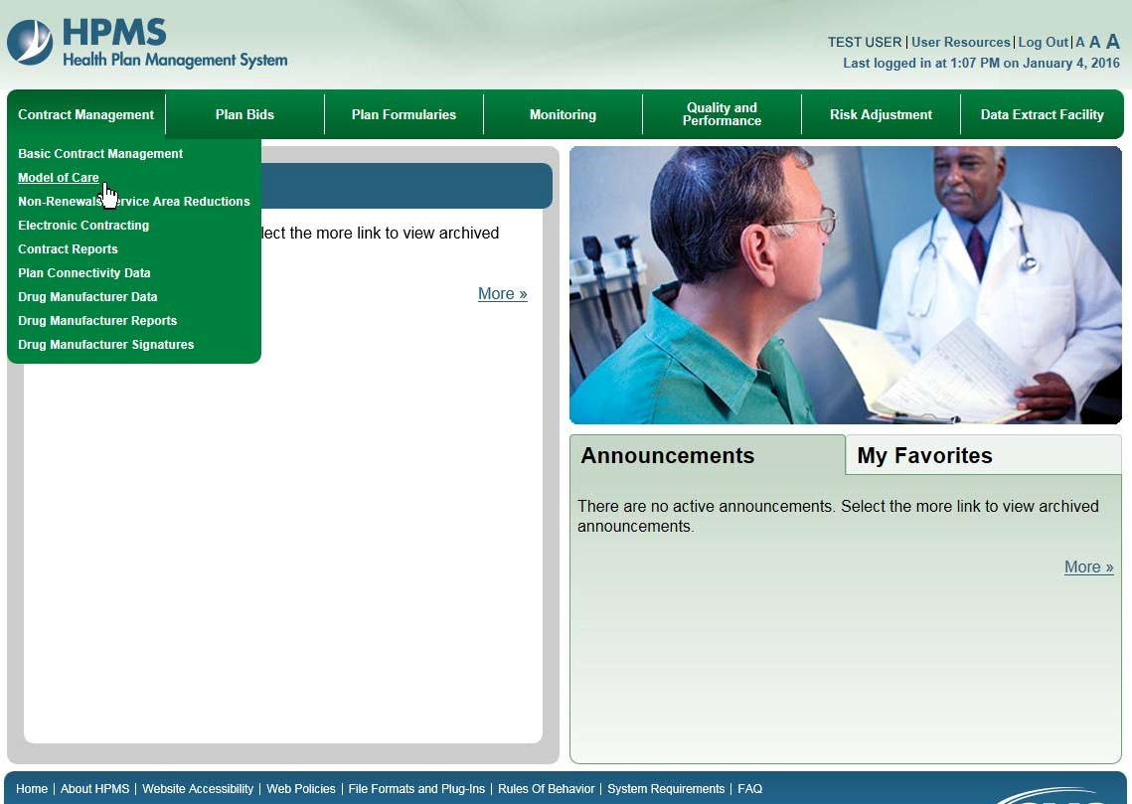
HPMS Review – Contract Management Tab

Slide 47
HPMS Review – Model of Care

Slide 48
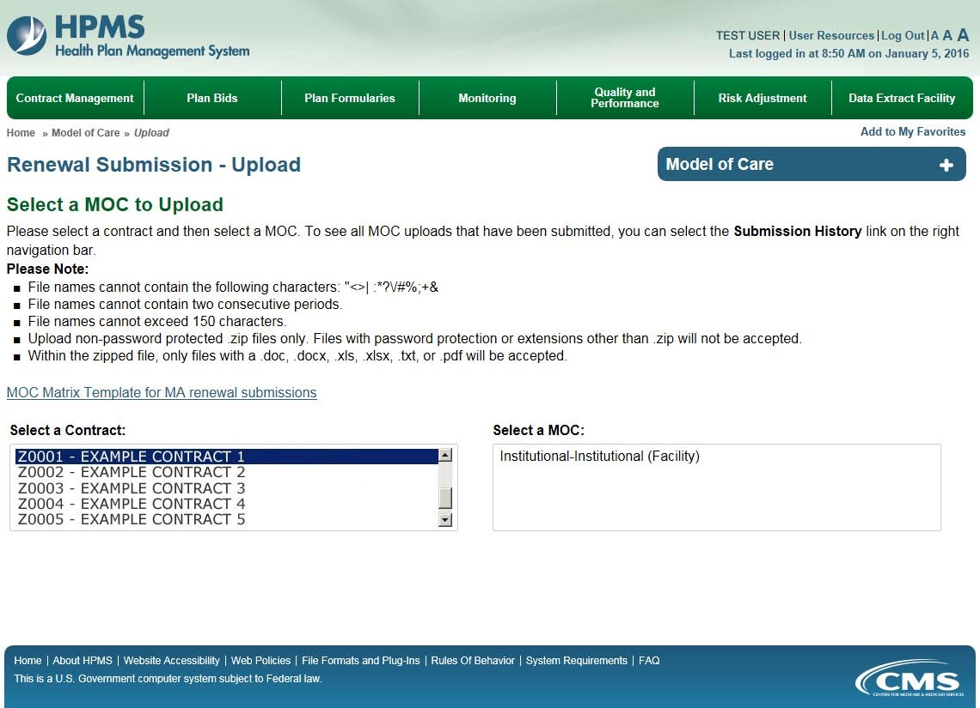
HPMS Review – Renewal Submission Upload

Slide 49
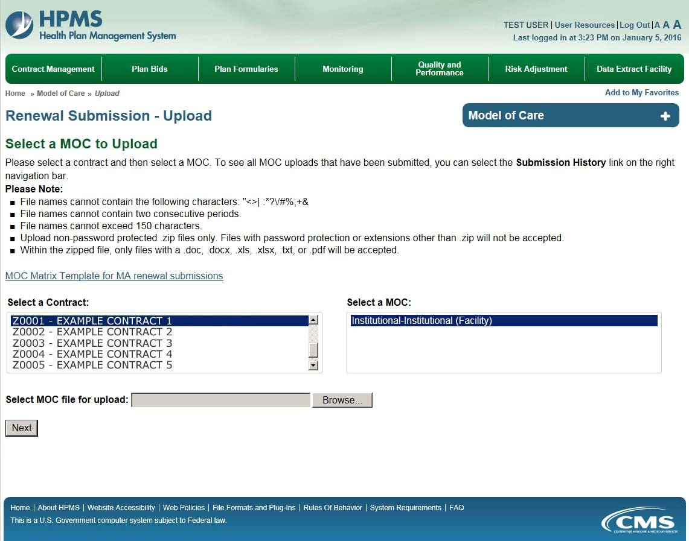
HPMS Review – Select an MOC File for Upload

Slide 50
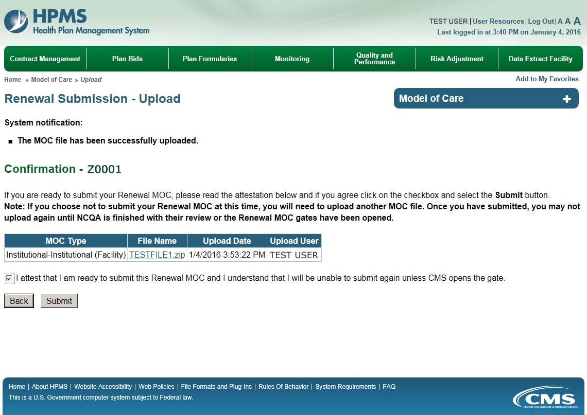
HPMS Review – MOC File Upload Confirmation

Slide 51
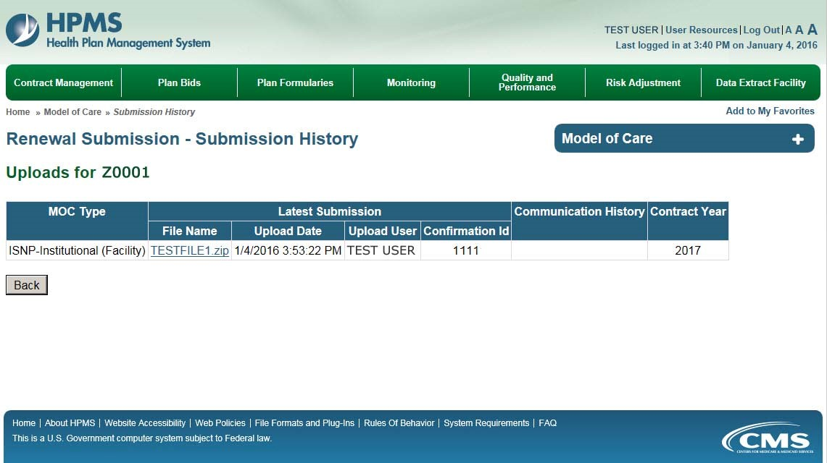
HPMS Review – Submission History

Slide 52
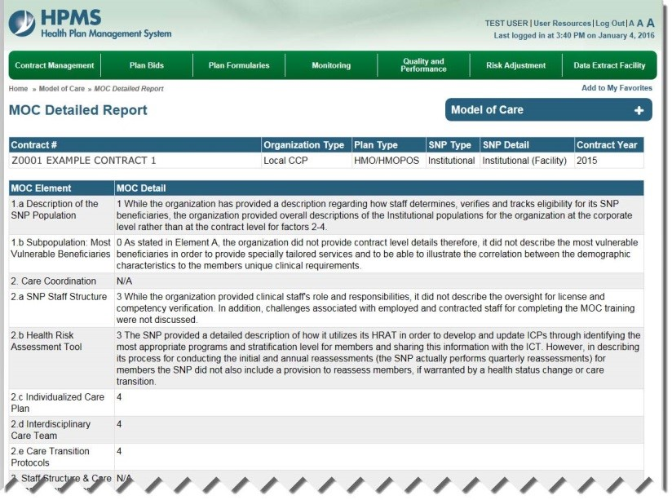
HPMS Review – MOC Detailed Report

Slide 53
Training & Education
Sessions focus on MOC Requirements & Technical Assistance
-- MOC Elements 1 & 2 (1 training)
January 12, 2016, 3:00-4:30pm EST
-- MOC Elements 3 & 4 (1 training)
January 14, 2015, 3:00-4:30pm EST
-- Technical Assistance Calls 3:00–4:30pm EST for SNPs scoring <70%
February 9, 2016
April 21, 2016
Recordings and slides available on NCQA SNP Approval website within one week of call.

Slide 54
CMS Contacts
For technical inquires related to the MOC program plan requirements, or other issues related to the SNP approval proposal in the regulations, please contact CMS at: https://dpap.lmi.org. In the subject line enter: SNP MOC Inquiry
For SNP application inquiries via the CMS SNP mailbox: please type https://dmao.lmi.org into your web browser, then select the SNP mailbox. Subject line: SNP Application Inquiry
CMS MMP mailbox: mmcocapsmodel@cms.hhs.gov
Subject line: MMP MOC Inquiry
For training recordings and slides: please visit the NCQA SNP Approval Website at: https://www.snpmoc.org

