Slide 1
New Medicare Card Project
Open Door Forum
09/13/18

Slide 2
We Are LIVE!
April 1, 2018- January 1, 2020
April 1, 2018
All systems & processes able to accept MBI. Mailing new Medicare cards to newly eligible people with Medicare. BEGIN TRANSITION PERIOD
May 2018
Continue mailing new Medicare cards with MBI to 60M beneficiaries
Jun 2018
Launch of provider
look-up tool
Oct 2018
Return MBI on remittance advice
MBI shared with downstream partners
Apr 16, 2019
Deadline for issuance of new Medicare cards
Jan 1, 2020
END OF TRANSITION PERIOD. Use the MBI on data exchanges

Slide 3
Solution Concept for the New Medicare Cards
CMS is providing the following:
Generate Medicare Beneficiary Identifiers (MBI) for all beneficiaries
Modify systems and business processes to accommodate receipt, transmission, display, and processing of the MBI
Issue new, redesigned Medicare cards

Slide 4
New Medicare Number Characteristics
The Medicare Beneficiary Identifier (MBI) has the following characteristics:
The same number of characters as the current HICN (11), but will be visibly distinguishable from the HICN
Contain uppercase alphabetic and numeric characters throughout the 11-digit identifier
Occupy the same field as the HICN on transactions
Be unique to each beneficiary (e.g., husband and wife will have their own MBI)
Be easy to read and limit the possibility of letters being interpreted as numbers (e.g., alphabetic characters are upper case only and will exclude S, L, O, I, B, Z)
Not contain any embedded intelligence or special characters
Not contain inappropriate combinations of numbers or strings that may be
offensive
CMS anticipates that the MBI will not be changed for an individual unless the MBI has been compromised

Slide 5
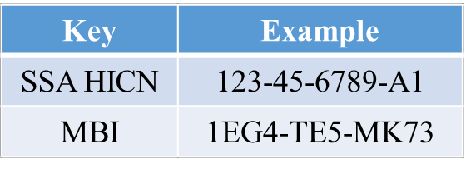
HICN and MBI Number
Health Insurance Claim Number (HICN)
Primary Beneficiary Account Holder Social Security Number (SSN) plus Beneficiary Identification Code (BIC)
9-byte SSN plus 1 or 2-byte BIC
Key positions 1-9 are numeric
Note: Identifiers are fictitious and dashes for display purposes only; they are not stored in the database nor used in file formats
Medicare Beneficiary Identifier (MBI)
New Non-Intelligent Unique Identifier
11 bytes
Key positions 2, 5, 8, and 9 will always be alphabetic

Slide 6
Transition Period (OCCURING NOW) April 1, 2018 – December 31, 2019
Transition Period (OCCURING NOW) April 1, 2018 – December 31, 2019

Slide 7
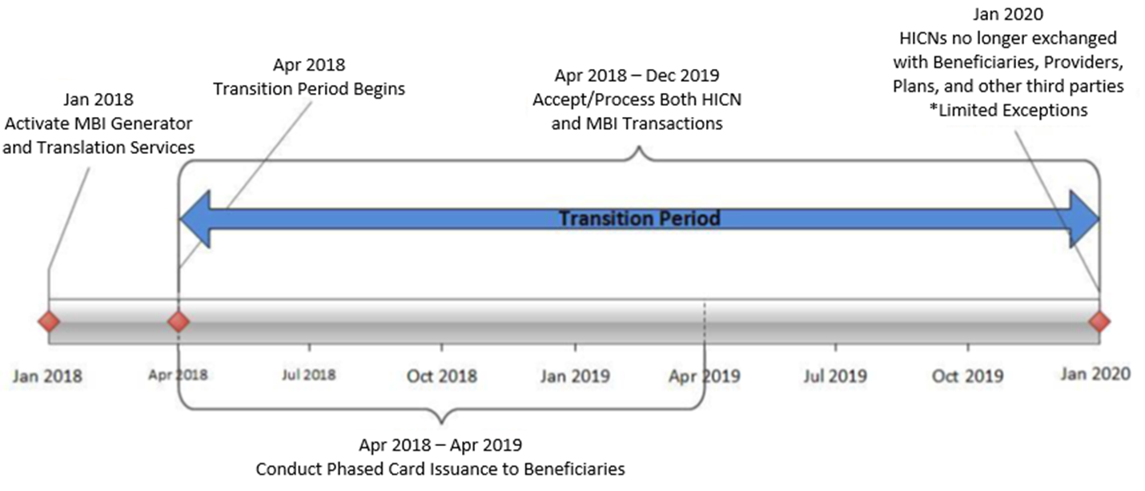
Transition Period Timeline
Transition period: April 1, 2018 – December 31, 2019

Slide 8
Using the New Medicare Number – During Transition
The transition period runs from April 2018 through December 31, 2019
CMS is accepting, using for processing, and returning to stakeholders either the
MBI or HICN, whichever is submitted on the claim, during the transition period.
All stakeholders who submit or receive transactions containing the HICN should now be ready to submit or exchange the MBI.
CMS will actively monitor use of HICNs and MBIs during the transition period to ensure that everyone is ready to use MBIs only by January 1, 2020

Slide 9
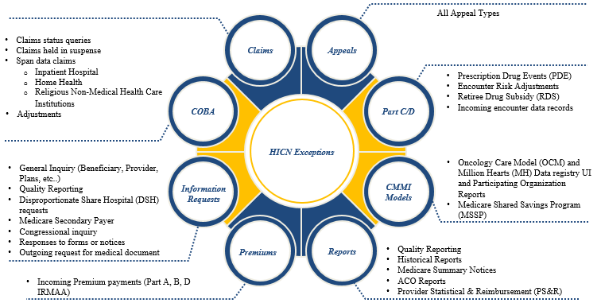
New Medicare Number HICN Exception Usage After the Transition Period
Beginning January 1, 2020, CMS will only accept the MBI for external data exchanges. CMS will continue to accept the HICN on the following data exchanges after January 1, 2020.
Note: CMS, Federal Partners and States will continue to use HICN for internal processing during and after the transition period.

Slide 10
Key Points for Providers
Providers Should be Ready Now!
Providers have 3 ways to get the new MBI:
Patient presents the card at time of service
Provider obtains it through the a secure web portal with the MAC
Provider receives it through the remittance advice starting in October 2018
Providers can receive and process all claims with either the HICN or MBI until January 1, 2020
Providers have resources when they talk to people with Medicare about the new Medicare cards: https://www.cms.gov/Medicare/New-Medicare-Card/Outreach-and-Education/Products-to-share-with-beneficiaries.html

Slide 11
Using the New Medicare Number – Providers
Providers/Suppliers can now look up the MBI on MAC portals
Providers must enter a valid National Provider ID (NPI) and enter a valid user ID and password to look up a beneficiary’s MBI via the Provider Lookup Tool in the MAC portals
Providers/Suppliers will need the following beneficiary information to look-up MBIs:
Patient SSN
Patient Last Name
Patient First Name
Patient Date of birth
Providers/Suppliers can use any MAC portal to look up a patient’s MBI
Additional information can be found under the Provider tab at www.CMS.gov/newcard (providers can also reference the portal instructions sent last September)

Slide 12
Using the New Medicare Number – Providers (2)
When a provider checks a beneficiary’s eligibility, the CMS HIPAA Eligibility Transaction System (HETS) returns a message on the response if CMS already mailed that particular beneficiary’s new Medicare card
Beginning October 2018 through the end of the transition period, when a provider submits a valid and active HICN on Medicare fee-for-service claims, CMS will return both the HICN and the MBI on the remittance advice

Slide 13
Important Clarifications for the New Medicare Card
The new Medicare Number is a unique combination of numbers and letters. The new number uses numbers 0 thru 9, and it never uses the letters S, L, O, I, B, and Z
An individual’s HICN may not always be their own SSN if benefits are tied to a spouse. Thus, using the numerical part of a HICN will not always return a response in the MBI look-up tools. Instead, use the individual’s specific SSN
Plans can return the MBIs to entities covered under the HIPAA standards if it was part of their normal business processes to return the HICN on the Plans’ 270/271 transactions

Slide 14
Using the New Medicare Number – Plans / Pharmacies
Plans
All Medicare Advantage plans received a HICN to MBI crosswalk file prior to the start of the transition period (April 1, 2018)
The MARx User Interface (UI) is now showing both the HICN and the MBI during the transition, but only the MBI when the transition’s over
Prescription Drug (Part D) Plans may submit either the Health Insurance Claim Numbers (HICN) or Medicare Beneficiary Identifiers (MBI) both during and after the transition period
CMS has provided information regarding the systems changes via the Health Plan Management System (HPMS) memos that have been released for the systems impacted
For beneficiaries enrolled in Medicare Advantage Plans, once they receive their new Medicare card and number, they may use it to enroll in a Medicare Advantage or Prescription Drug Plan
All Medicare beneficiaries who are enrolled in a Medicare Advantage and/or a Prescription Drug Plan will still receive an insurance card from their Plan that they must continue to use when obtaining services while enrolled in the Plan
E1 Transactions for Pharmacies
Both the Part D and A/B E1 transactions will return the MBI
Pharmacies may submit the HICN or MBI now and after the transition

Slide 15
Using the New Medicare Number – Other Stakeholders
Accountable Care Organizations (ACOs)
ACOs are receiving MBI information for their assigned Medicare beneficiary populations
Both HICNs and MBIs are included in the Claims and Claims Line Feed Files (CCLFs) until December 2019
Crossover Claims Processing
During the transition period, CMS is processing and transmitting Medicare crossover claims using either the Health Insurance Claim Number (HICN) or Medicare Beneficiary Identifier (MBI)
Medicaid Agencies – Dual Eligible Medicare and Medicaid beneficiaries
State Medicaid Agencies are receiving both HICNs and MBIs in their system exchanges with CMS
State Third Party Buy-In Dual Eligible beneficiaries will continue to use HICN now and post transition

Slide 16
Using the New Medicare Number – Other Stakeholders (2)
Private payers
For non-Medicare business, private payers won’t have to use the MBI. For Medicare, we’ll continue to use supplemental insurer’s unique numbers to identify customers, but after the transition period, supplemental insurers must use the MBI for any Medicare transactions where they would have used the HICN
Third Party Group (TPG) Payers
Third Party Systems are allowing the submission of either the MBI or the HICN throughout the transition period
However, after the transition period—as of January 1, 2020, TPG Payers must use the MBI for any Medicare transactions where they would have used the HICN

Slide 17
Electronic Remittance Advice (ERA)
Starting October 1, 2018, CMS will update the following ERAs so that they also include the MBI when a valid and active HICN is submitted:
Medicare Remit Easy Print (MREP): We’re changing the current MREP Remittance Advice HICN label to Medicare ID (MID) and adding a new MID label and field that will show the MBI number
PC Print (Medicare Part A Providers & Facilities): We’re changing the current PC Print Remittance Advice HICN label to Medicare ID (MID) and adding a new MID Corrected (MID COR) label and field
Your MAC can give you access to free PC Print software so you can see and print remittance advice information
Samples of the above can be found at: https://www.cms.gov/Outreach-and-Education/Medicare-Learning-Network-MLN/MLNGenInfo/Downloads

Slide 18
Paper Remittance Advice
Standard Paper Remits (SPRs): Starting October 1, 2018, we’ll update the SPRs so it also gives you the MBI when you submit a claim with a valid and active HICN.
Samples of the above SPRs can be found at: https://www.cms.gov/Outreach-and-Education/Medicare-Learning-Network-MLN/MLNGenInfo/Downloads

Slide 19
Railroad Retirement Board (RRB) Beneficiaries
RRB mailed cards to their beneficiaries, and they will continue to send cards with the RRB logo, but you can’t tell from looking at the MBI if beneficiaries are eligible for Medicare because they’re railroad retirees
We’ll return a message on the HETS eligibility transaction response to alert the provider it’s an RRB patient. The message says, "Railroad Retirement Medicare Beneficiary
Medicare Providers must program their systems to identify RRB beneficiaries so they know to send those claims to the Specialty Medicare Administrative Contractor (SMAC)

Slide 20
Card Mailing Began April 1, 2018
Card Mailing
Began April 1, 2018

Slide 21
Card Mailing Update
Card Mailing Strategy: https://www.cms.gov/Medicare/New-Medicare-Card/NMC-Mailing-Strategy.pdf
Wave | States Included | Cards Mailing
Newly Eligible People with Medicare | All - Nationwide | April 2018 - Ongoing
1 | Delaware, District of Columbia, Maryland, Pennsylvania, Virginia, West Virginia | Beginning May 2018 COMPLETE
2 | Alaska, American Samoa, California, Guam, Hawaii, Northern Mariana Islands, Oregon | Beginning May 2018 COMPLETE
3 | Arkansas, Illinois, Indiana, Iowa, Kansas, Minnesota, Nebraska, North Dakota, Oklahoma, South Dakota, Wisconsin | Beginning June 2018 COMPLETE
4 | Connecticut, Maine, Massachusetts, New Hampshire, New Jersey, New York, Rhode Island, Vermont | Beginning July 2018
5 | Alabama, Florida, Georgia, North Carolina, South Carolina | Beginning August 2018
6 | Arizona, Colorado, Idaho, Montana, Nevada, New Mexico, Texas, Utah, Washington, Wyoming | After August 2018
7 | Kentucky, Louisiana, Michigan, Mississippi, Missouri, Ohio, Puerto Rico, Tennessee, Virgin Islands | After August 2018

Slide 22
Card Mailing Update
The new Medicare card mailing will include the new Medicare card along with a letter with instructions on how to destroy the old card
There will be specialized communications for those with alternative format needs. These formats include large print, Braille, audio and data cd
People with alternate format preferences will be mailed their new cards and letters following the same schedule as those with no preference

Slide 23
Key Points to Reinforce with Beneficiaries
Raise awareness that new cards are coming and direct people to Medicare.gov/newcard to find out when cards are coming to their area
Understand that mailing everyone a new card will take some time. Cards might arrive at a different time than a friend’s or neighbor’s
Make sure the beneficiaries’ mailing address is up-to-date. If beneficiaries’ need to correct an address, contact Social Security at ssa.gov/myaccount or 1-800-772-1213. TTY: 1-800-325-0778
CMS will never ask beneficiaries to give personal or private information to get a new Medicare number and card
The letters O and I are never used in the new Medicare Number so they should not be confused with numbers 0 and 1 which may be included, when checking status on Mymedicare.gov

Slide 24
Communications and Outreach
Communications and Outreach

Slide 25
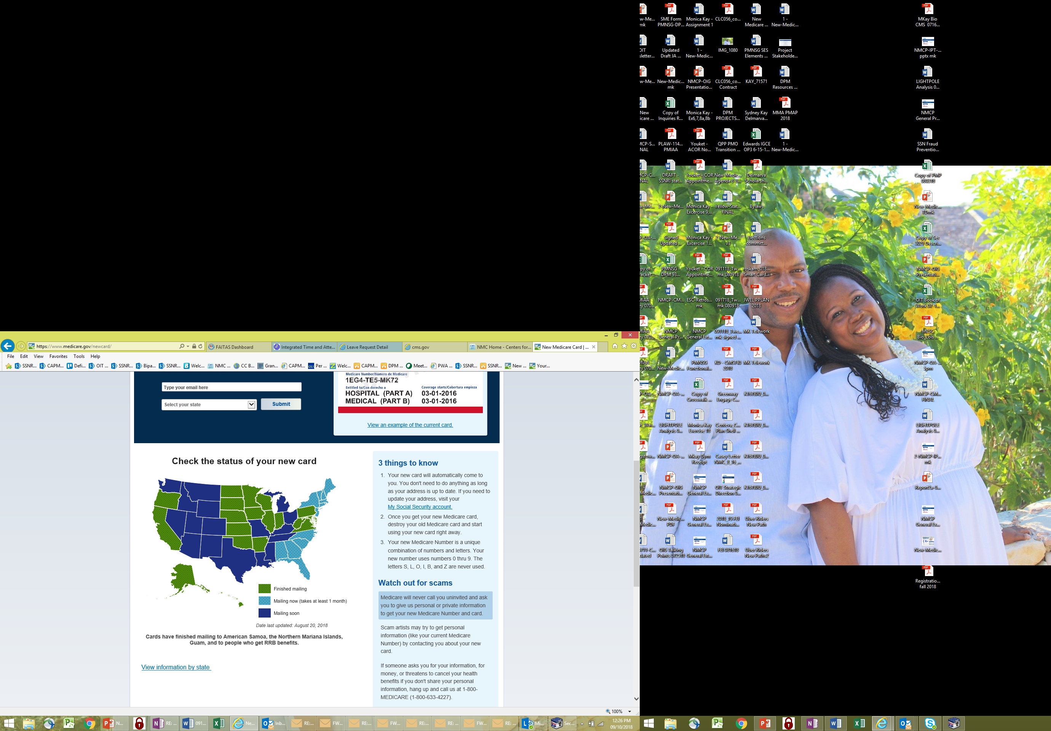
Medicare.gov/NewCard – Campaign page
Individuals can track where CMS is mailing cards using the interactive map

Slide 26
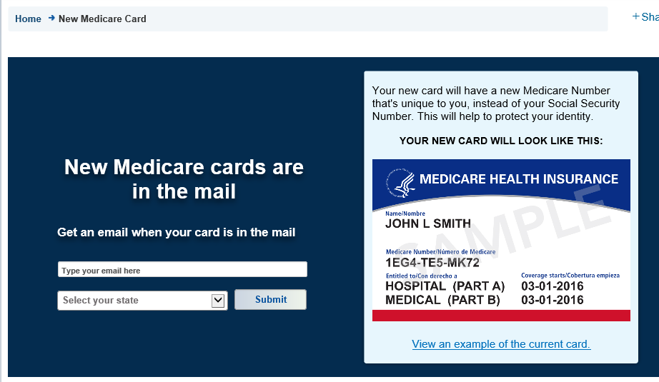
Medicare.gov/NewCard – Campaign page (cont.)
Individuals can sign up to receive email notifications when CMS starts mailing to their State

Slide 27
Customer Service
If someone with Medicare says they didn’t get a card and their mailing wave has completed, ask them to:
Sign into MyMedicare.gov to see if we mailed their card. If so they can print an official card. They’ll need to create an account if they don’t already have one.
Call 1-800-Medicare (1-800-633-4227). There might be something that needs to be corrected, such as updating their mailing address
Use their current card to get health care services

Slide 28
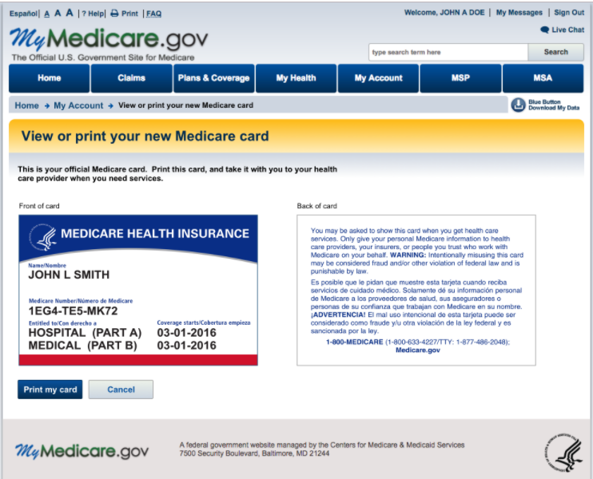
MyMedicare.gov - View or Print new Medicare card
Sign into or sign up for MyMedicare.gov
Card status message is dynamic based on whether beneficiary’s card has mailed yet:
“Your card has not yet mailed”
“Expected to mail on or around”
“View or print” link only displays for beneficiaries who have had their card mailed and have an MBI
This page is available to view on smaller devices like cell phones.

Slide 29
Outreach Materials on CMS.gov/NewCard
Order free copies of most materials at Productordering.cms.hhs.gov
Job aid for Partners: Includes key messages to communicate to people with Medicare
Tear-off Pads for Provider Offices
You’re Getting a New Medicare Card!: Contains an image of the card and a reminder to make sure your mailing address is up to date with Social Security
Still Waiting for Your New Card?: Contains instructions for beneficiaries to call 1-800-MEDICARE if they still haven’t received their cards and card mailing is finished for their state.
Small Posters for Provider Offices: Messaging similar to tear-off sheets
Conference cards to hand out at events
"10 Things to Know About Your New Medicare Card" handout
Audio Public Service Announcement: To run in National pharmacy chains
Widgets: Partner focused with link to CMS.gov/newcard
Some products may be available in languages other than English and Spanish.

Slide 30
Final Thoughts
Thank you for participating in this discussion today, to learn more about the New Medicare Card check out our websites:
For stakeholder/operational information go to: https://www.cms.gov/newcard
For beneficiary focused information go to: https://www.medicare.gov/newcard
For resources to use when you talk to people with Medicare about the new Medicare cards: https://www.cms.gov/Medicare/New-Medicare-Card/Partners-and-Employers/Partners-and-employers.html
Please submit any additional comments or questions to the New Medicare Card team mailbox: NewMedicareCardSSNRemoval@cms.hhs.gov

