Slide 1
CMS Measures Management System (MMS)
Testing Tools
Lizzie Charbonneau & David Czulada - MITRE
Anne Smith, Director of Measure Validation – NCQA
February 22, 2018
Notes:
Thank you for joining this Information Session. My name is Martin Alvarado and I am with Battelle. Today’s presentation is titled: CMS Measures Management System (MMS) Testing Tools and will be presented by Lizzie Charbonneau who will be talking about the eCQM testing tool Bonnie; David Czulada who will talk about a second eCQM testing tool called Cypress and Anne Smith, Director of Measure Validation who will talk about the NCQA testing tool that has been approved as an alternate method to test eCQMs. I would like to turn things over to Lizzie.
Thank you, Martin.

Slide 2
Overview
Bonnie Background
Bonnie History
Using Bonnie
Standards in Bonnie
Resources
Questions, Suggestions, Discussion

Slide 3
Bonnie Background
Bonnie is an electronic Clinical Quality Measure (eCQM) testing tool that allows users to:
  Load eCQMs exported from Measure Authoring Tool (MAT).
  Build synthetic patients using data elements defined as part of the measure definition.
  Test new and updated eCQMs using synthetic patients.
  Explore the behavior and complexity characteristics of eCQMs.

Slide 4
Bonnie Background (cont.)
Prior to Bonnie, the only way to test eCQMs was by hand.
  eCQMs are large and complex.
  Checking by hand is time consuming and error prone.
Before Bonnie was in use, 381 logic errors were reported by implementers. Each eCQM had at least one error.

Slide 5
Bonnie Background (cont.)
Bonnie enabled automated testing of eCQMs prior to publication.
This led to:
A reduction in errors in published eCQMs.
Faster measure testing.
Greater confidence by CMS, measure developers, and the community that measures calculate as intended.

Slide 6
Bonnie History
First released April 2014.
Used for 2015, 2016, and 2017 annual update eCQMs:
  2015: 5,000+ synthetic test records, 80% logic coverage
  2016: 10,000+ synthetic test records, 100% logic coverage
  2017: 16,000+ synthetic test records, 100% logic coverage
Transitioned to Clinical Quality Language (CQL) for 2018 annual update to eCQMs.
National Quality Forum (NQF) recommends use of Bonnie to support NQF eCQM endorsement.

Slide 7
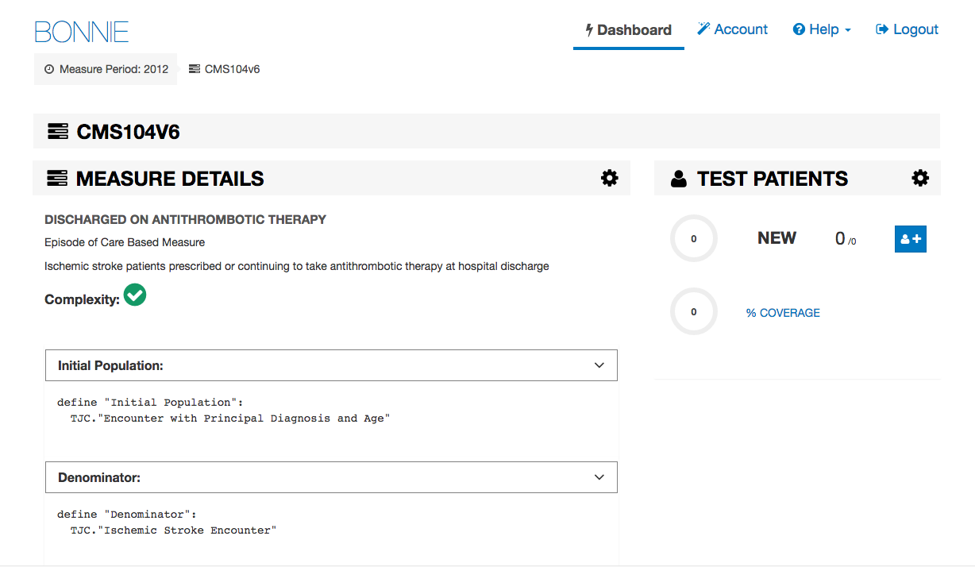
Using Bonnie
Viewing a measure
Notes:
This is a view you would see if you upload a measure into Bonnie. There is summary information on the measure, the title, the description, the complexity, and the measure logic. It is divided into the populations included within the measure, and below that is each definition within the measure.

Slide 8
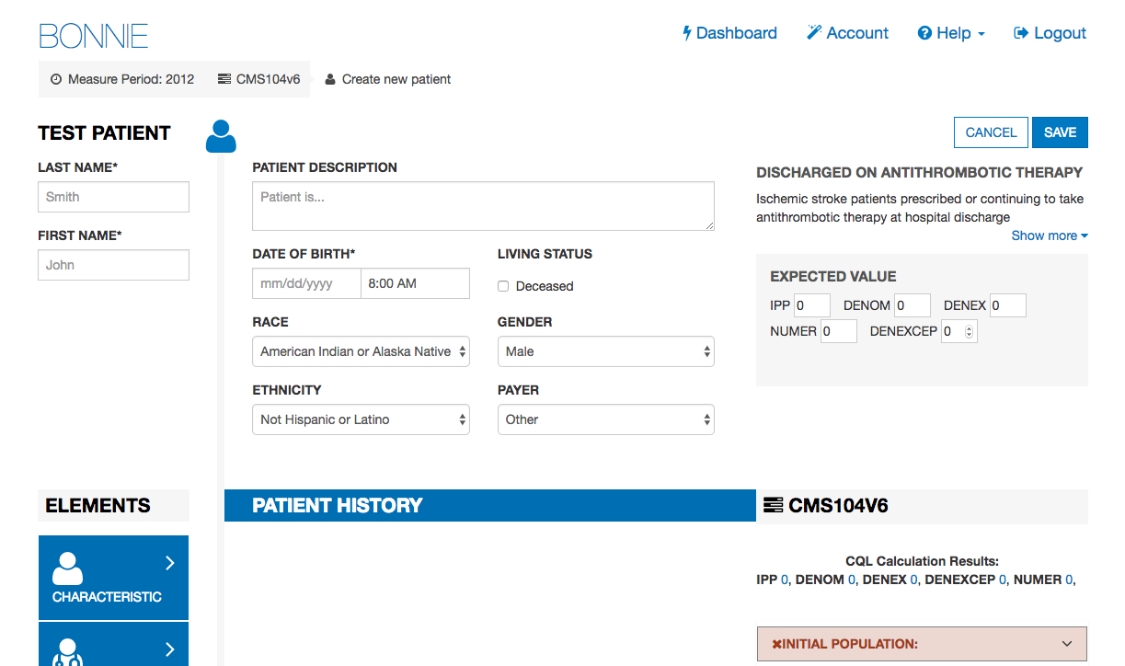
Using Bonnie (cont.)
Creating a synthetic test record
Notes:
This is the view when creating a synthetic test record/patient. You can add metadata and any other descriptions to help you remember what exactly this patient should be testing. You also would add the expected value here.
The expected calculation results are also shown. If the patient calculates differently from what you expected, Bonnie will show you a failed patient calculation. This likely means that there is an issue within the measure logic and that will indicate to the measure developer to go back and address any logic issues they have discovered through this testing process.

Slide 9
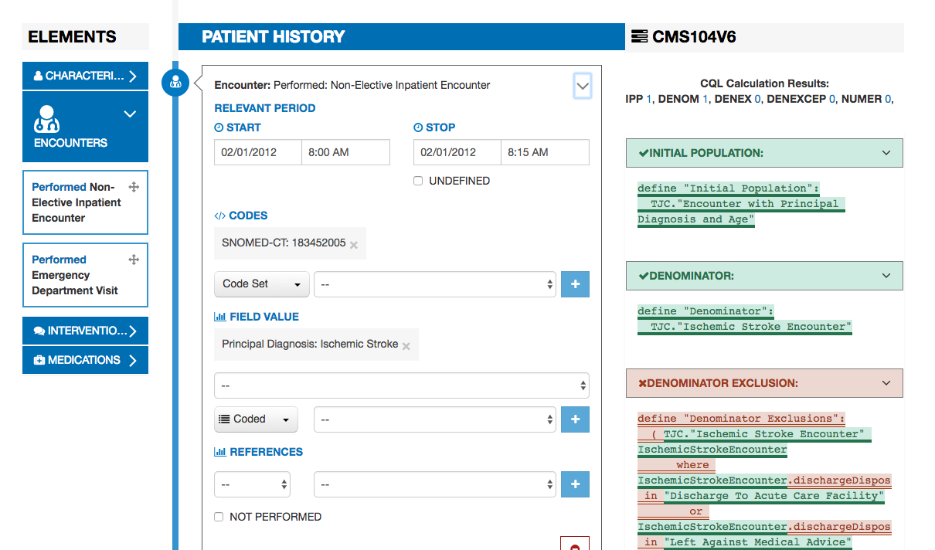
Using Bonnie (cont.)
Seeing logic calculations
Notes:
This is the same view as the previous slide, scrolled down. Some of the patient history data elements have populated. You can see on the right-hand side that Bonnie color codes the logic to help the measure developer understand what pieces of the logic are returning true based off of the patient’s history, or returning false based off of the patient’s history. This gives the measure developers the granularity to understand the calculation results when they are investigating any discrepancies they might find.

Slide 10
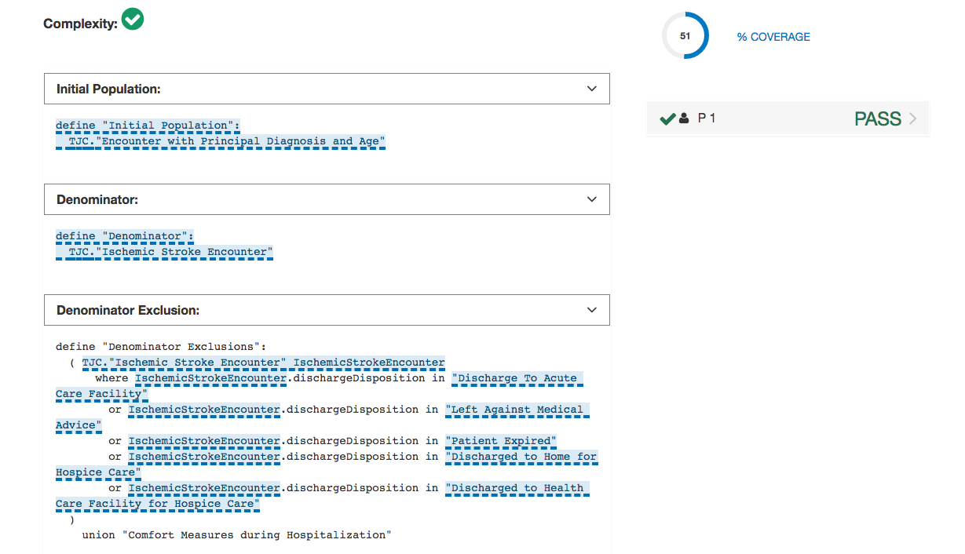
Using Bonnie (cont.)
Viewing code coverage
Notes:
This is the measure details view of code coverage, with the logic highlighted in blue. Measure developers have a test deck comprised of many synthetic patients – usually between 50 and 100 — and use the coverage indicator (upper right) to ensure 100% coverage. If the coverage is not at 100%, as in this example, developers can look for what is not highlighted to pinpoint the gaps.

Slide 11
Standards in Bonnie
Bonnie uses the following eCQM-related standards:
  Health Quality Measure Format (HQMF)
  Clinical Quality Language (CQL)
  Quality Data Model (QDM)
  Quality Reporting Document Architecture (QRDA)
Bonnie is regularly updated to align with the latest versions of the standards.
Notes:
Health Quality Measure Format (HQMF) is a standards-based representation of quality measures as electronic documents.
Clinical Quality Language (CQL) is part of the effort to harmonize eCQMs and clinical decision support. It also provides the ability to express logic that is both human readable and allows for electronic queries.
The Quality Data Model (QDM) is the model representation of the measure. It defines what a data element looks like and attributes such as relevant period, author, date, or time.
We also support the Quality Reporting Document Architecture (QRDA) format. After a test deck has been created and once a QRDA update is released for latest QDM model, Bonnie enables measure developers to export patient packages in the QRDA format.

Slide 12
Resources
Public website: https://bonnie.healthit.gov/
User guide: https://bonnie.healthit.gov/resource/Bonnie_user_guide.pdf
Git repository: https://github.com/projecttacoma/bonnie

Slide 13

Questions, Suggestions, Discussion

Slide 14
CMS Measures Management System (MMS)
Cypress
David Czulada
MITRE
February 22, 2018
Notes:
Hi, I am David Czulada. I am the software development lead for a tool called Cypress.

Slide 15
Overview
What is Cypress?
The Continual Need for Certification and Testing
Cypress Certification Testing
How is Cypress Made Available?
Engagement with the User Community
Questions, Suggestions, Discussion

Slide 16
What is Cypress?
A testing tool
  Validates electronic health record (EHR) system’s ability to correctly calculate electronic Clinical Quality Measures (eCQM).
The official testing tool for the 2014 and 2015 EHR Certification Program
  Supported by the Office of the National Coordinator for Health Information Technology (ONC).
An open-source project
  Freely available for use or adoption by the health information technology (IT) community, including EHR vendors and testing labs.

Slide 17
The Continual Need for Certification and Testing
eCQMs exist in a fluid environment
  eCQMs are updated in a yearly cycle to address
    Changes in clinical practices
    The addition and removal of codes
    Bugs in measure logic
    New and retired measures
    eCQM standards updates
Each year, certified systems need to update their systems to comply with the updates to eCQMs and standards.
  Even though recertification is not required, vendors retest their systems using Cypress.
Notes:
Lizzie mentioned that there is a pretty drastic change this year in moving from QDM-based eCQMs to CQL-based eCQMs. Due to all of these changes, certified systems need to update their systems to comply with the updated eCQMs and the standards that define and report on eCQMs.

Slide 18







Cypress Certification Testing
What does Cypress test?
Given a set of patients and eCQMs, Cypress tests the ability of an EHR to:
1
2
Capture the information required to calculate the selected eCQM
Export the information required to calculate the selected eCQM
Patient record
QRDA
Patient record
QRDA
3
4
5
Calculate the results of the selected eCQM
Report the calculated result of the selected eCQM
Report eCQM data that has been filtered
Patient record
QRDA
QRDA
Note - QRDA=Quality Reporting Document Architecture
Notes:
Cypress tests five things. Given a set of test patients and eCQMs, Cypress tests the ability of an EHR to capture the information required to calculate the selected eCQM. Cypress tests the ability of an EHR to export the information required to calculate eCQMs. Cypress tests the ability of an EHR to calculate the results of selected eCQMs. Cypress tests the ability of an EHR system to report the calculated results of the selected eCQMs, to include reporting the eCQMs to CMS and so complying with the CMS standards and implementation guide. Finally, Cypress tests the ability of the EHR to report filtered eCQM data.

Slide 19
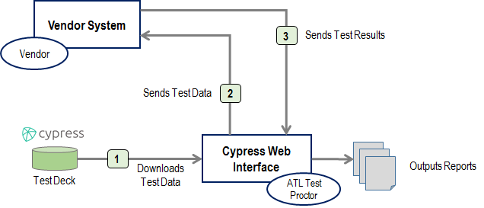
Cypress Certification Testing
Testing Workflow
Notes:
The workflow for testing with Cypress is relatively straightforward, and it is facilitated by a test proctor who is operating the Cypress web interface. The test proctor will create a set of certification tests. They will send data to a vendor that is going through certification. That vendor will upload all of the test data that the test proctor has provided them. The vendor will then send back to the test proctor their results of entering that information into their system. The test proctor then loads that information back into Cypress at which case Cypress will verify that the information is valid and will output results of those tests. Cypress is available to vendors to test on their own. The vendor can take the role of the test proctor and they can perform these tests internally within their own firewalls and their own development environments, but generally the workflow will have a test proctor facilitating the test effect.

Slide 20
Cypress Certification Testing
Standards Supported
(Cypress and Cypress Validation Utility)
CMS Measure Specification | QRDA Implementation Guides
eCQM Specifications for Eligible Professionals May 2017 | CMS Implementation Guide for Quality Reporting Document Architecture Category III, Implementation Guide for 2018 HL7 CDA® R2 IG: Quality Reporting Document Architecture Category I (QRDA I); Release 1, DSTU Release 4 HL7 CDA® R2 Implementation Guide: Quality Reporting Document Architecture (QRDA III), Release 1, STU Release 2.1
eCQM Specifications for Eligible Hospitals May 2017 | CMS Implementation Guide for Quality Reporting Document Architecture Category I, Implementation Guide for 2018 HL7 CDA® R2 IG: Quality Reporting Document Architecture Category I (QRDA I); Release 1, DSTU Release 4 HL7 CDA® R2 Implementation Guide: Quality Reporting Document Architecture (QRDA III), Release 1, STU Release 2.1
eCQM Specifications for Eligible Professionals April 2016 | 2017 CMS QRDA III Implementation Guide for Eligible Clinicians Reporting v1 HL7 CDA® R2 IG: Quality Reporting Document Architecture Category I (QRDA I); Release 1, DSTU Release 3.1 HL7 CDA® R2 Implementation Guide: Quality Reporting Document Architecture (QRDA III), Release 1, STU Release 2.1
eCQM Specifications for Eligible Hospitals April 2016 | 2017 CMS QRDA Implementation Guide for Hospital Quality Reporting HL7 CDA® R2 IG: Quality Reporting Document Architecture Category I (QRDA I); Release 1, DSTU Release 3.1 HL7 CDA® R2 Implementation Guide: Quality Reporting Document Architecture (QRDA III), Release 1, STU Release 2.1
Notes:
Cypress is similar to the eCQMs. Cypress is developed and released on an annual basis to include the latest versions of eCQMs, as well as the latest versions of standards used to report on those eCQMs. The annual update measures are generally made available in the spring. The most recent annual update measures were released May 2017. Cypress is generally released in the summer following the annual update measures.
Cypress version 3.2 was released on July 27, 2017. So then after the annual update measures, and it includes the updated standards for QRDA as well as the implementation guide from HL7 as well as CMS. Cypress can be used to test all versions, or the most recent annual updates starting from 2015. We can test with the 2015 eCQMs, the 2016 eCQMs as well as the 2017 eCQMs.

Slide 21
Cypress Certification Testing
Cypress Test Desk
 | 2016 | 2017
# of Measures | 93 | 71
Eligible Clinicians Patients | 81 | 205
Eligible Hospitals Patients | 81 | 78
Minimum Coverage | 80% | 95%
Populations | Every patient population covered by test deck
Notes:
I mentioned on slide 18 that one of the key components of testing in Cypress is a set of test patients that is given to the vendor system to enter into their EHR, and that test deck is actually generated using the Bonnie tool. The 2016 test deck included 93 measures which had 81 eligible clinician patients and 81 eligible hospital patients. In that bundle we had a minimum coverage of 80% of the logic for all of those measures.
If you remember Lizzie’s presentation where the measure developers strive to have 100% logic coverage in their test patients, Cypress similarly strives to have as much coverage as possible, but in the 2016 timeframe we had a minimum coverage of 80% of all measures using 162 patients. The bundle that we released in 2017 was for 71 measures and included just under 300 patients. We increased our minimum coverage from 80% to 95% coverage. Many of those measures actually had 100% coverage with the minimum being 95%, but that does not mean that all of them had 95%. Every patient population is covered in the test deck, and so that means that every population-defining eCQM has a patient that corresponds with that logic.

Slide 22
How is Cypress made available?
Cypress is developed as Open Source
  Source code is made freely available and may be redistributed and modified
Cypress releases are distributed as a:
  Virtual Machine
    A fully enclosed version which can be installed as-is on an organization’s network.
  Amazon Machine Imagine
    A virtual machine that can be run on Amazon’s Elastic Compute Cloud.
  Demo Server
    Publicly available instances of Cypress
      https://cypress.healthit.gov/
      https://cypressvalidator.healthit.gov/
    Distribution model allows for EHR vendors to install and use Cypress locally within their organization’s firewalls, prior to certification.

Slide 23
Engagement with the User Community
The Cypress development team is continually engaged with its user community (certification bodies and EHR vendors):
  Cypress hosts a bi-weekly tech talk.
    Register at https://attendee.gotowebinar.com/register/8110364277730751489
  All tech talks and webinars are posted on the Cypress website.
    https://www.healthit.gov/cypress/techtalks.html
  The team continually engages with the EHR community.
    Google Group forum/discussion board
      project-cypress-talk@googlegroups.com
    Public Issue tracking
      https://oncprojectracking.healthit.gov/support/browse/CYPRESS
Cypress releases Beta versions prior to each official release, seeking inputs from user community.
Many usability enhancements proposed from the user community have been included in a Cypress release.

Slide 24
Questions, Suggestions, Discussion

Slide 25
CMS Measures Management System (MMS)
NCQA’s Testing Tool
Anne Smith
NCQA
February 22, 2018
Notes:
Hi, I am Anne Smith. I am here to tell you a little bit about our alternate test tool, NCQA’s testing tool. We were just recently approved by the Office of the National Coordinator for Health Information Technology (ONC) to test those electronic clinical quality measures (eCQMs) that are in the annual update. If you go back to David’s graphic [REVISIT SLIDE 18] which I am very happy he put up — he had five different things that Cypress tests. On the top he had two things — imports and exports. And then on the bottom he had the three pieces that talked about the actual logic within the eCQM and the reporting of the eCQM and the filtering of the eCQM. Those are the three things that our tool tests as well, and so we do not really test the export and import features, but we focus on the bottom of that graphic with the actual calculations of the measures.

Slide 26
Overview
Test Deck Development
Testing Process
Online Scoring Program
Starting the Process

Slide 27
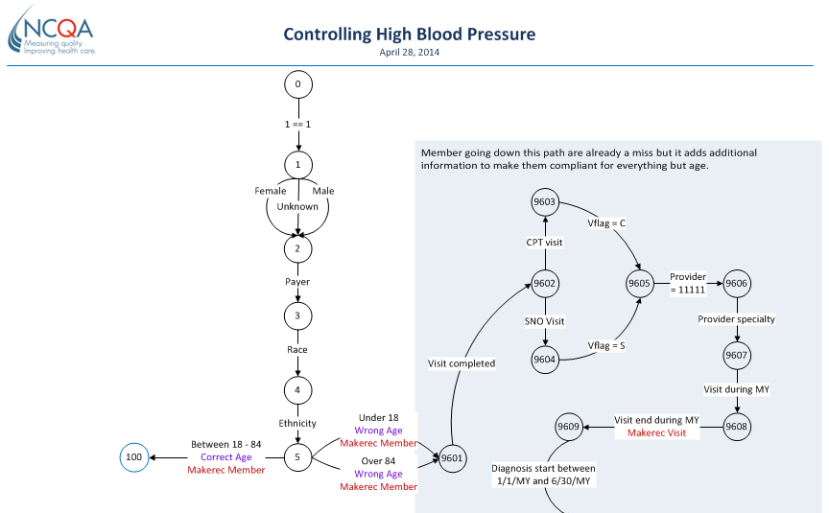
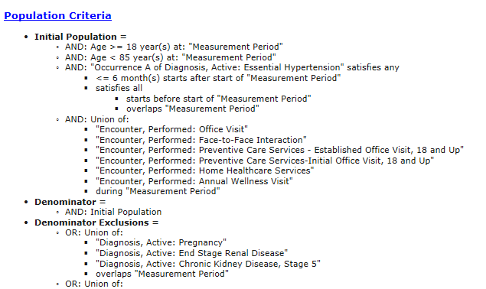
Test Deck Development
Notes:
Our test deck development process is a little different. We generate synthetic test patients and we do it by measure, and then we actually look at that measure-- so we take the logic for that measure. We look at all of the decision points within that measure.
We also think about common programming errors that could happen with that particular measure and because NCQA is one of the measure developers, we have some insights into where vendors are having problems with programming or understanding where and how a measure works. We do receive those questions, and so for those measures we can go through and say, “Where are people having problems? Where are there issues with the logic? Where is the logic either not clear or complicated and people are having a problem understanding how that logic works?”
We aggregate all of those things and we create a flow diagram for the measure. This flow diagram shows all of the decision points within the measure as well as decision points that we would like to test to make sure that people have the measure appropriately calculated. For instance, we would generate a decision point for sex — either male or female — even if the measure requires both males and females, because we would want to make sure that a vendor is not inadvertently excluding either males or females from the measure. We program paths that we know will end up being a miss where the person, or the patient, will not be in the measure at all, or they will miss a certain part of the measure. There will not be a denominator exclusion or not be a numerator hit, because we want to make sure we are testing all of those possible paths through that measure and all of those possible decision points.
Once we have generated this flow diagram, we have a set of three programs that run. The first one ensures that every patient is going through the flow diagram on a different path, and that all possible paths are hit by at least one patient within our set of test data. The second program then takes those patients and follows their path through the flow diagram and actually generates the patient data. For instance, if we have a patient flowing down a path that says they are 18-85, then our second program will generate somebody who is 18-85. Maybe the first run-through it will generate somebody who is 56; maybe the second run-through it will generate somebody who is 25, but that birthdate will fit within the parameter specified within the flow diagram.
Our third program formats the data to send to the vendors. We use the standard formats provided by HL7 to send our patient data to the vendors. What this means overall is that we can generate many, many sets of test data. Each set of test data for a measure will look completely different. In the first set of test data we generate perhaps the first person in that data will be a numerator hit. They will be the right age and have the right services for the numerator. Maybe the second time we run that program things will generate in a different order, and the first patient will be a miss. They will not even be in the measure, but we can generate as many sets of test data as we want. The answers will always be different, but we know that we are testing each set of test data out of all of those paths that are in that flow diagram. So then we know even though we are generating a different set of test data that we are testing the vendor on the same decision points — regardless of what set of data they’re running.

Slide 28
Testing Process
Vendor Processing
NCQA Posts Test Decks Online
Vendor Downloads Test Deck(s)
Zip files of CCDs
Vendor Processes Test Deck
Loads CCD files and runs measure logic
Vendor Uploads Results
QRDA Category I and III Reports
NCQA Scoring
No
NCQA Scores Vendor’s Results
Compares NCQA’s expected results and vendor’s results
100 % Match?
NCQA Review
NCQA and vendor work to understand discrepancies, if any
Yes
ONC Testing Report
Process repeats until results match
NCQA Scorekey
28
Notes:
We typically generate anywhere from 800-1,500 patients per measure to make sure that we are testing all of the possible paths through that measure — as well as testing as many of the codes and value sets as we can for each of the measures. Once we generate our test deck, we take that test deck and we zip it up. We put it online in our online scoring program. I will show that on the next slide, but we take that data and post it.
Our vendors who are testing with us have an account online. They can go and work at their own pace through as many measures as they want to test with us. They will download the set of test data for that particular measure. They will run it through their measure logic and they will upload the results, and then we will score those results.
We typically look at the aggregate report first. We make sure that we agree on the counts for the denominator and numerator. And then we look at the individual members or patients that they are saying belong in the measure or belong in a certain portion of the measure, and we will look and make sure that we agree with that. If they say that this person should be in the denominator and this person had a service for the numerator, we will look at that and say, “Yes, we agree, that person is in the denominator and in the numerator.”
Once the vendor has generated their result files, they upload them on our website and they are scored immediately on the website. That scoring report will return just a simple pass if we agree on everything. If we disagree on some things and the match is not 100%, then the vendor can take a look at their data. They can ask us questions. We can explain to them why certain people were hits or misses depending on what was in the data file. And then the vendor can get a completely new set of data. As I explained, it is all generated based on the flow diagrams so that we can generate a new set of data. We can give them answers to the first set of data, because once we do that we are not going to pass them on that set of data.
They are going to have to load and run a completely new set of data to be able to pass the measure, and so they may make fixes to their programs and whatever they need to do. And then they will run a completely new set of data and that data will scored. We will repeat the process until there is a 100% match! That is how it works.

Slide 29
Online Scoring Program
Notes:
This is our online interface for vendors. As you can see, the vendor can filter and test as many measures as they want. Right now we offer 25 measures in our program, and we are building out the rest of the measures. Right now we offer 25 of the EP measures for the eligible providers, so they can test anywhere from 1-25 of those measures. They will get a different set of test data for each of those measures. They will be able to come here to their website and filter. They will see where they are and track their progress. They will be able to download the test decks and upload their results, and do all of their testing within this online scoring program.

Slide 30
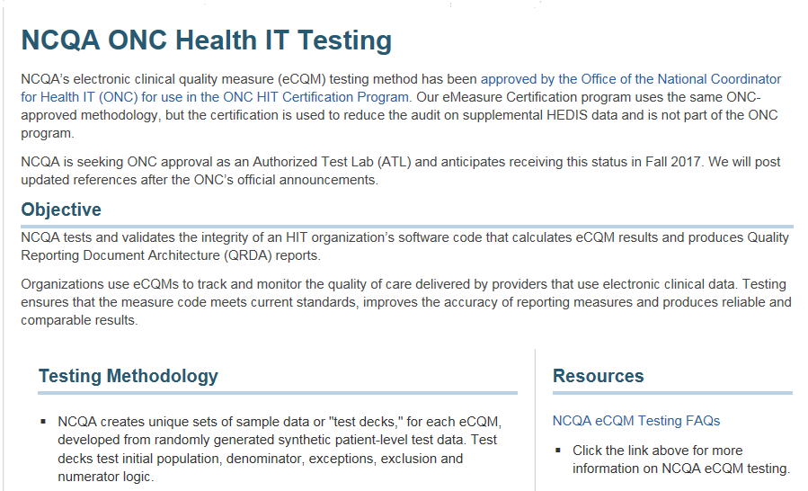
Starting the Process
http://www.ncqa.org/hedis-quality-measurement/data-reporting-services/emeasure-certification/onc-health-it-testing
Notes:
We have our website on the NCQA family of websites that talk about our ONC health IT testing, the link is at the bottom. That is a great place to start.

Slide 31






Starting the Process (cont.)
Complete application
Schedule an eMC Overview presentation meeting
Discuss the program and have your
questions answered by the eMC team
Step 1
Apply
Step 2
Contract
NCQA will process application and fees
Sign license agreement
Complete invoice payment
Step 3
Test
Review testing process
Gain access to testing site
Complete measure testing
Notes:
Setting up with us is very easy. There is an application form that you can submit that will help us identify how many measures you want to test, and what version of the specifications you want to test on. We will contract with you, including processing that application and setting up a license agreement, and then we can give you access to the website to test.

Slide 32
Questions, Suggestions, Discussion

Slide 33
Upcoming Webinars
Planned Upcoming Webinars:
March 19, 1:00 – 2:00 PM EST: Measure Submission Criteria, NQF
Suggestions for future topics?
Email: MMSsupport@battelle.org

