Slide 1
MACRA Info Session #10 CMS Measure Development Education & Outreach
Measure Evaluation During Maintenance & the CMS National Impact Assessment
Presenters:
Brenna Rabel, Battelle
Kyle Campbell, HSAG
July 17, 2019
2:00-3:00pm ET
Notes:
This presentation will address the topic of evaluating measures in CMS’ programs. We will begin with how CMS and its contractors evaluate measures as part of the measure maintenance process. Later in this slide deck, Noni Bodkin from CMS and Kyle Campbell from the Health Services Advisory Group will present information from the National Impact Assessment which is another way that CMS evaluates its measures.

Slide 2

Vision and Goals: MACRA Info Sessions
An ongoing process to engage the public in quality measure development.
Elicit feedback that will help CMS design resources that can help all of those interested in healthcare quality improvement better understand the goals of quality measurement.
Education
Outreach
Dedicated Websites
Measure Development Roadmaps
Listserv opportunities
Notes:
CMS is committed to providing Education and Outreach opportunities about the quality measure development process to interested stakeholders to improve understanding of the process. CMS also seeks continual feedback to improve and/or expand its offerings to the healthcare quality measure development community and interested stakeholders.
To date, CMS has implemented an Education and Outreach webinar series and has created resource materials that break down and explain various components and challenges in the measure development process. There are dedicated websites, listservs, and roadmap documents that are available to support those that are working in quality measure development, or are just curious and want to learn more about how it is done.

Slide 3
Agenda
Background on measure maintenance
Measure evaluation during maintenance
Overview of Impact Assessments methods and findings

Slide 4
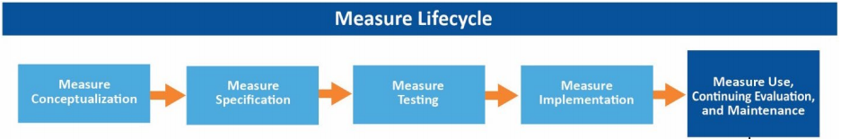
Measure Lifecycle
Notes:
There are five phases to the measure lifecycle:
Conceptualization:
The initial phase when an important issue or need is identified and researched to determine if and how to develop a quality measure to address that issue.
Specification:
The phase where that initial idea really becomes a measure. It’s the point at which a measure developer fleshes out the measure details and thinks about how the measure could actually be calculated and tested.
Testing:
The phase where a measure is first evaluated to determine whether it meets the criteria for use in a program. The information from testing leads to refinements in the measure specifications, and then those refinements may be retested. In other words, it’s an iterative process between specification and testing.
Implementation:
The phase at which if the measure meets CMS criteria — after the public has had an opportunity to weigh in on the measure — CMS may accept that measure into one or more of its programs.
Maintenance:
The last phase that encompasses everything that measures undergo, once they’re implemented in a program with key activities such as updating and comparing against the business case, gathering stakeholder feedback and doing additional analysis.

Slide 5



Measure Maintenance
After measures are implemented, measure developers monitor performance of the measures
Two measure maintenance activities that apply to every measure: annual update and triennial comprehensive reevaluation
Ad hoc review occurs only if there are significant unforeseen problems with the measure
Five possible outcomes following maintenance review
Notes:
During Measure Maintenance:
Measure developers use a continuing evaluation process to determine if measures in use continue to meet CMS criteria.
At annual updates, the review of stakeholder feedback about the measure specifications or scientific acceptability.
Comprehensive reevaluation occurs triennially and is a more in-depth and thorough review to ensure that the CMS measures continue to be of the highest caliber.
Gathering information generated since the measure’s development or since the last comprehensive reevaluation, whichever one occurred most recently.
Evaluating the measure and recommending action based on the evaluation, and then approving and implementing that action.

Slide 6
Outcomes of Maintenance Review
Outcome | Description
Retain | Keep the measure active with its current specifications and minor changes
Revise | Update the measure’s current specifications to reflect new information
Retire | Cease to collect or report the measure indefinitely
Suspend | Temporarily cease to report a measure
Remove | A measure is no longer included in a specific CMS program set for one or more reasons
Notes:
Additionally, for suspended measures, the data collection and submission may continue as directed by CMS, but it won't be reported. This option may be used by CMS for topped-out measures where there’s a concern that rates may decline after data collection for reporting ceases. For removed measures, the measure is no longer included in a specific CMS program set for one or more reasons, but this doesn't imply that other payers, purchasers, or programs should cease using a measure.

Slide 7



Purpose of Evaluation during Maintenance
Ensures that CMS programs are using sound measures to drive healthcare quality improvement
Confirms that measures continue to add value to quality reporting programs
Helps ensure that CMS measures retain NQF endorsement
Notes:
As during measure development, measure developers, technical expert panel (TEP) members, and other stakeholders work towards ensuring that sound measures can be used to drive healthcare quality improvement and to inform consumer choice. The steps depicted on this slide help CMS ensure that its measures continue to be of the highest caliber, and that they retain their NQF endorsement if endorsed.

Slide 8
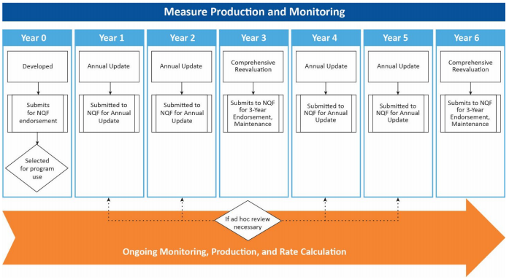
Ongoing Maintenance Timeline
Notes:
The figure on this slide depicts the two parallel processes. CMS scheduled maintenance reviews are in the top row with the parallel NQF maintenance submissions listed as subprocesses below.

Slide 9




Measure Evaluation Criteria
Importance to measure and report
Evidence, performance gap
Scientific Acceptability
Reliability, validity
Feasibility
Usability and Use
Notes:
Importance to measure and report:
The extent to which the measure focus is evidence-based and important to making significant gains in healthcare quality; that where there is variation in or overall less than optimal performance.
Evidence, which refers to the strength of the evidence on which the measure is based.
Performance gap, which refers to the extent to which the measure is addressing an important gap or area of need.
Scientific acceptability:
The extent to which the measure produces consistent and credible results about the quality of care when implemented, which encompasses the subcriteria of reliability and validity.
Feasibility:
The extent to which the specifications, including the measure logic, require data that are readily available or could be captured without undue burden and can be implemented for performance measurement.
Usability and use:
The extent to which the potential audiences are using, or could use performance results for both accountability and performance improvement to achieve the goal of high quality and efficient healthcare for individuals, or for the population.

Slide 10

Comparing Against Business Case
How does the measure perform compared to the trajectory projected in the business case?
Update justification for the measure and any changes to the technical specifications
Notes:
Developers ensure the following:
Determine that aspects of care included in the specifications continue to be highly important to measure and report; that they supply meaningful information to consumers and healthcare providers and drive significant improvements in healthcare quality and health outcomes.
Demonstrate that data elements, codes and parameters included in the specifications are best to quantify the specific measure; that data collection doesn't cause undue burden on resources or staff.
Demonstrate that calculations in the specifications represent a clear and accurate reflection of the variation and the health outcome of interest, or the quality or efficiency of the care delivered.

Slide 11


Report Results of Evaluation
Developers should submit a separate Measure Evaluation Report (MER) for each measure to CMS:
When recommending disposition of the measure after comprehensive reevaluation
When recommending disposition of the measure after an ad hoc review
When completing the MER during maintenance, the current rating of each subcriterion should be compared to the prior measure evaluation
Notes:
The measure evaluation criteria and subcriteria are detailed in the Blueprint which also contains a blank Measure Evaluation Report (MER). The MER is how developers report their findings from their evaluation efforts to CMS.

Slide 12
Annual Program Evaluation
Measures are evaluated within the program annually and changes proposed in rulemaking and other technical guidance.
Factors considered in measure removal:
Performance is high and unvarying (‘‘topped-out’’ measures)
Measure does not align with current clinical guidelines
More broadly applicable measure (ex. across settings) is available
Improvement or performance does not result in better patient outcomes
Measure can be replaced by a measure that is more strongly associated with desired patient outcomes for the particular topic
Collection or public reporting leads to negative unintended consequences
Implementation is not feasible
Reporting and/or maintenance costs associated with a measure outweigh the benefit
Notes:
As an example, the IPPS rule outlined the following removal criteria:
Factor 1:
Measure performance among IPFs is so high and unvarying that meaningful distinctions and improvements in performance can no longer be made (‘‘topped-out’’ measures)
A measure is ‘‘topped out’’ if there is statistically indistinguishable performance at the 75th and 90th percentiles and the truncated coefficient of variation is less than or equal to 0.10.
Factor 2:
Measure does not align with current clinical guidelines or practice.
Factor 3:
Measure can be replaced by a more broadly applicable measure (across settings or populations) or a measure that is more proximal in time to desired patient outcomes for the particular topic.
Factor 4:
Measure performance or improvement does not result in better patient outcomes.
Factor 5:
Measure can be replaced by a measure that is more strongly associated with desired patient outcomes for the particular topic.
Factor 6:
Measure collection or public reporting leads to negative unintended consequences other than patient harm.
Factor 7:
Measure is not feasible to implement as specified.
Factor 8:
The costs associated with a measure outweigh the benefit of its continued use in the program.
Lastly, any measure can be proposed for removal from that program, if it’s found to be associated with any of those factors which ensures that at both the measure level and the program level, the measures used in CMS programs continue to drive progress toward improved healthcare quality.

Slide 13
2018 Impact Assessment of CMS Quality and Efficiency Measures Kyle Campbell, PharmD Noni Bodkin, PhD, RN Vice President, Pharmacy & Quality CMS Contracting Officer’s Representative Measurement, HSAG and Technical Lead, QMVIG
Notes:
The Impact Assessment project carries out work statutorily required under the Social Security Act, Section 1890A. This work is to produce and publicly post a triennial report that represents the assessment of the quality and efficiency impact of measures in CMS reporting programs. Provided will be a background on some of the methodology and highlights of our most recent CMS Impact Assessment Report posted by March 1, 2018.

Slide 14
Presentation Objectives
Provide project background and objectives​
Present strategic approach​
Review methods
Highlight results
Notes:
Additional objectives include providing an overview of where the Impact Assessment fits into some of the activities presented earlier in the slide deck, as well as providing a review at a high level of the methods and key findings from the 2018 Impact Report.

Slide 15
Statutory Authority
An assessment of impact of CMS quality measures is mandated by Section 1890A(a)(6) of the Social Security Act:
The Secretary shall:
conduct an assessment of the quality and efficiency impact of the use of endorsed measures
(B) make such assessment available to the public, not later than March 1, 2012, and at least once every three years thereafter.
Prior Reports: 2012, 2015, 2018
Notes:
In each iteration of the reports we have worked extensively with stakeholders from public and private sector, patients and caregivers, and others to give input on improvements to the report and ensure that the analyses are more robust.

Slide 16
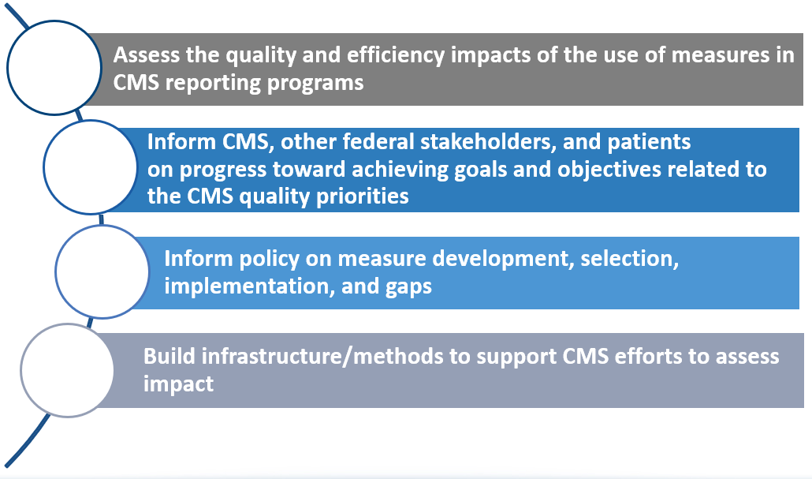
Report Objectives

Slide 17
Strategic Approach
Strategic Altitude
All included reporting programs
National rates and disparities
Assess national patient and cost impacts
Aligns with Meaningful Measure Initiative
Impact Assessment
Program
Evaluation
CMS reporting programs
Clinician and provider profiling/rates
Assess implementation of program design
15,000 Feet
Individual measures
Clinical/scientific updates,
measure maintenance
Evaluate according to criteria:
usability, scientific acceptability, importance, feasibility
Measure
Evaluation
Ground Level
Notes:
The Impact Assessment is at the 30,000-foot level, above program evaluation and looks broadly across all the included reporting programs. We want to try to align that with CMS’ quality priorities, including the Meaningful Measures Initiative.
Considerations:
How are we moving the needle in the national healthcare system?
What are the national rates?
What is occurring with regard to disparities across reporting programs?
What is the impact to patients?
What is the impact of costs in terms of the implementation of use of these measures?

Slide 18
Definition of “Impact”
For the 2018 Report, impact is defined as progress toward achieving goals and objectives related to the CMS quality priorities, demonstrated by
Trends in performance and disparities on Key Indicators
Estimated patient impact and costs avoided associated with changes in performance rates of Key Indicators
Aggregate trends in performance and disparities on measures used in CMS Medicare programs
Actions taken by hospitals and nursing homes in response to the use of performance measures, as identified from national surveys
Notes:
Additionally, the nursing homes and hospitals were picked as the initial settings to work in for a national provider survey due to the legacy of how long those quality reporting programs (QRPs) have been around and potentially changing care.

Slide 19

Key Indicators
Key Indicators: Measures or groups of measures used to gauge performance on aspects of CMS healthcare quality priorities
Aligned with the CMS Meaningful Measures initiative
28 Key Indicators displayed in Quality Dashboards assigned to healthcare quality priorities
Notes:
A Meaningful Measure Area (MMA) may include admissions and readmissions to hospitals; therefore, we have a key indicator related to all-cause readmissions in the report. Throughout the report are key indicators and how they specifically align to a quality priority, but also to the specific MMAs. These are displayed in quality dashboards associated with the healthcare quality priorities, i.e., patient safety and coordination of care.

Slide 20

2018 Impact Assessment Report Structure
762 unique measures in 24 Reporting Programs reviewed
Over 300 quality measures analyzed
Trend analysis included 247 measures reported as early as 2006 and as recently as 2015
Disparity analyses on all measures with available data
Patient impact and cost-avoided analyses for select Key Indicator measures
Nationally representative surveys in hospitals and nursing homes

Slide 21
Methods
Selection of Key Indicators
Multi-stakeholder input from diverse experts and federal agencies
Trend analysis
Measures with at least 3 annual data points included
Log linear regression model
Percentage change calculated to determine trend
Patient impact
Number of patients affected
Difference between observed and expected (assuming measure rate was unchanged) rates for measures
Notes:
The appendix on the website goes into further detail on each of these methods:
Key Indicators:
Multi-stakeholder input from a technical expert panel (TEP), and a federal assessment steering committee composed of various federal agencies. We worked with CMS on the final selection of those indicators highlighted in the report.
Trend analysis:
For example, if you look at the report in 2018, if you said, “I don’t see the measure here in the appendix, a measure that I know has been implemented,” it’s possible that you don’t see it because it hasn’t been implemented for at least three years. That is the inclusion criteria for the trend analysis.
Patient Impact:
A suggestion voiced from our patients/caregivers was the ability to understand the number of patients affected by the various measures in the reporting programs. Our methodology looks at the difference between the “observed and expected” rates from measures from which we can determine the number of patients having benefited from a given process or outcome.

Slide 22
Methods
Costs avoided
Value per event estimated from published literature
Costs converted to 2015 dollars through the Medical Care Services Index
Disparities analysis
Defined as relative difference ≥ to 0.10 and statistical significance (α = 0.05)
Compared race/ethnicity, sex, age group, urbanicity, income, and census region
Nationally representative surveys of quality leaders
Nursing Homes (n = 1,182)
Hospitals (n = 1,313)
Notes:
Costs avoided:
There is robust literature on quality measures with some economic models that have been estimated. We derive a value per event from that published literature and convert the cost to 2015 dollars in the case of the 2018 report using the Medical Care Services Index, the standard economic adjustment for healthcare.

Slide 23
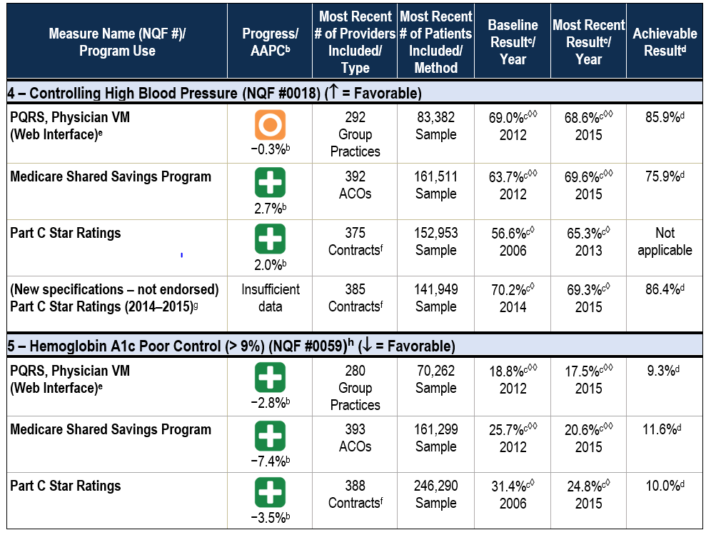
Results: Quality Dashboard Example
Notes:
Key indicators:
Controlling blood pressure: NQF #0018
Hemoglobin A1c poor control: NQF #0059
First column:
The programs for which this measure is currently being reported, i.e., legacy systems
PQRS and physician value modifier (VBM)
Medicare Shared Savings (MSSP) and Part C
Second column:
The average annual percentage change:
If the measure is going in the right direction, that icon shows up in green.
If the measure is stable, the icon shows up as amber.
If the measure is in the wrong direction — which fortunately here none of the measures we show you are going in the opposite direction — that indicator would show up as red.
Third column:
Number of providers included in that particular measurement:
Physician measure, 392 ACOs
High blood pressure, 292 group practices
Fourth column:
Number of patients included in the sample for that measure
Fifth and sixth columns:
Provides a baseline result in year and a most recent result in year.
Seventh/final column:
Achievable result at the national level, employing what’s called an “achievable benchmark of care” looking at distribution and performance between providers and the measure in an attempt to move the needle towards higher-performing providers.

Slide 24
Trend Analysis Results
Notes:
Looking globally across all measures analyzed in the 2018 report, the majority of outcome and process in all of the structural measures showed improvement. A relatively smaller number of outcome and process measures were stable, meaning no change in annual percentage change.
Improving measure:
The rates for screening for clinical depression and follow-up plan improved by 60% for clinician group practices between 2013-’15. The rate doubled for ACOs in that same period.
Declining measure:
The rates for colorectal cancer screening in the PQRS, physician-based modifier program (VBM).

Slide 25
Patient Impacts and Costs Avoided
Patient impacts estimated from improved national rates for Key Indicators
670,000 additional patients with controlled blood pressure (2006–2015)
510,000 fewer patients with poor diabetes control (2006–2015)
12,000 fewer deaths following hospitalization for a heart attack (2008–2015)
70,000 fewer unplanned readmissions (2011–2015)
840,000 fewer pressure ulcers among nursing home residents (2011–2015)
Nearly 9 million more hospitalized patients with a highly favorable experience with their hospital (2008–2015)
Significant costs avoided for a subset of Key Indicators
$4.2 billion–$26.9 billion estimated for increased medication adherence (2011–2015)
$2.8 billion–$20.0 billion estimated for fewer pressure ulcers (2011–2015)
$6.5 billion–$10.4 billion estimated for fewer patients with poor diabetes control (2006–2015)
Notes:
Depicted here are the key findings from the Impact Assessment. The highest actual costs avoided related to medication adherence for commonly prescribed chronic medications for diabetes and blood pressure and statins. The reason for the overall bounded estimates are due to the literature review to establish the models. Models were chosen at both ends of the spectrum. An estimate of the expected range for the true value of the cost to be avoided is somewhere between below or an upper bound shown here.

Slide 26
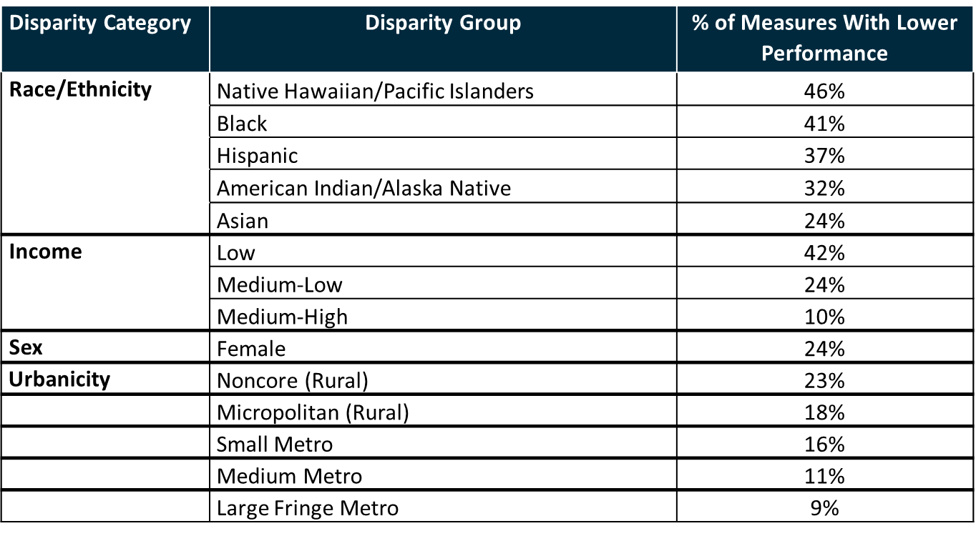
Select Disparities Results
Percentages of measures for each comparison group with significantly lower performance than for the reference group:
Notes:
Race/ethnicity:
For Native Hawaiian, Pacific-Islanders and black patients, there were 46% of the measures we analyzed and 41% of the measures we analyzed respectfully where those groups had lower performance on the measure than the reference group. Medication adherence for diabetes medications were approximately 36% lower for Hispanics in the Medicare Advantage population, and 66% lower for black patients in prescription drug plans when compared to the white reference group.
Income:
There were 42% of the measures; female patients 24%, and for rural patients 23% of those individuals having lower scores than their counterparts within the urban area. For specific measures highlighted in the report, 30-day mortality following heart failure (HF) hospitalization rates were 23% and 18% higher for the most rural populations, non-core and micropolitan when compared to the most urban category.

Slide 27
National Provider Survey Results
CMS measures were considered clinically important by respondents in both settings
92% of hospitals
91% of nursing homes
Performance on CMS measures reflected improvements in care that both hospitals (90%) and nursing homes (83%) had made
Majority of hospitals (89%) and nursing homes (81%) responded “yes” or “mostly yes” that they should be held responsible for performance on CMS measures

Slide 28
National Provider Survey Results
Nearly all (> 99%) hospitals and nursing homes made at least 1 change to improve performance on CMS measures in response to the measures:​
Average hospital made 17 of 23 changes (74%)​
Average nursing home made 13 of 22 changes (60%)
30% of hospitals and 12% of nursing homes noted barriers to reporting on CMS measures​
92% of hospitals and 85% of nursing homes indicated barriers to improving performance on CMS measures
Notes:
Improvements:
Hospitals cited most useful the adoption of standardized care protocols and focusing specifically on quality improvement for targeted measures.
Nursing homes cited quality improvement initiatives around specific measures most frequently.
Nursing homes cited the institution of interdisciplinary rounds as instrumental in this work.
Barriers:
Hospitals cited difficulties with changes in measure specifications
Hospitals cited limitations of electronic health records (EHRs)
Hospitals and nursing homes cited changing frontline clinician behavior and a difficult patient mix
Nursing homes cited staff understanding of measure specifications
Nursing homes cited applying the measure specifications correctly
Nursing homes also experienced high rates of staff turnover

Slide 29
Study Limitations
Quality improvement gains highlighted in this report cannot be solely attributed to the implementation of quality measures and were estimated based on available data.
Attribution and quantitative analyses regarding the factors contributing to measure performance rate changes were beyond the scope of this assessment.
Quality measurement is a key component of most quality improvement efforts, and it is likely that measurement contributed to at least some of the observed improvements characterized in the report.
Notes:
These findings were based on available data from quality reporting programs (QRPs) and CMS contractors. There are many local and federal and nonprofit organization initiatives in quality, and we recognize that gains from the Impact Assessment report cannot be solely attributed to the measure implementation itself. However, “if you don’t measure it, you can’t improve it.” If the measures didn’t exist, it’s very unlikely that we would have seen all of the improvements.

Slide 30
Conclusion
CMS quality measures have likely contributed to improvements in national health care.
Key Indicators are vital to providing high-quality care and improving outcomes.
National provider survey findings indicate:
– Hospital and nursing home quality leaders recognize importance of quality measures
– These leaders have made changes in response to measures to improve care
– Barriers remain to reporting and improving performance
Notes:
The key indicators were selected with multidisciplinary, multi-stakeholder input and are vital to providing high quality care and improving outcomes.

Slide 31
Reference Links
The 2018 Impact Assessment Report and its appendices are posted on the CMS Impact Assessment website: (https://www.cms.gov/Medicare/Quality-Initiatives-Patient-Assessment-Instruments/QualityMeasures/National-Impact-Assessment-of-the-Centers-for-Medicare-and-Medicaid-Services-CMS-Quality-Measures-Reports.html)

Slide 32
Thank you!
HSAG Project Director
Kyle Campbell
kcampbell@hsag.com
CMS COR
Noni Bodkin
noni.bodkin@cms.hhs.gov

Slide 33

Discussion Questions

Slide 34
Upcoming MACRA Info Sessions
Planned Upcoming Webinars:
August 2019 – Merit-based Incentive Payment System (MIPS): Insights from CMS
September – TBD
To suggest topics for upcoming Info Sessions, email: MMSsupport@battelle.org

Slide 35
Upcoming Public Webinars
Planned Upcoming Webinars:
July 24, 2019 and July 25, 2019 – Patient-Centered Quality Measurement: What It Is and How to Get Involved

Slide 36
Final Slide with CMS and Battelle Contact Information
Battelle
Measures Manager
Contact: MMSsupport@Battelle.org
CMS
Kimberly Rawlings (CMS COR)
Contact: Kimberly.Rawlings@cms.hhs.gov

