Slide 1
Title Page: Patient-Centered Quality Measurement: What It Is and How to Get Involved
Public Webinar CMS Measure Development Education & Outreach
Patient-Centered Quality Measurement: What It Is and How to Get Involved
Presenters:
Kim Rawlings, CMS
Brenna Rabel, Battelle
Dr. Nicole Brennan, Battelle
July 24th & 25th, 2019
2:00-3:00pm EDT
Notes:
This presentation will provide an overview of clinical quality measures (CQMs) and how patients and other stakeholders are considered and involved in the process of developing them. It will cover the various phases of the measure lifecycle and describe the ways in which stakeholder feedback is collected and used throughout each phase.

Slide 2
Introduction to CMS Quality Goals
Welcome! This is the second of a two part series to engage the public in the work CMS is doing around quality measurement
Aim to shed light on the processes and function of quality measurement in CMS programs and initiatives
If you are new to quality measurement, stay tuned for available resources that can help navigate development and use
Notes:
These webinars are part of an ongoing effort to engage measure developers, consumers, and other stakeholders in quality measurement topics — an effort that also includes a series of newsletters and bulletins, monthly Information Sessions and routine updates to the Measures Management System (MMS) website.
The public webinars typically occur over the summer and focus on broad topics related to quality development, intended to help introduce those who are new to measure development to key concepts and to orient stakeholders such as patients and frontline clinicians to the work being done around quality measures.

Slide 3
Agenda
Introduction to CMS and Quality Goals
What quality measures are used and how they are used
Meaningful Measures
Stakeholder involvement throughout the quality measure lifecycle

Slide 4


What is a Clinical Quality Measure?
A Clinical Quality Measure (CQM) is a tool that quantifies healthcare processes, outcomes, patient perceptions, and organizational structure and/or systems and:
Is associated with the ability to provide high-quality health care and/or that relate to one or more quality goals for health care
Is supported by evidence
Notes:
Our main goal at CMS is to improve healthcare outcomes by ensuring that patients are achieving good results; that care received is aligned with the most up-to-date and evidence-based guidelines available.
Percentage of diabetic patients receiving a “foot exam” during annual wellness visit:
A measure may track patient experience, whether the patient was able to get the necessary appointment and care as quickly as needed.
A measure could track diabetes outcomes looking at the number of hospitalizations or deaths attributable to poorly controlled blood sugar.
A different type of measure may look at organizational structures, whether healthcare facilities have appropriate lab equipment or staff to process required lab tests.
Many CMS measures are used for public reporting and payment programs. It is crucial that measures are tested to demonstrate the relationship to provisions of high-quality care and/or related to healthcare quality goals. Also supported by good evidence, through peer-reviewed literature or in clinical guidelines demonstrating alignment with the measure’s intent.

Slide 5
Purpose of CQMs
Goal 1: Improve the quality of healthcare provided to patients
A tool for making “good decisions”
One that makes it more likely that patients/providers will experience a good result and
Makes it less likely that the provider/patient will experience an adverse result
Low performing clinicians can choose to allocate resources to becoming high-performing
Goal 2: Empower patients to make informed decisions
Patients can use quality measures to select high-performing clinicians
Ex., using Physician Compare or Hospital Compare
Notes:
Goal 2: Empower patient to make informed decisions:
Some quality measure results are publicly reported and found in places such as Physician Compare, Hospital Compare, Nursing Home Compare, et cetera. This information can be used to help guide the patients, their family members or caregivers in decision-making when selecting a provider for a specific condition or treatment; however, not every quality measure is used for this purpose. CMS is continually working on improving ways that patients can use measures for this purpose.

Slide 6
CMS CQM Prioritization
Meaningful Measures Initiative
Legislative Mandates
Patients, Public, and Other Stakeholders
Other Reports/ Documents
Quality Measure Development Plan (MDP)
Medicare Payment Advisory Committee (MedPAC) and Medicaid and CHIP Payment and Access Commission (MacPAC) quality reports
Agency for Healthcare Research and Quality (AHRQ) National Healthcare Quality and Disparities Reports
Notes:
Legislative Mandates:
Most CMS quality incentive reporting programs are borne out of legislation.
Legislation outlines specific measure requirements that need to be considered when developing measures for that program.
Patients, Public, Other Stakeholders:
We receive input and feedback from patients, clinicians, advocacy organizations, specialty societies and other stakeholders through public comment, technical expert panels (TEPs), MAP workgroups, et cetera.
Other Reports/Documents:
Environmental scans and a gap analysis are standard in the beginning stages of measure development for any specific program.

Slide 7
Meaningful Measures Objectives
Meaningful Measures focus everyone’s efforts on the same quality areas and lend specificity, which can help identify measures that:
Address high-impact measure areas that safeguard public health
Are patient-centered and meaningful to patients, clinicians and providers
Are outcome-based where possible
Fulfill requirements in programs’ statutes
Minimize level of burden for providers
Identify significant opportunity for improvement
Address measure needs for population based payment through alternative payment models
Align across programs and/or with other payers
Notes:
At CMS we believe that achieving these objectives will guide us to having measurable improvements for the nation, while encouraging the use of more parsimonious measure results and working to reduce the burden of measurement for clinicians and providers, and ultimately improving the quality of care for our patients.
CMS introduced over the past several years a comprehensive approach using the Meaningful Measures Framework to identify those areas of highest priority of quality measurement improvement, and to assess those core issues most critical to providing high quality care and improving individual outcomes.

Slide 8
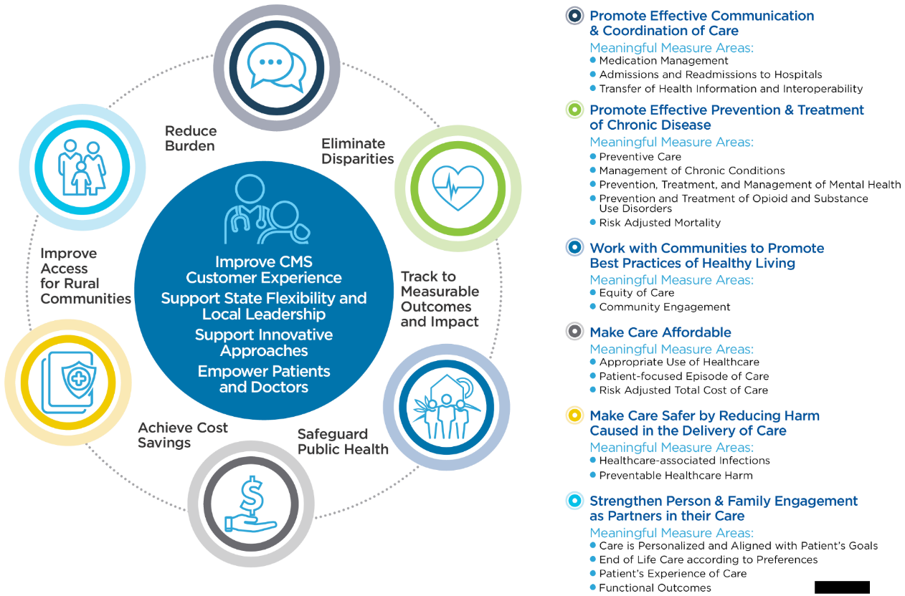
Meaningful Measures Framework
Notes:
At the center of this Meaningful Measures Framework are our four CMS strategic goals along with a pictorial depiction of the provider and patients, which again emphasizes that that relationship is at the core of this strategy.
The six crosscutting criteria are to eliminate disparities, track to measurable outcomes and impact, safeguard public health, achieve cost savings, improve access for rural communities and reduce burden. By crosscutting criteria we infer that these are criteria that all measures should touch upon when implemented into our programs.
In the bolded list are our six healthcare priorities — promote effective communication and coordination, promote effective prevention and treatment of chronic disease, work with communities to promote best practices of healthy living, make care affordable, make care safer by reducing harm caused in the delivery of care, and strengthen person and family engagement as partners in their care.
Underneath those are 19 Meaningful Measure Areas (MMAs). The MMAs make this link between this very broad quality priority such as “make care affordable” and the actual measure. Think of it as a couple of categories underneath “make care affordable” that are a bit more specific to help make the connection.

Slide 9

What is a Patient-Centered Quality Measurement?
Measures developed with input from patients
Focus on measures that are important or meaningful to patients
May also include measures of patient-reported outcomes or patient experience
Notes:
Chronic pain management:
What treatment options would be the most valuable to patients?
What measures would be the most meaningful or usable?
A measure related to alternative therapies? One that looks at opioid prescribing?
Patient-centered measurement:
Should factor in patient perspectives.
Should balance them against clinical guidelines or evidence to create measures that are useful and meaningful to patients; that promote healthcare practices that align with information available in the clinical literature.
Patient-reported outcomes (PROs):
Patient experience; information gathered directly from patients about their symptoms or experiences with the healthcare system; direct information is used to determine the quality of care being delivered to patients.

Slide 10
Ways to be Involved in Quality Measurement
Technical Expert Panels (TEPs) / patient panels
Convened by measure developers to support measure development
Opportunities posted here: https://www.cms.gov/Medicare/Quality-Initiatives-Patient-Assessment-Instruments/MMS/Technical-Expert-Panels.html
Public comment
Provide opportunities for the public to provide feedback on measures under development or maintenance
Opportunities posted here: https://www.cms.gov/Medicare/Quality-Initiatives-Patient-Assessment-Instruments/MMS/Public-Comments.html
Testing
Measure developers may recruit patients or clinicians to participate in measure testing
Frequently advertised via the MMS Newsletter (sign up here: https://www.cms.gov/Medicare/Quality-Initiatives-Patient-Assessment-Instruments/MMS/MMS-Listserv.html)
Notes:
TEPs:
A TEP is a group of experts
Patients are experts of their lived experiences
Calls for TEPs are posted on the MMS website
Search opportunities to join TEPs and self-nominate, if your experience aligns with the needs of that particular project. As a member, patients are invited to talk about their experiences with the healthcare system and provide important perspectives that may balance or provide context around the perspectives of clinicians or methodology experts also on those panels.
Public comment:
A formal opportunity for members of the public to provide feedback on measures that are under development (MUD) or maintenance.
Measures are posted online for around 30 days, during which time anyone can review the measure information and submit a comment with feedback about the measure.
Jira provides an online ticketing system to log comments.
Testing:
May include focus groups or interviews with clinicians or patients.
May include onsite testing at hospitals or clinician practices.
An opportunity for clinicians and patients to contribute to how measures are specified.
Opportunities are advertised via the MMS Newsletter.
Patient advocacy groups:
Are plugged into quality measurement and other policy issues that impact patients.
Serve as a conduit between patients and CMS measure developers.
Helps you stay informed about public comment opportunities and upcoming webinars.
To receive announcements of opportunities, get signed up for the MMS Newsletter, or for information about patient advocacy organizations email us at MMSsupport@battelle.org

Slide 11
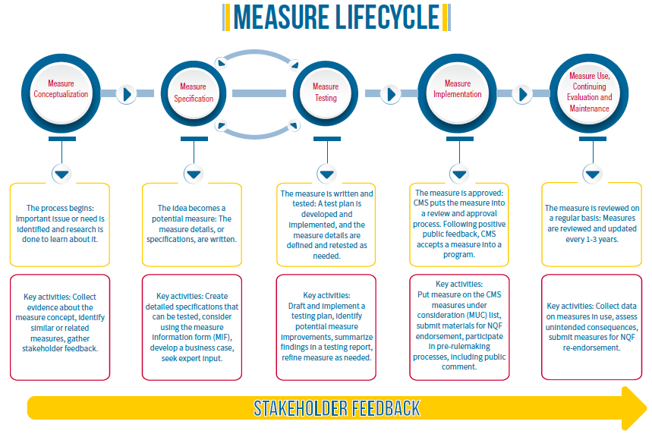
Measure Lifecycle
Notes:
1st Phase—Conceptualization:
CMS and measure developers identify an important issue or area of need.
Research begins to better understand the problem, possible solutions, and gaps.
2nd Phase—Specification:
The point at which the initial idea becomes a measure where developers flesh out measure details and specifications:
Nail down the population the measure will target
How the different parts of the measure will be defined
How the measure will be scored or calculated
3rd Phase—Testing:
Specification and testing is an iterative process.
Measure developers assess how to prove the measure is sound and usable, and continually identify changes that may improve the measure.
Measure developers produce a list of research questions and do a series of activities to answer those questions:
Qualitative research, such as talking to patients, clinicians or technical experts.
Quantitative research, collecting real data from hospitals or practices to see whether the measure results reflect the actual quality of care provided at those places.
Data gathered throughout testing is used to make changes to the specifications; ensure that measures are scientifically sound, unlikely to result in negative unintended consequences, and useful and important to patients and providers.
4th Phase—Implementation:
The point at which measures prove promising
Measures undergo public comment
Measures are approved by CMS for use in a program
CMS takes into consideration patient/public comment feedback
NQF endorsement is not a requirement but viewed favorably by CMS as a signifier that the measure meets the desired criteria.
5th Phase—Maintenance:
Measures that have been accepted for use in a CMS program.
Measures are reviewed and updated annually to ensure that they continue to align with the most up-to-date information available.
Re-endorsement:
When changes result in substantive changes to the measure, measures undergo another public comment period.
Stakeholders weigh in on the proposed changes before they’re enacted.
Measures receiving NQF endorsement are reevaluated every three years to ensure that they still meet the criteria for endorsement.

Slide 12


Measure Conceptualization
Building the evidence base for the measure concept and basic elements of the measure
Steps to be completed in this phase:
Information Gathering
Gap Analysis
Initial Business Case
Stakeholder Input
Public Comment
Notes:
1st Phase—Conceptualization:
Measure developers build the evidence base for the measure concept and basic elements of the measure — population to be included, disease or condition of interest, relevant interventions or screening.
An in-depth process, including information-gathering, typically a literature review.
Includes a gap analysis, the process that measure developers use to identify similar or related measures that already exist and to identify gaps.
Developers make the business case for the measure, assessing how the implementation of the measure would impact healthcare costs and quality — as well as the phase where initial stakeholder input is collected (TEPs/public comment/interviews).

Slide 13



Measure Conceptualization: Stakeholder Involvement
Participate in a Technical expert panel (TEP) or Patient and Family Advisory Councils or Boards, or even by working as part of a measure development team
Submit feedback via Public Comment
Types of patient feedback needed during conceptualization:
Information about the patient experience with a given condition/treatment/outcome
Patient perceptions of what makes “quality” care for a given condition/treatment/outcome
Help prioritizing potential measure concepts
Notes:
1st Phase—Conceptualization:
Patients providing lived experiences with conditions, treatments or outcomes being proposed as a measure can provide useful context and contours to the measure development team that can inform the measure ultimately being developed. Through patient experiences with the healthcare system, patients are in a crucial position to point out when the measure focus is misaligned with expectations or needs.

Slide 14

Measure Conceptualization: Stakeholder Feedback (cont’d)
Types of clinician feedback needed during conceptualization:
Information about clinical workflows, clinician burden, and other feasibility considerations
Perceptions about existing clinical guidelines or evidence that might influence their use in a measure
Help prioritizing potential measure concepts
Other considerations:
Diversity of stakeholder perspectives
Notes:
1st Phase—Conceptualization (cont’d):
In general, this is the point at which developers are looking for diverse perspectives from all kinds of stakeholders to ensure that they and CMS are only investing resources to develop measures that are likely to be feasible and useful to those stakeholders.

Slide 15
Measure Specification
Specifications provide the comprehensive details that allow the measure to be collected and implemented consistently, reliably, and effectively
Measure Attributes
Description
Numerator
Denominator
Denominator Exclusions
Rationale
Evidence
Steps to be completed in this phase:
Develop candidate measure list
Develop precise technical specifications and update the Measure Information Form (MIF)
Define the data source
Specify code systems and construct data protocol
Notes:
2nd Phase—Specification:
Will the measure use information from Medicare claims?
Is it going to be based on clinical data from the electronic health record (EHR)?
This is also the point at which developers think through the coding systems they’re going to use to define clinical concepts. This is a technical phase that calls upon quite a lot of methodological expertise to do well, but the result of this phase is a detailed measure specification that can be used for testing.

Slide 16
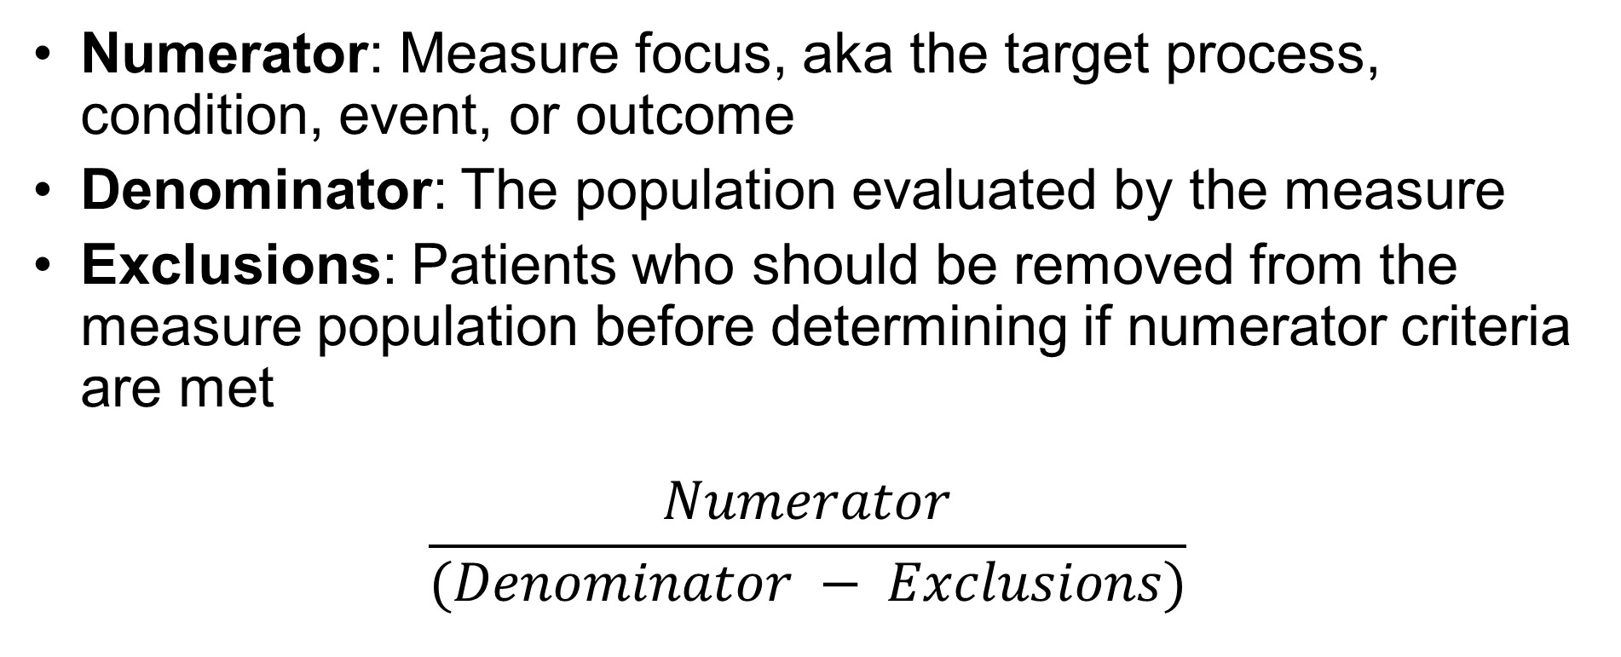
Measure Attributes
Numerator: Measure focus, aka the target process, condition, event, or outcome
Denominator: The population evaluated by the measure
Exclusions: Patients who should be removed from the measure population before determining if numerator criteria are met
$$\frac{Numerator}{(Denominator − Exclusions)}$$
Notes:
2nd Phase—Specification:
A visual depiction of a measure composition and structure is shown on this slide. For example, in some Medicare measures the denominator is all patients 65 years of age and older.

Slide 17
Measure Specification: Stakeholder Involvement
Same roles as for conceptualization
Types of patient feedback needed during specification:
Feedback about how a given measure might positively or negatively impact their interactions with doctors
Feedback on whether the specified measure is meaningful and important
Considerations related to potential unintended consequences
Notes:
2nd Phase—Specification:
Will the measure incentivize providers to use a specific questionnaire or diagnostic tool?
Will that improve or worsen the quality of care received from providers?
How might a patient use or interpret a provider’s score on a measure?
Might a measure related to shorter wait times for wellness visits result in less time with your doctor once you’re in the exam room? Would that be a good or a bad thing?

Slide 18

Measure Specification: Stakeholder Feedback (cont’d)
Types of clinician feedback needed during specification:
Information about how the measure might impact or fit into existing clinical workflows
Feedback about the measure’s face validity
Input on measure exclusions, risk adjustment, and other measure details
Considerations related to potential unintended consequences
Notes:
2nd Phase—Specification:
Clinical knowledge is leveraged to shape and refine the measure prior to testing.
Clinicians provide insight into how the measure as specified fits into existing clinical workflows; whether it creates feasibility challenges or result in efficiencies or improvement.
Clinicians weigh in on the measure’s face validity; whether a high score on the measure would be an indicator of higher quality care.

Slide 19


Measure Testing
Testing quality measures, including the components of the measure such as the data elements, the scale, and the performance score
Steps to be completed in this phase:
Develop testing work plan
Implement Alpha and Beta testing
Analyze testing results and refine measure specs
Report on measure testing results
Continued stakeholder engagement
Notes:
3rd Phase—Testing:
Involves qualitative and quantitative assessments of the measure to demonstrate its readiness for use in a program.
It begins with the development of a test plan in two phases — alpha and beta testing.
Alpha testing involves collecting feedback from patients, clinicians, and any other experts about the measure’s feasibility; the extent to which it can reasonably be implemented without creating a lot of burden at practices. And then its usability both to patients and clinicians.
Face validity, the extent to which it measures what it’s supposed to measure, and then using that information to further refine the specifications before launching into full beta testing.
Beta testing involves rigorous quantitative testing using real data to assess whether the measure can quantify what it’s supposed to quantify, and to ensure the measure can accurately detect differences in performance between clinicians or hospitals. These results are used to further refine specifications and provide information to CMS about any potential challenges associated with implementation.

Slide 20

Measure Testing: Stakeholder Involvement
In addition to TEPs and PFABs, testing also presents opportunities to participate in patient focus groups
Types of patient feedback needed during testing:
Similar to feedback during specification (and if participating on a TEP, you may only need to weigh in after both preliminary specification and testing have been completed, so that you can react to a more fleshed out version of the specifications)
Notes:
3rd Phase—Testing:
Presents opportunities to participate in patient interviews or focus groups. Being a member of a patient advocacy group is helpful, since it’s one way that measure developers seek to identify patients to participate in these activities.
During testing the feedback that measure developers are seeking from patients is an opportunity to think through how the measure may impact the care a patient would receive and to discuss whether the measure is useful or important relative to other aspects of care.

Slide 21

Measure Testing: Stakeholder Feedback (cont’d)
Types of clinician feedback needed during testing:
Help interpreting findings from site testing
Insight into the generalizability of findings
Input on potential refinements to measure details
Considerations related to potential unintended consequences
Notes:
3rd Phase—Testing:
A test site participating during beta testing provides a more in-depth view of how the measure functions in the clinical environment, allowing one to provide more informed information about how such a measure might be implemented in that setting.
TEP members with a clinical background are instrumental in helping developers interpret findings from site testing and provide insight into the generalizability of these findings.
Example:
If a measure works well at a test site, will it work at other practices as well? If not, why?

Slide 22
Measure Implementation
Refers to the transparent process by which a measure is submitted for use by CMS, and is subject to stakeholder and public review
Steps to be completed in this phase:
Submit measure specifications to CMS Pre-Rulemaking Process
MAP Workgroup recommendations
CMS rulemaking processes
Continued stakeholder engagement
Notes:
4th Phase—Implementation:
Measure implementation refers to the transparent process by which a measure is submitted for use by CMS and is subject to stakeholder and public review. It involves submitting the measure to CMS for consideration via the pre-rulemaking process. Measures proposed for CMS programs undergo detailed review by external experts to determine their suitability for CMS programs, and then once again undergo public comment to allow stakeholders to weigh in on them.

Slide 23
Measure Implementation: Stakeholder Involvement
Patients, clinicians, and other stakeholders can participate in measure implementation via the public comment process
Presents an opportunity to weigh in on measures being proposed for use in CMS programs
Example types of feedback:
Support for a proposed measure that addresses an area of interest or concern
Concerns about potential for unintended consequences or harms related to a proposed measure
Notes:
4th Phase—Implementation:
The public comment process is specifically designed to promote transparency and to allow the public to weigh in on the types of measures being proposed for use in CMS programs.

Slide 24

Measure Use, Continuing Evaluation, and Maintenance
The processes and data collection used to ensure the continued soundness of the measure
Steps to be completed in this phase:
Data collection and literature reviews
Evaluate Business Case
Measure Updates
Comprehensive Reevaluation
Ad Hoc Review
Notes:
5th Phase—Maintenance:
Measure stewards must evaluate the measure’s business case to determine whether the measure is performing as expected based on initial predictions, and where deemed necessary measures may need to be updated or revised. This is an ongoing process that ensures that CMS measures continue to meet the criteria required for inclusion in their programs.

Slide 25

Measure Maintenance: Stakeholder Involvement
Patients, clinicians, and other stakeholders can participate in measure maintenance via the public comment process
When measures are considered for removal from programs, the public has an opportunity to comment
Example types of feedback:
Support or concern for a proposed measure removal
Notes:
5th Phase—Maintenance:
As with measure implementation, the best way for clinicians and patients and other stakeholders to participate in measure maintenance is via the public comment process.
When a measure is being considered for removal from a program, the public has an opportunity to comment. For clinicians directly impacted and accountable for measures in a given program, this can be a crucial way to have your voice heard.

Slide 26
Resources for More Information

Slide 27
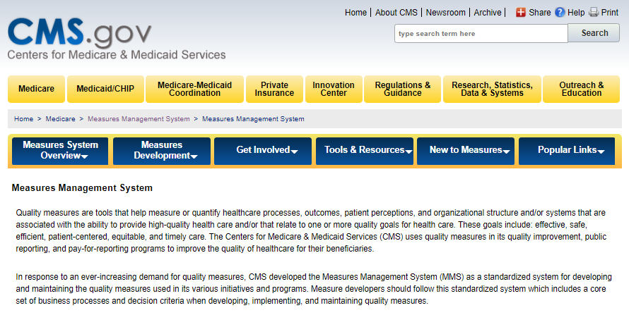
For more information and support:
Go to our Measures Management System website
Contact us at: MMSSupport@Battelle.org
Notes:
By selecting the “get involved” tab, you would locate a list regarding technical expert panels (TEPs), which one TEP currently is actively recruiting new members. On this site you can search measures open for public comment, as well as ways to link to our newsletters.

Slide 28
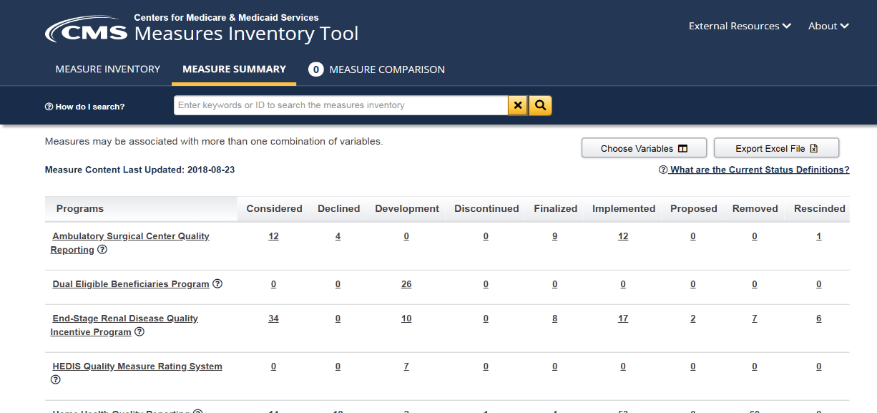
CMIT
The CMS Measures Inventory Tool (CMIT) provides a searchable repository of the measures used across CMS quality programs and initiatives.
Notes:
CMIT provides information about measures contained within the CMS portfolio. You can sort by any number of filters through the inventory to locate measures of interest. Let’s say you are interested in learning about measures related to a specific TEP. You could create a filter based off measures perhaps on depression or other behavioral health.
If you know that a measure is being proposed to be removed from a program — you want to know a little bit more about the history of that measure — you can find the measure here in the inventory and learn when it was initially proposed for a program; in what programs it’s currently being utilized and when it’s scheduled for being retired from the inventory.

Slide 29

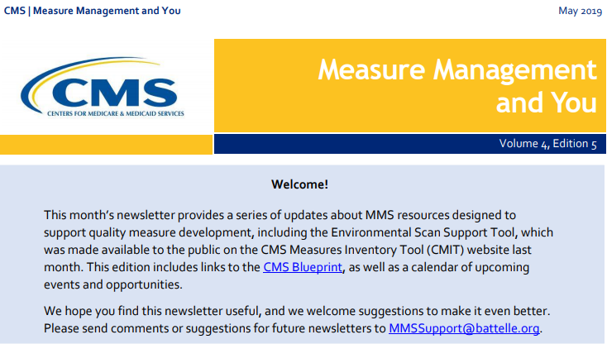
MACRA Bulletin/MMS Newsletter
MACRA Bulletin
Email MMSsupport@battelle.org to sign up
MMS Newsletter
Sign up here: https://public.govdelivery.com/accounts/USCMS/subscriber/new
Notes:
MMS Newsletter:
Provides updates on TEPs seeking new members.
Provides new rules, as well as information about new or finalized measures.
Provides information regarding upcoming webinars and their topics.
MACRA Bulletin:
Contains real-time updates for TEPs and other opportunities.

Slide 30
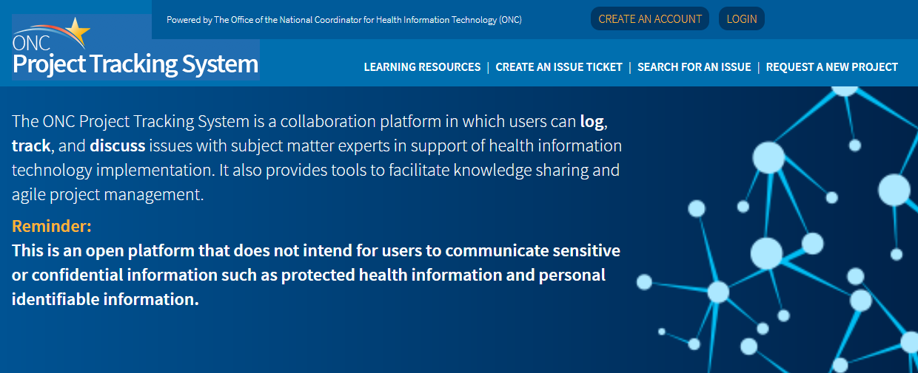
Jira
Jira is the platform for commenting on measures under consideration
Quick Start Guide available here: https://www.cms.gov/Medicare/Quality-Initiatives-Patient-Assessment-Instruments/QualityMeasures/Downloads/CMS_Jira_Quick_Start_2019.pdf
Notes:
Jira is a platform that measure developers use when submitting measures to CMS for the measures under consideration (MUC) list. If you have an interest in submitting a measure to CMS in the next cycle, you can access the link here. It will send you to a Quick Start Guide on how to gain access to Jira and what other resources you might need when submitting a measure to CMS, or to a program for them to consider putting into a rule or sending for additional scientific review to be put into one of the rulemaking programs.

Slide 31

CMS Quality Measurement CMS MMS Blueprint
The Blueprint is a helpful resource whether your interest is in developing measures or in understanding the measure development process.
Six sections to guide measure development
Measure lifecycle
In-depth look on each step of the process
Forms and templates
Notes:
The 376-page Blueprint is not designed to be read from front to back, and therefore is best utilized as a guide to the measure development process.
Section 1 & 2:
Provides a high-level overview of MMS and the measure lifecycle.
Section 3:
This section begins a deeper dive into topics such as “person and family engagement, or measure testing or measure evaluation.”
Section 4:
Provides the necessary forms for developers. When developing a measure on behalf of perhaps a specialty society, you can access these forms for insights on how to develop a business case for your measure and what kind of information is required, if you were to submit the measure for CMS consideration into one of their programs.
Section 5:
Contains a glossary and a list of the acronyms that you’ll see throughout the Blueprint.

Slide 32
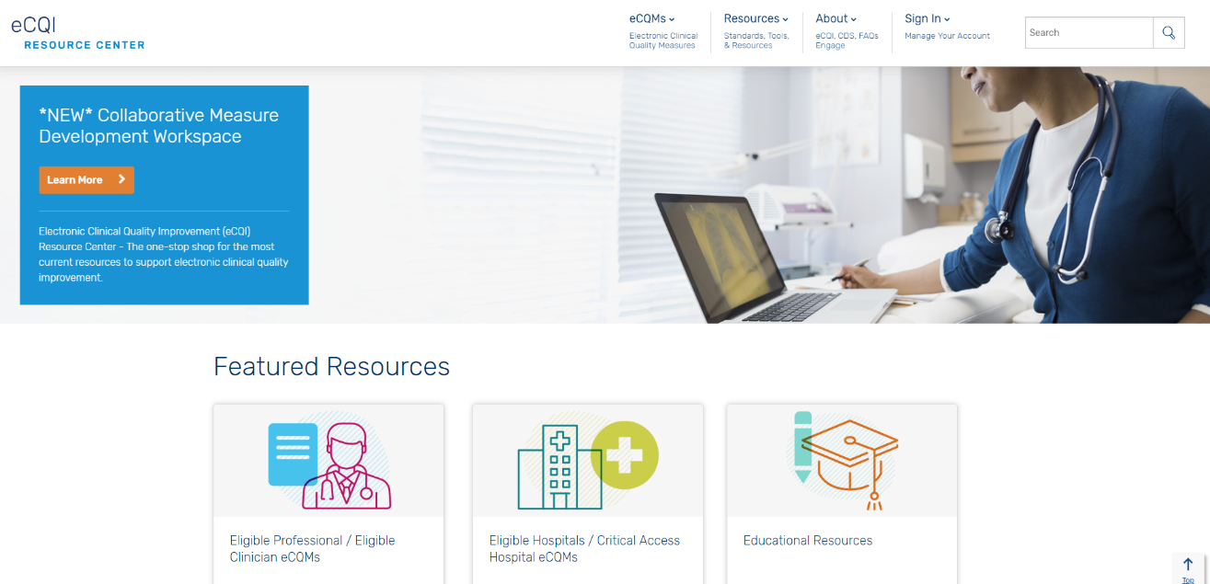
eCQI Resource Center
The eCQI Resource Center brings together stakeholders from across the eCQI community and provide a centralized location for news, information, tools, and standards related to eCQI and electronic clinical quality measures (eCQMs).
Notes:
The eCQI Resource Center is a great resource for those developing electronic quality measures. It is considered a one-stop shop for stakeholders engaging in electronic quality improvement. The site contains resources from CMS, as well as contributing agencies such as the Agency for Healthcare Research and Quality (AHRQ) and the National Academy of Medicine (NAM). You will find resources used at various stages of eCQM development such as testing, certification, as well as continuous evaluation.

Slide 33

Impact Assessment Reports
Impact Assessment Reports are written every three years. They assess the quality and efficiency impact of measures used in CMS programs.
Notes:
The National Impact Assessment is published by CMS at least once every three years. The 2018 report was divided into nine chapters looking at the impact of specific measure types, such as measures addressing “person and family engagement,” including a discussion on the overall trends for CMS quality measures and how they impact the nation. It also includes key indicators and how they were selected by technical expert panels (TEPs) and how patients helped inform that process.

Slide 34
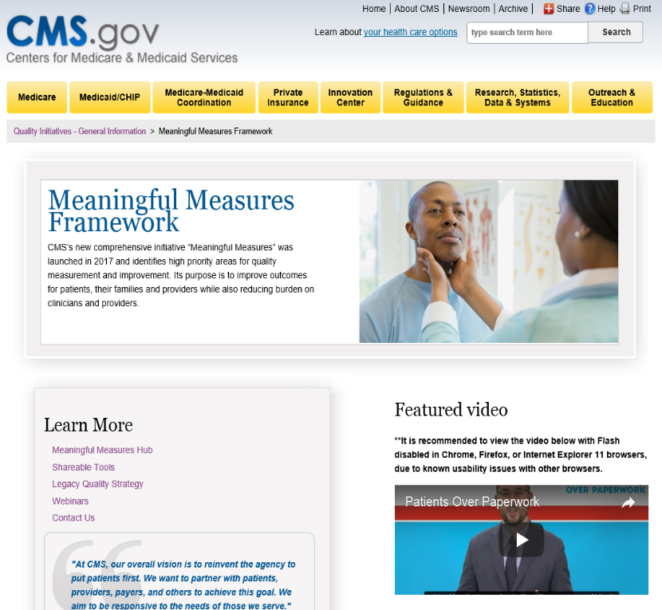
Meaningful Measures Framework
This website serves as a hub for information on the Meaningful Measures Framework. There are several resources including videos, fact sheets, and Q&As which provide more detail on the 19 Meaningful Measure Areas.
Notes:
On the Meaningful Measures Framework website you will find videos and additional resources that delve more in-depth on the Meaningful Measures and how they’re currently being used throughout CMS.

Slide 35
Final Page with Contact Information
Battelle
Measures Manager
Contact: MMSsupport@Battelle.org
CMS
Kimberly Rawlings (CMS COR)
Contact: Kimberly.Rawlings@cms.hhs.gov

