Slide 1

IMPACT Act: Connecting Post-Acute Care Across the Care Continuum
Jennie Harvell, M.Ed, Senior Technical Adviser,
Centers for Medicare & Medicaid Services
Terrence A. O’Malley, MD, Physician, Massachusetts General Hospital
Elizabeth (Liz) Palena Hall, MIS, MBA, RN, LTPAC Coordinator,
Office of the National Coordinator for Health IT, DHHS

Slide 2
Disclaimer
This presentation was current at the time it was published or uploaded onto the web. Medicare policy changes frequently so links to the source documents have been provided within the document for your reference.
This presentation was prepared as a service to the public and is not intended to grant rights or impose obligations. This presentation may contain references or links to statutes, regulations, or other policy materials. The information provided is only intended to be a general summary. It is not intended to take the place of either the written law or regulations. We encourage readers to review the specific statutes, regulations, and other interpretive materials for a full and accurate statement of their contents.
2

Slide 3
Agenda
IMPACT Act: Requirements to Standardize and Make Interoperable Post Acute Care Assessment Data Elements
Using and Exchanging Clinically Relevant Assessment Data for Multiple Purposes
Health Information Technology Standards- A Primer
CMS Data Element Library
3

Slide 4
IMPACT Act Requirements to
Standardize and Make Interoperable
CMS Post-Acute Care Data Elements
Jennie Harvell, M.Ed, Senior Technical Adviser,
Centers for Medicare & Medicaid Services
4

Slide 5
IMPACT Act of 2014
Bi-partisan bill introduced in March, U.S. House & Senate, passed on September 18, 2014, and signed into law by President Obama October 6, 2014
The Act requires the submission of standardized assessment data by:
  Long-Term Care Hospitals (LTCHs): LCDS
  Skilled Nursing Facilities (SNFs): MDS
  Home Health Agencies (HHAs): OASIS
  Inpatient Rehabilitation Facilities (IRFs): IRF-PAI
The Act requires that CMS make interoperable standardized patient assessment and quality measures data, and data on resource use and other measures to allow for the exchange of data among PAC and other providers to facilitate coordinated care and improved outcomes
Improving Medicare Post-Acute Care Transformation (IMPACT) Act of 2014
5

Slide 6
Why IMPACT? Why Now?
The lack of comparable information across PAC settings undermines the ability to evaluate and differentiate between appropriate care settings for and by individuals and their caregivers
Standardized PAC assessment data will allow for continued beneficiary access to the most appropriate setting of care
Standardized PAC assessment data allows CMS to compare quality across PAC settings (longitudinal data)
Standardized and interoperable PAC assessment data allows improvements in hospital and PAC discharge planning and the transfer of health information across the care continuum
Standardized PAC assessment data will allow for PAC payment reform (site neutral or bundled payments)
Standardized and interoperable PAC assessment data supports service delivery reform
6

Slide 7
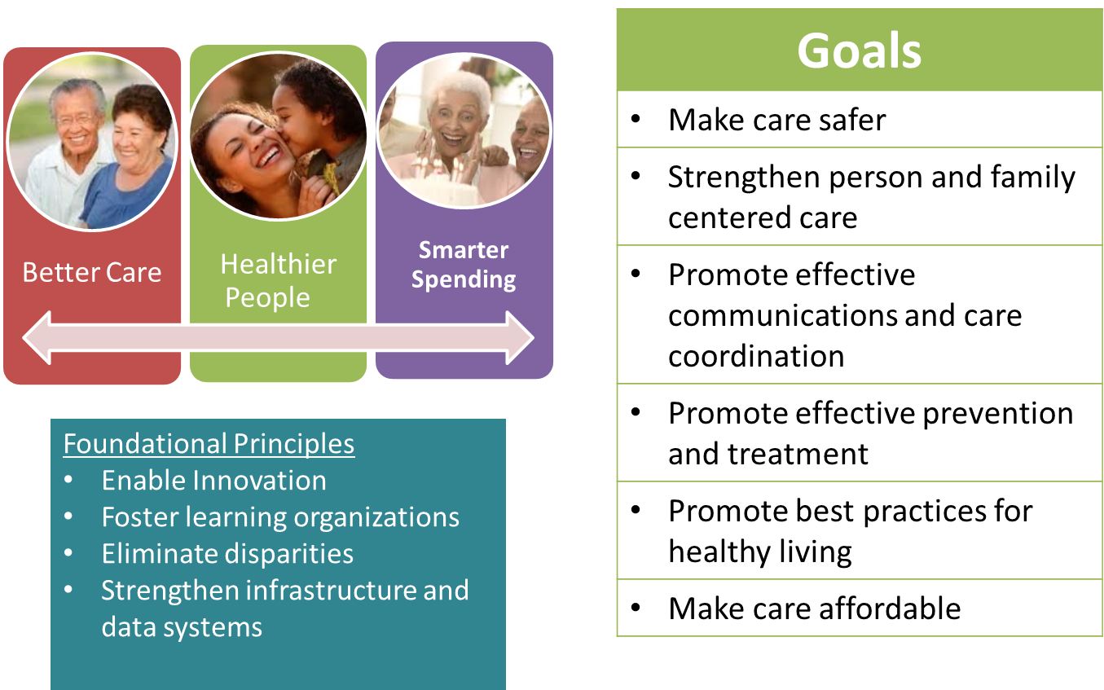
CMS Quality Strategy
7

Slide 8
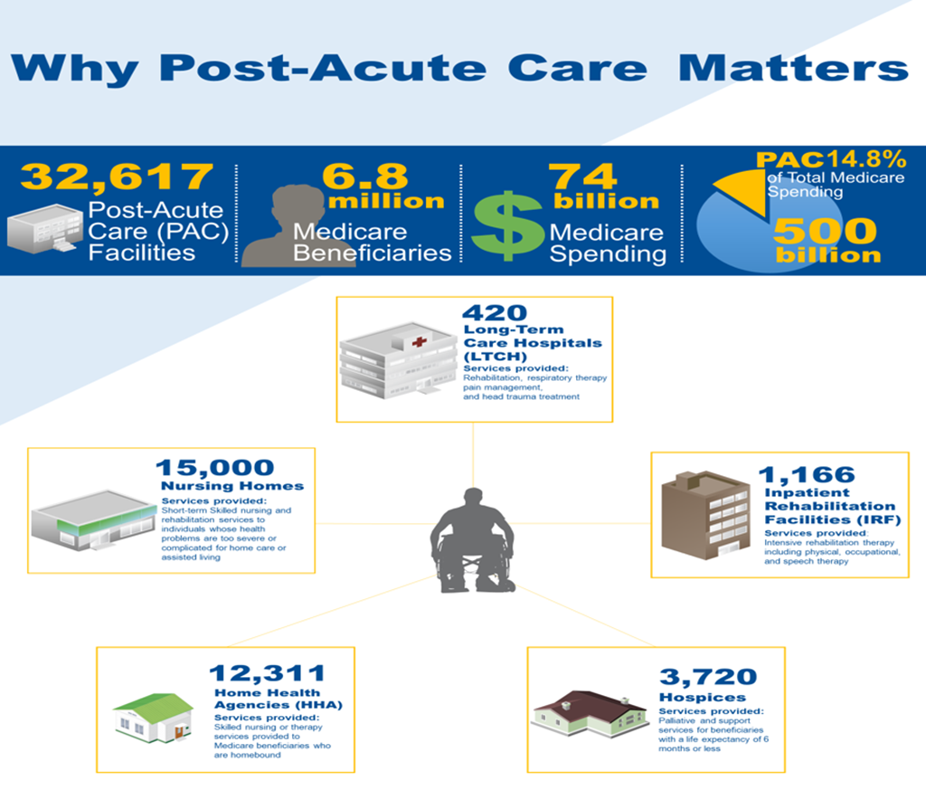
Achieving Better Care, Healthier People, & Smarter Spending
Why Post-Acute Care Matters
8

Slide 9
Standardized PAC Patient Assessment Data for Quality Measures
IMPACT Act requires PAC providers to report standardized assessment data for the following Quality Measure Domains by the following dates:
 | LTCH | IRF | SNF | HH
Quality Measure Domains
Functional status/ cognitive function | 10/1/18 | 10/1/16 | 10/1/16 | 1/1/19
Skin integrity | 10/1/16 | 10/1/16 | 10/1/16 | 1/1/17
Medication reconciliation | 10/1/18 | 10/1/18 | 10/1/18 | 1/1/17
Incidence of major falls | 10/1/16 | 10/1/16 | 10/1/16 | 1/1/19
Communicating the existence of and providing for the transfer of health information and care preferences | 10/1/18 | 10/1/18 | 10/1/18 | 1/1/19
  The measure domains provided in the Act are not exhaustive.
9

Slide 10
Quality Measure: Transfer of Health Information and Care Preferences
The IMPACT Act requires a quality measure on:
  The transfer of individual health information and care preferences of an individual to the individual, family care caregivers, and service providers when the individual transitions from:
    Hospital or critical access hospital (CAH) to another setting including Post Acute Care (PAC) provider or home
    PAC provider to another setting, including a different PAC provider, a hospital or CAH, or home
10

Slide 11
Standardized Patient Assessment Data
IMPACT Act requires PAC providers to report standardized assessment data in the following Assessment Data Categories:
  Functional status
  Cognitive function and mental status
  Special services, treatments, and interventions
  Medical conditions and co-morbidities
  Impairments
  Other categories
Standardized Assessment Data Reporting Dates
LTCHs, IRFs, SNFs | HHAs
10/1/18 | 1/1/19
11

Slide 12
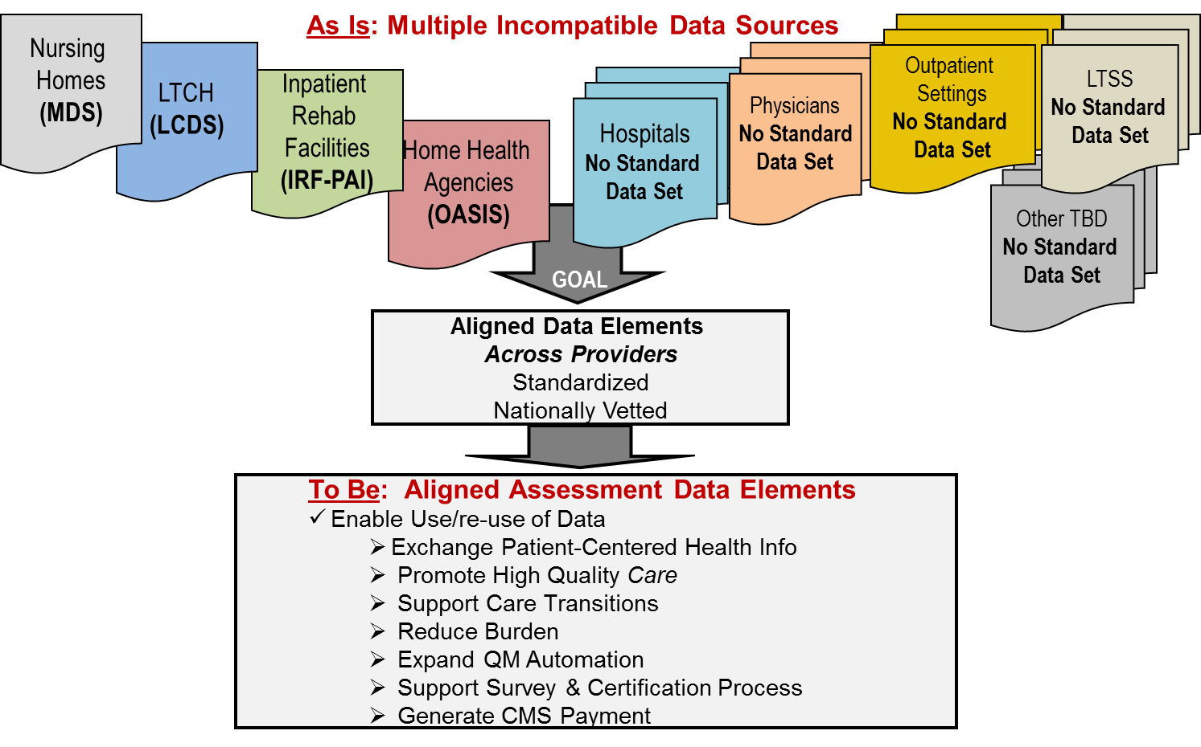
Standardization: ‘As Is’ Transitions ‘To Be’
12

Slide 13
Data Element Standardization
Achieving standardization (i.e., alignment/harmonization) of clinically relevant data elements improves care and communication for individuals across the continuum:
  Enables shared understanding and use of clinical information
  Enables the re-use of data elements (e.g., for transitions of care, care planning, referrals, decision support, quality measurement, payment reform, etc.)
  Supports the exchange of patient assessment data across providers
  Influences and supports CMS and industry efforts to advance interoperable health information exchange and care coordination
While data element standardization is required for certain assessment domains/categories in the IMPACT Act, unique data elements specific to PAC settings will also persist
13

Slide 14
IMPACT Act and Interoperability
The IMPACT Act requires that CMS make post-acute care assessment data elements interoperable to:
  “allow for the exchange of data among PAC providers and other providers and the use by such providers of such data that has been exchanged, including by using common standards and definitions, in order to provide access to longitudinal information for such providers to facilitate coordinated care and improved Medicare beneficiary outcomes.”
14

Slide 15
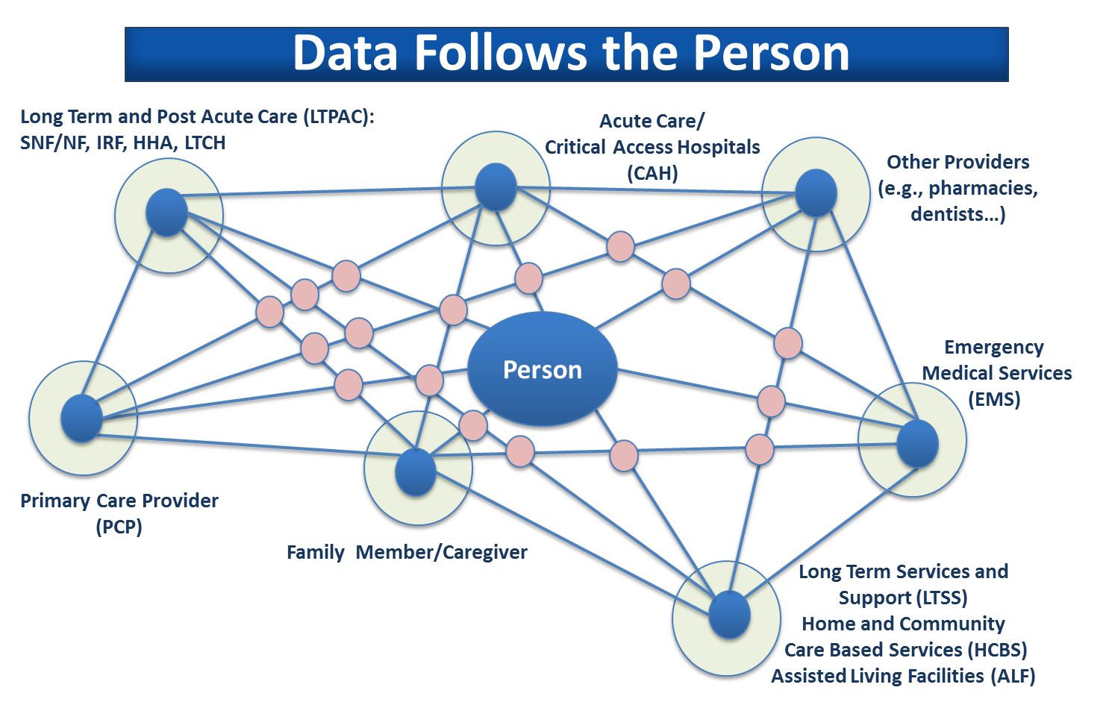
Interoperability
Future State
15

Slide 16
Opportunities to Re-Use Standardized and Interoperable Assessment Data Elements
Leveraging and mapping PAC assessment data elements to nationally accepted Health IT standards supports:
  Information exchange and re-use with and by:
      Acute care hospitals and primary care providers
      Long-term and post-acute care providers
      Home and community based providers (HCBS)
      Other providers
      Health Information Exchange Organizations
  Use and re-use of assessment data in a variety of document types including:
      Transfer documents
      Referral documents
      Care plans
      LTPAC Assessment Summary Documents
CMS will make available public reports of PAC Assessment Data Elements mapped to health IT standards
16

Slide 17
Summary
The IMPACT Act requires that:
  PAC providers report to CMS (by certain dates) standardized assessment data elements in certain quality measure domains and assessment categories; and
  CMS make assessment data elements interoperable.
CMS will:
  Standardize (aka align/harmonize) data elements,
  Make data elements interoperable by linking to health IT standards, and
  Make available to the public reports mapping assessment data elements to health IT standards (more on this to follow).
Use of standardized and interoperable PAC assessment data elements are key enablers to achieving service delivery and payment reform envisioned in the CMS Quality Strategy.
17

Slide 18
The Exchange and Re-use of Clinically Relevant Data Elements
Terrence A. O’Malley, MD, Physician, Massachusetts General Hospital

Slide 19
What Will IMPACT Give Us?
Standardized and interoperable data elements
Exchangeable information across the care continuum including hospitals, post acute care facilities, home health agencies, and other providers (e.g., home and community based service providers and pharmacists)
So what? Why do we need Standardized and Interoperable data elements?
    Currently, these providers and other actors don’t really need to work well together
    They are only working well enough to be successful with FFS
19

Slide 20
Value Based Payments Replaces Fee For Service
Value Based Payments (VBP) pays for outcomes and not for the volume of services
Total cost of care for a population
Must focus on the most complex individuals who:
  Drive most of the costs; and
  Get care in multiple sites from multiple providers
20

Slide 21
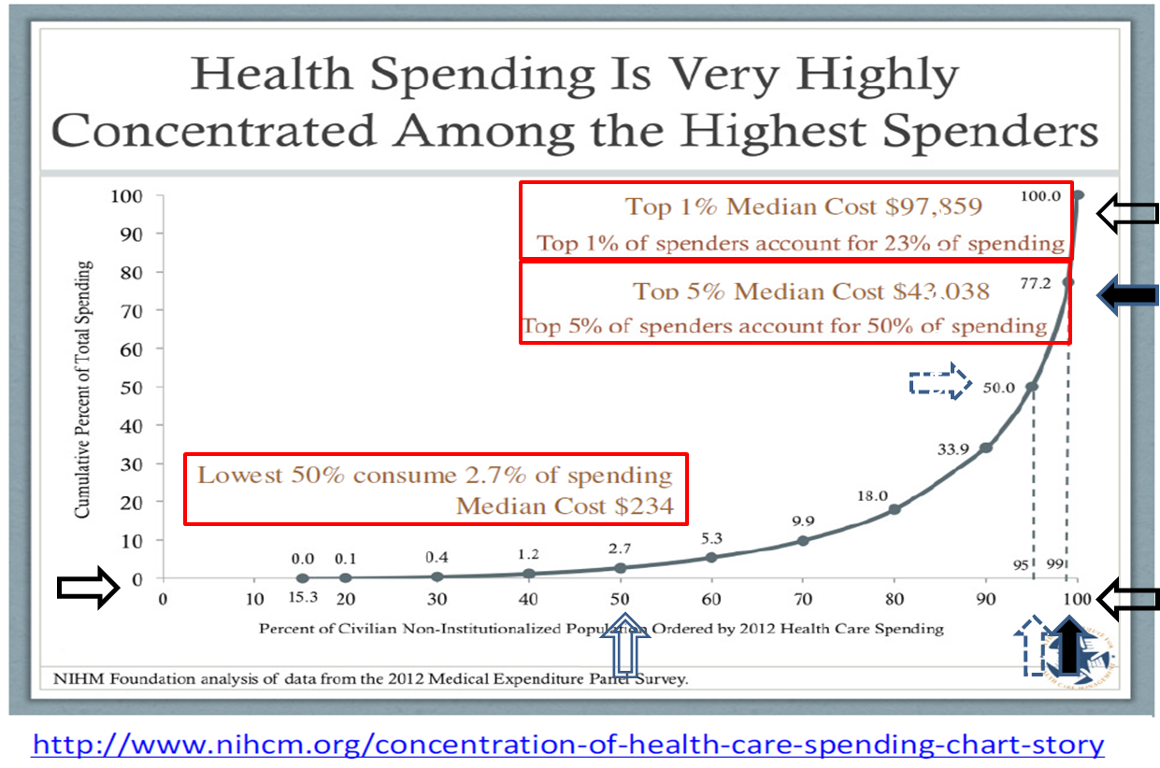
Focus on the Top 1-5%
21

Slide 22
Similarities at the Top of the Cost Curve
Complex medical, behavioral (chronic Severe Mental Illness), functional and environmental issues including social determinants
Care from multiple providers
Care paid by multiple payers
Care in multiple sites
High utilization of emergency responders, emergency departments, hospitals, nursing facilities, home nursing and home based services
Experience multiple transitions and need an overall care plan
Current service delivery and payment systems are in disarray
Standardized and interoperable information is necessary (but not sufficient) to organize care
22

Slide 23
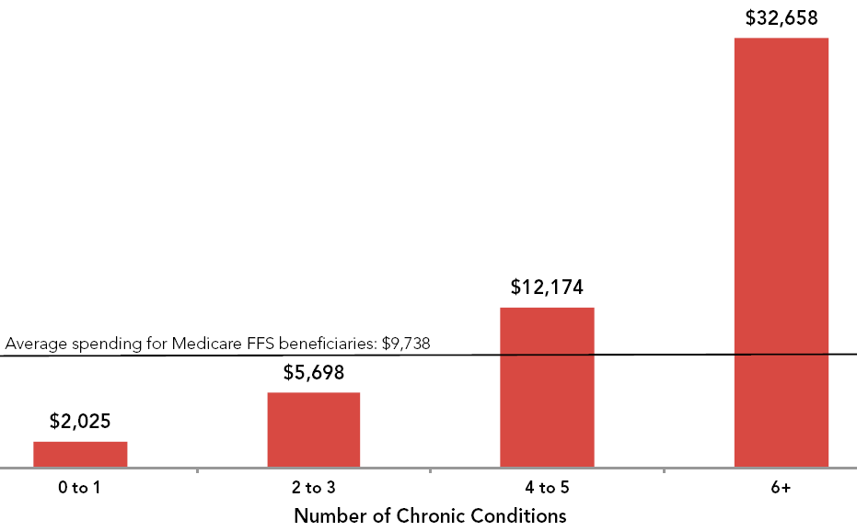
Per Beneficiary Medicare Spending
Source: 2012 Medicare Chart Book: https://www.cms.gov/Research-Statistics-Data-and-Systems/Statistics-Trends-and-Reports/Chronic-Conditions/2012ChartBook.html
23

Slide 24
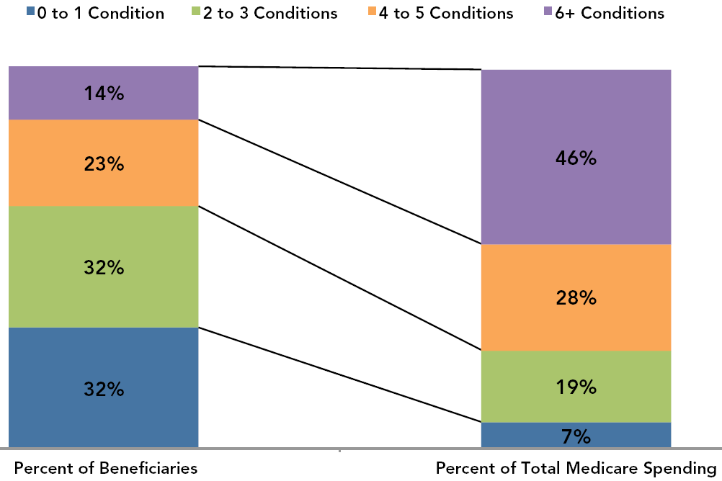
Proportion of Medicare Spending
Source: 2012 Medicare Chart Book: https://www.cms.gov/Research-Statistics-Data-and-Systems/Statistics-Trends-and-Reports/Chronic-Conditions/2012ChartBook.html
24

Slide 25
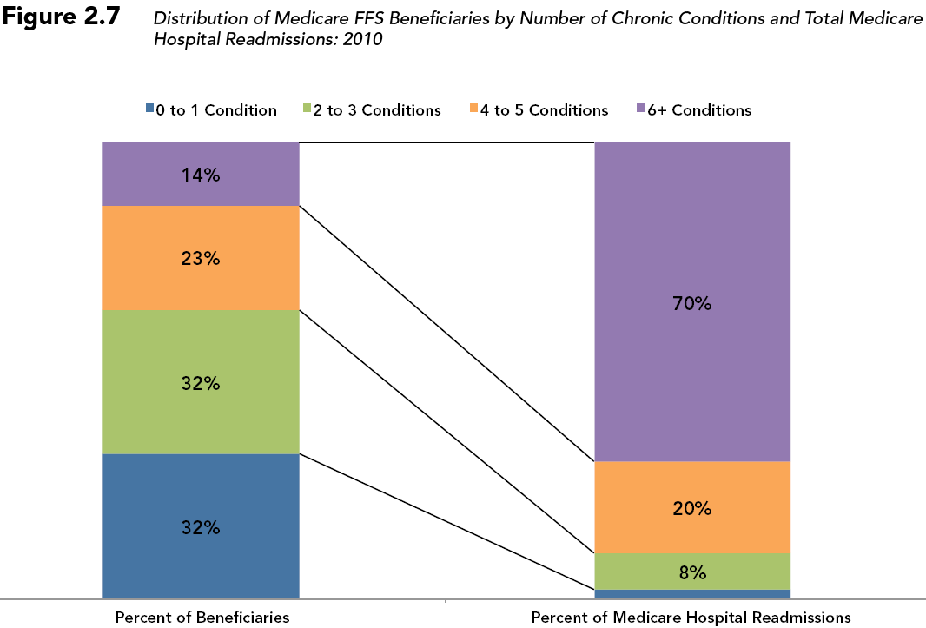
Medicare Readmissions by Number of Chronic Conditions
Source: 2012 Medicare Chart Book: https://www.cms.gov/Research-Statistics-Data-and-Systems/Statistics-Trends-and-Reports/Chronic-Conditions/2012ChartBook.html
25

Slide 26
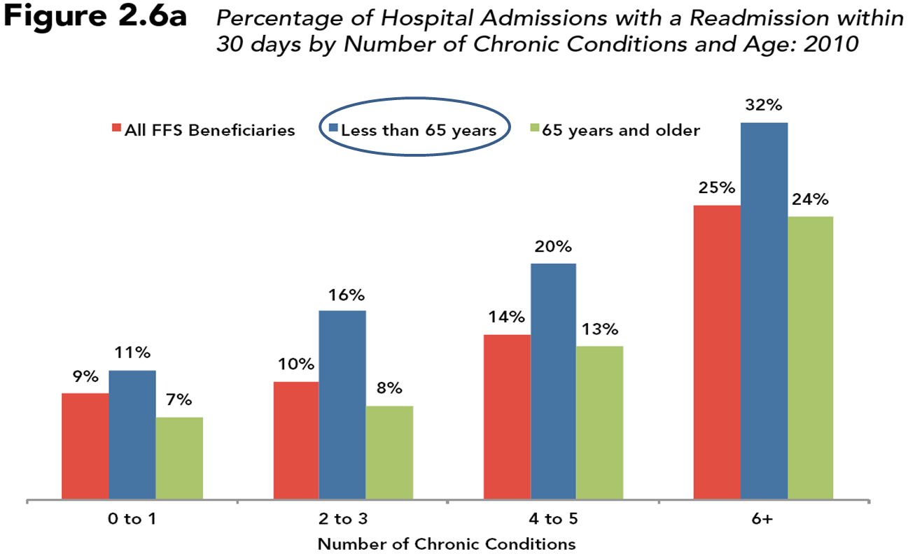
Readmissions: Greatest Among Younger Persons with Disabilities
26

Slide 27
Social Determinants
Social determinants drive a greater proportion of health care spending than do clinical conditions
Social determinants include:
  Race, class, gender, education, employment, housing, community/family supports, contact with criminal justice system, chronic severe mental illness, substance abuse
27

Slide 28
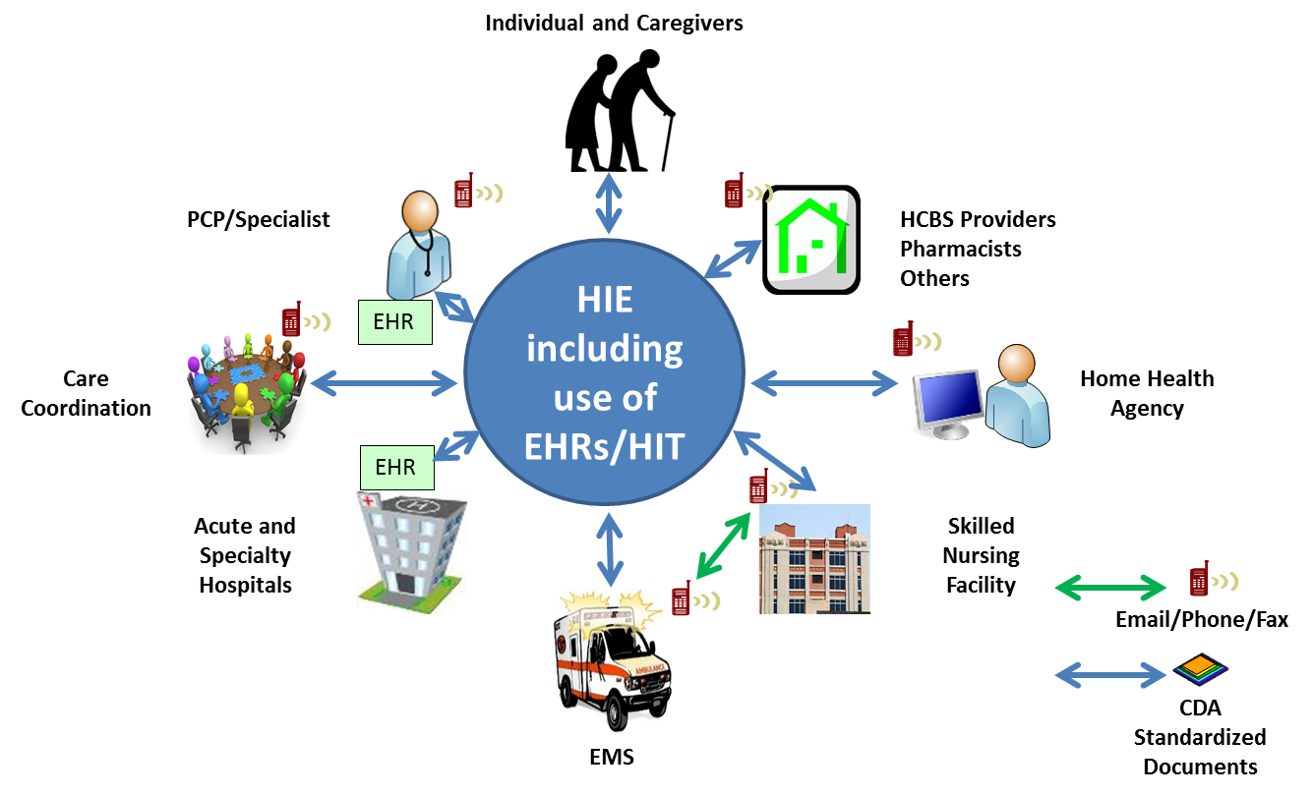
The Future Accountable Care Community
28

Slide 29
Changing to VBP Means Changing Communications
Requires effective communication between sites
To create safer transitions of care for those with the most complex issues
To improved coordination of care across all sites with a shared care plan
These new connections will rely on the electronic exchange of standardized and interoperable information
29

Slide 30
Opportunities for Data Re-use in Accountable Care Communities
Quality Measures: How well do we exchange health information?
    Is the Content complete (cognition, function, etc. from standardized assessment instruments)
    Is the Format useable?
    Does the information arrive when needed?
Public health: reportable events
Creation of care plan
    Generate all site/all team lists: problems, interventions, team members, priorities of the individual, outcomes
Measure ACC performance
    Gaps between problems and interventions
    Effectiveness of interventions
    Outcomes that matter
30

Slide 31
Why This Matters
New Payment Demands New Systems of Care
Many Sites Many Teams
Standardized Exchange of Data Elements for Patient Care
  Within, between and across sites and team (e.g., to support care coordination)
Re-use for Quality Measurement
  Within sites, transitions between sites, coordination across entire episodes of care
Re-use for Public Health Reporting
Re-use to Generate System “Intelligence” so the System can Learn
31

Slide 32
Health IT Standards- A Primer
Liz Palena Hall, LTPAC Coordinator
Office of the National Coordinator for Health IT

Slide 33
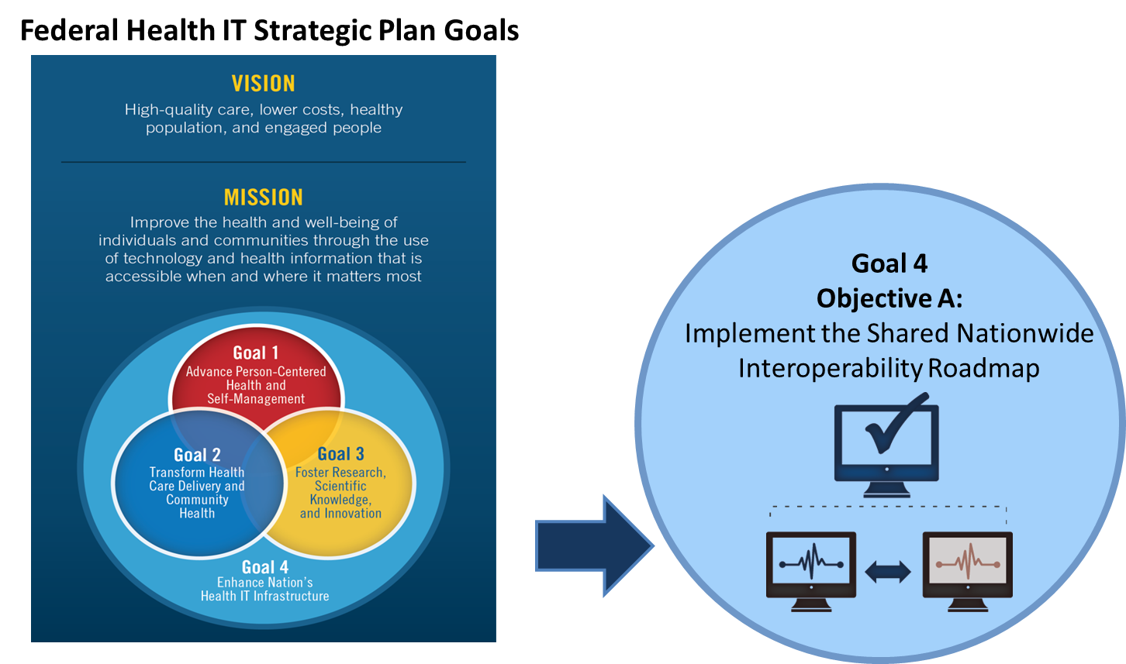
Interoperability Vision for the Future
33

Slide 34
What is Interoperability? What are the Benefits?
Interoperability: The ability of a system to exchange electronic health information with and use electronic health information from other systems without special effort on the part of the user.
All individuals, their families and health care providers should be able to send, receive, find and use electronic health information in a manner that is appropriate, secure, timely and reliable to support the health and wellness of individuals through informed, shared decision-making.
  The electronic exchange and re-use of information means that “individuals, their families and their health care providers have appropriate access to health information that:
    Allows individuals and caregivers to be active partners and participants in their health and care, and
    Improves the overall health of the nation’s population.”
*From ONC’s Connecting Health and Care for the Nation,10 Year Vision to Achieve and Interoperable Health IT Infrastructure;
A Shared Nationwide Interoperability Roadmap Final Version 1.0.
34

Slide 35
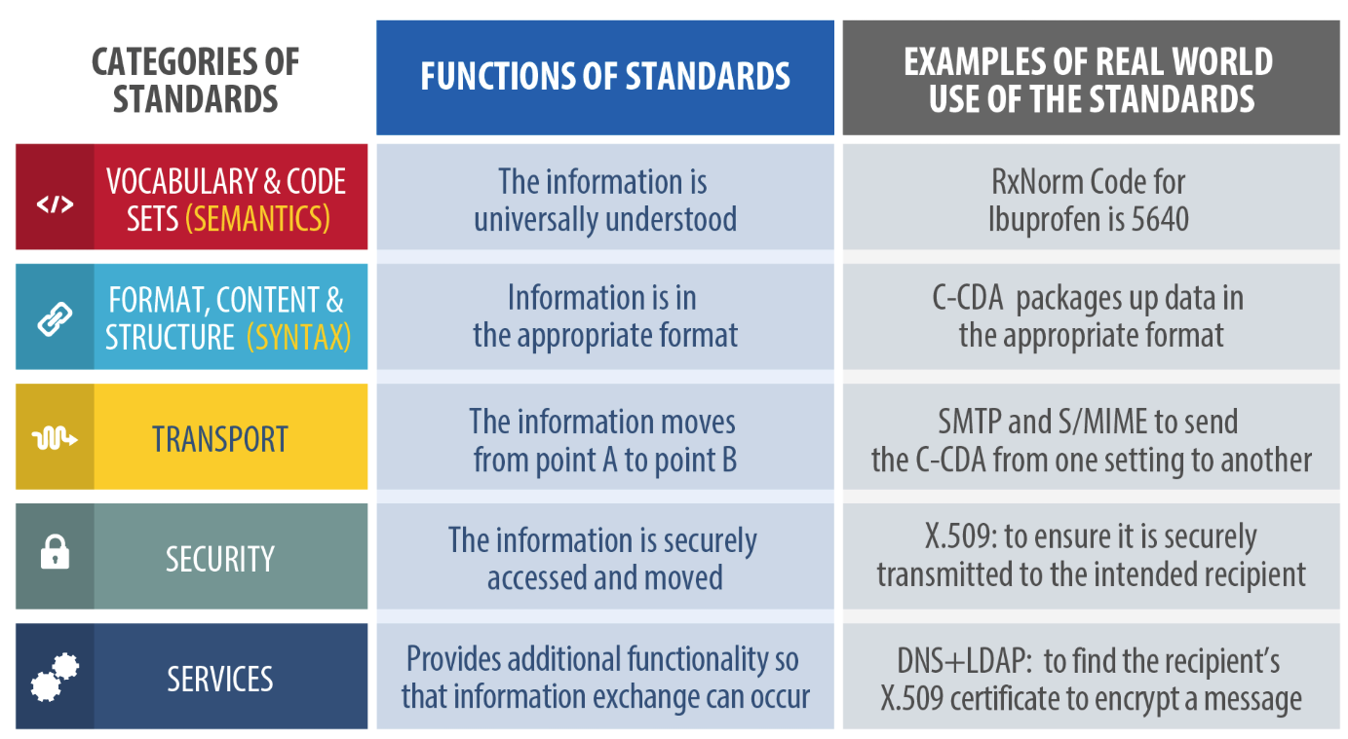
Standards
*From ONC’s Connecting Health and Care for the Nation, A Shared Nationwide Interoperability Roadmap Final Version 1.0
35

Slide 36
Interoperability and Specificity
Six specificity questions to keep in mind when we talk about “interoperability”:
  For what purpose?
  With whom?
  With what data?
  Via what infrastructure?
  By when?
  Toward what expected benefits?
36

Slide 37
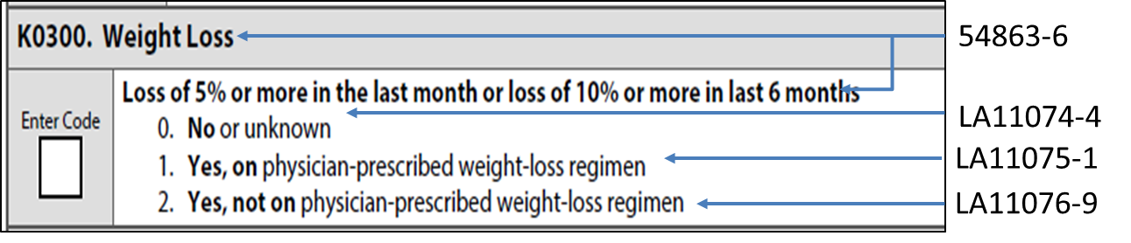
Example Semantics
RxNorm - used for medications
Metoprolol Tartrare 50 mg tablet by mouth twice daily RxNorm code: 866514
LOINC - used for assessment questions/answers
SNOMED CT: Used to represent clinical meaning.
For example: SNOMED codes for clinical concepts related to weight loss:
  89362005|Weight loss (finding)|
  416528001|Intentional weight loss (finding)|
37

Slide 38



What do we mean by CDA and Consolidated-CDA?
Clinical Document Architecture (CDA) is the base standard for building electronic clinical documents
Templates provide the “building blocks” for clinical documents
To help simplify implementations, commonly used templates were harmonized from existing CDA implementation guides and “consolidated” into a single implementation guide-the C-CDA Implementation Guide (IC)
38

Slide 39
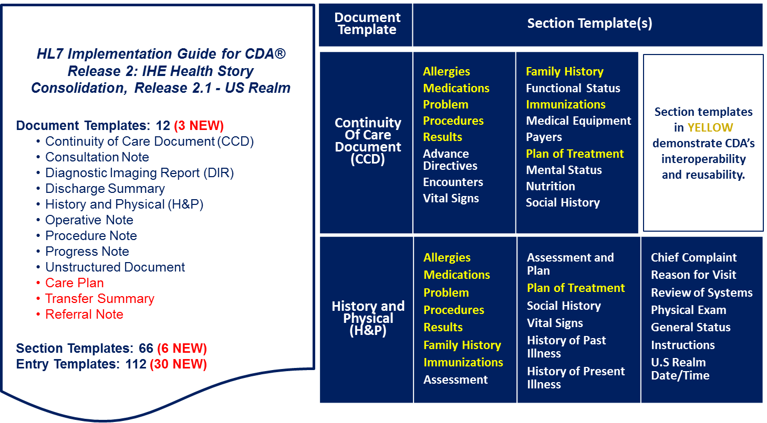
C-CDA Release 2.1 Building Blocks
39

Slide 40
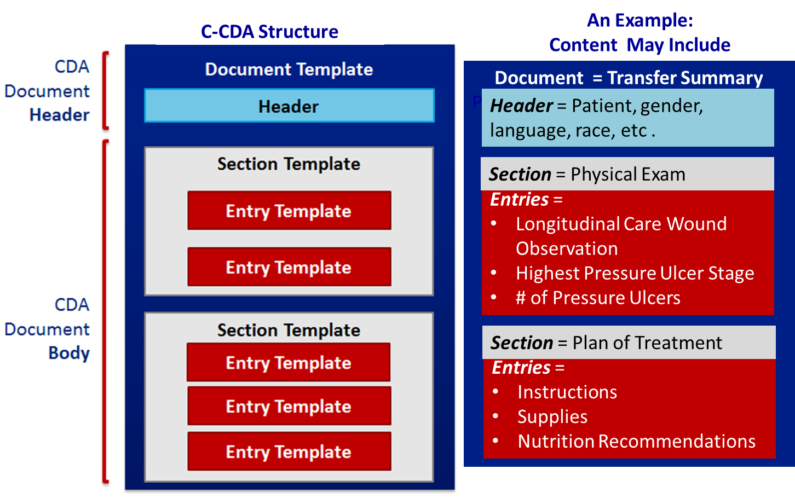
C-CDA Built with Reusable Templates
40

Slide 41
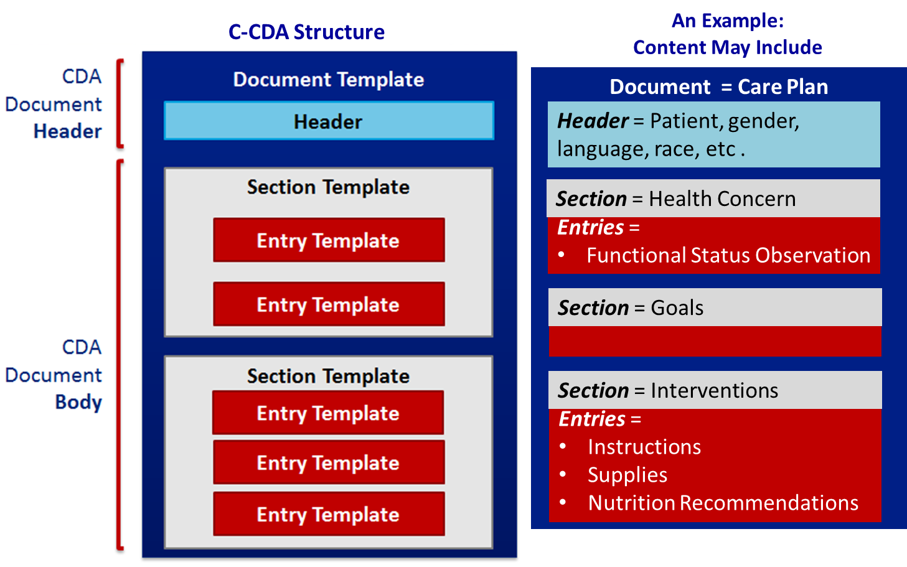
C-CDA Built with Reusable Templates
41

Slide 42
ONC 2015 Edition Health IT Certification
Contains new and updated vocabulary, content, and transport standards for the structured recording and exchange of health information
The ONC Health IT Certification Program is “agnostic” to settings and programs, but can support many different use cases and needs
This allows the ONC Health IT Certification Program to support multiple program and setting needs, for example:
    EHR Incentive Programs
    Long-term and post-acute care
    Chronic care management
    Behavioral health
    Other public and private programs
42

Slide 43
ONC 2016 Standards Advisory
The standards advisory represents an updated list of the best available standard(s) and implementation specification(s). The list is not exhaustive but it is expected that future advisories will incrementally address a broader range of clinical health IT interoperability needs.
Purpose:
  To provide the industry with a single, public list of the standards and implementation specifications that can best be used to fulfill specific clinical health information interoperability needs.
  To reflect the results of ongoing dialogue, debate, and consensus among industry stakeholders when more than one standard or implementation specification could be listed as the best available.
  To document known limitations, preconditions, and dependencies as well as known security patterns among referenced standards and implementation specifications when they are used to fulfill a specific clinical health IT interoperability need.
43

Slide 44
Summary
Nationwide interoperability across the diverse health IT ecosystem will require stakeholders to agree to and follow a common set of standards, services, policies and practices that facilitate the appropriate exchange and use of health information nationwide and do not limit competition.
Standards and methods for achieving interoperability must be accessible nationwide and capable of handling significant and growing volumes of electronic health information, to ensure no one is left on the wrong side of the digital divide.
Near-Term Success: An increase in the proportion of individuals, office-based physicians, hospitals and behavioral health, long-term care and post-acute care providers that:
  Send, receive, find and use electronic health information;
  Have electronic health information available from outside sources and make electronic health information available to outside sources; and
  Use electronic health information to inform decision-making.
*From ONC’s Connecting Health and Care for the Nation, A Shared Nationwide Interoperability Roadmap Final Version 1.0
44

Slide 45
CMS Data Element Library
Jennie Harvell, M.Ed, Senior Technical Adviser,
Centers for Medicare & Medicaid Services

Slide 46
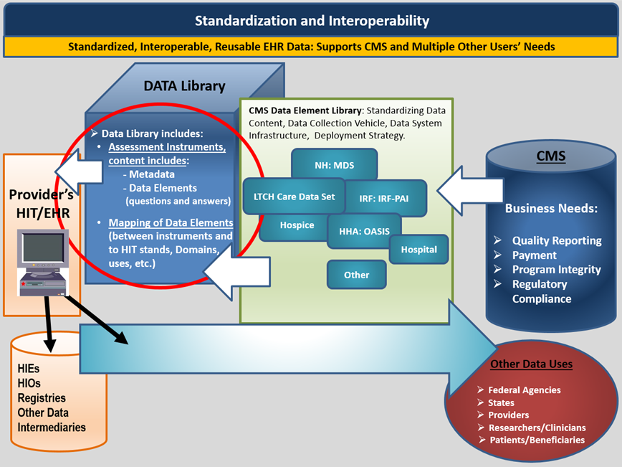
CMS Data Element Library (DEL)
46

Slide 47
Data Element Library
The Data Element Library will include:
  PAC assessment data elements (including those that are standardized); and
  Data elements mapped:
    To Domains,
    Across instruments indicating whether data elements are standardized, and
    To applicable HIT content and exchange standards to support interoperability
47

Slide 48
CMS Data Element Library
Content from the CMS Data Element Library (DEL) will assist:
    CMS in managing the standardization of PAC assessment data elements and identification of HIT standards for these data elements;
    PAC and other providers in accessing content to support interoperable health information exchange (HIE) and the adoption of interoperable health IT (HIT) products; and
    HIT vendors in accessing content to support the development of interoperable HIT and HIE solutions for PAC and other providers.
48

Slide 49
Library: Content and Implementation
Content in the Data Element Library will include:
    Repository of Questions and Responses in Assessment Instruments
    Assessment Instruments and versions
    Relationships mapped to and between data elements including:
      Question to Question, HIT standards, Domains, Other Mappings
Implementation of the Data Element Library:
    Phased implementation
    Regular updates to include new and modified data elements, new assessment instrument versions, and new and updated HIT mappings
49

Slide 50
Reports from the Data Element Library
Pre-defined public reports will include:
    Inventory of questions and responses in an assessment instrument
    Standardized data elements in more than one assessment instrument
    Assessment data elements and linked HIT standards report
Reports will be posted on CMS website in the following formats:
    PDF
    CSV
50

Slide 51
CMS Assessment Library Data Council (CALDC)
CMS established the CALDC as the governing body for the Data Element Library.
The CALDC provides guidance, direction and issue resolution to the development and maintenance of the Data Element Library.
The CALDC has established workgroups (WGs) and Teams responsible for Library content, including:
    Library Management Workgroup – responsible for approving new data elements and data element changes to support the IMPACT Act;
    Stakeholder Teams – providing technical expertise on specific assessment instruments and use of their data elements; and
    Health IT Standards Workgroup – responsibilities include mapping assessment data elements to health IT standards to support interoperable exchange and re-use.
51

Slide 52
CALDC/Health IT and Standards Workgroup
  Mission: The HITWG provides expertise, seeks consensus and provides input on assessment data elements (i.e., questions and answers) and their associated HIT terminology and exchange standards, and other HIT issues and other topics identified by the CALDC and CMS Assessment stakeholders.
  Membership: The CALDC HITWG is comprised of: CMS assessment data owners and leaders knowledgeable about CMS assessment tools and HIT terminology and exchange standards. Participation may include other HHS representatives (e.g., ASPE, NLM, and ONC) and private sector expertise obtained by CMS contractors.
  HITWG recommendations are brought back to CALDC for approval
52

Slide 53
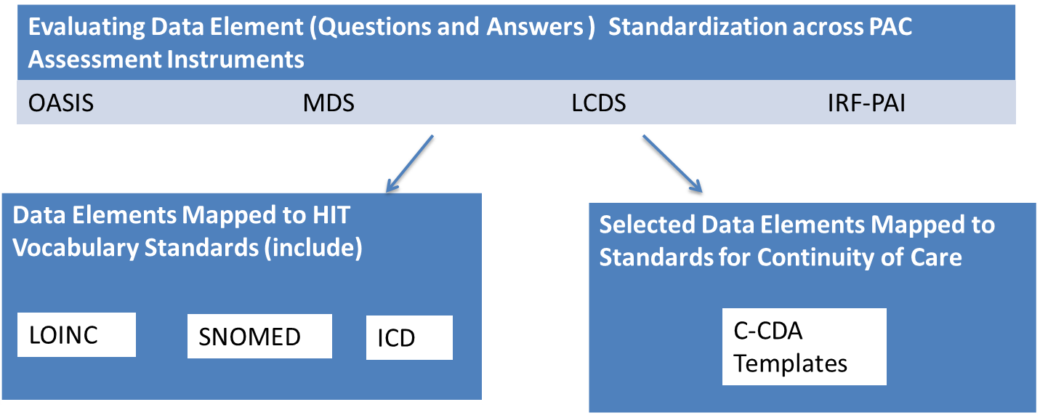
HITWG Activity: An Example
Evaluating Data Elements Standardization (i.e., Alignment) and Mapping to HIT Standards
Prioritizing DEs in need of standards:
DEs in QM Domains
DEs needed for health information exchange
53

Slide 54
Summary
The IMPACT Act requires that CMS make PAC assessment data elements interoperable to provide longitudinal information for PAC and other providers to facilitate care coordination and improved beneficiary outcomes.
CMS will make available public reports that map assessment data elements to health IT standards (as well as other reports).
Use of standardized and interoperable PAC assessment data elements are key enablers to achieving the goals of service delivery and payment reform envisioned in the CMS Quality Strategy.
54

Slide 55
Resource Links
IMPACT Act: Improving Medicare Post-Acute Care Transformation (IMPACT) Act of 2014
CMS IMPACT ACT Website: https://www.cms.gov/Medicare/Quality-Initiatives-Patient-Assessment-Instruments/Post-Acute-Care-Quality-Initiatives/IMPACT-Act-of-2014-and-Cross-Setting-Measures.html
NICHM Foundation: http://www.nihcm.org/concentration-of-health-care-spending-chart-story
2012 Medicare Chart Book: https://www.cms.gov/Research-Statistics-Data-and-Systems/Statistics-Trends-and-Reports/Chronic-Conditions/2012ChartBook.html
PACQualityInitiative@cms.hhs.gov
55

Slide 56
Resource Links (continued)
Federal Health IT Strategic Plan 2015-2020: https://www.healthit.gov/sites/default/files/9-5-federalhealthitstratplanfinal_0.pdf
Connecting Health and Care for the Nation: 10 Year Vision to Achieve an Interoperable Health IT Infrastructure: http://www.healthit.gov/sites/default/files/ONC10yearInteroperabilityConceptPaper.pdf
Shared Nationwide Interoperability Roadmap Final Version 1.0: https://www.healthit.gov/sites/default/files/hie-interoperability/nationwide-interoperability-roadmap-final-version-1.0.pdf
ONC 2015 Edition Health IT Certification: https://www.healthit.gov/policy-researchers-implementers/2015-edition-final-rule
ONC 2016 Standards Advisory: https://www.healthit.gov/standards-advisory/2016
56

Slide 57
Acronyms in this Presentation
ACC: Accountable Care Community
ALFs: Assisted Living Facilities
ASPE: Assistant Secretary for Planning and Evaluation
CAH: Critical Access Hospital
CALDC: CMS Assessment Library Data Council
CCD: Continuity Of Care Document
CCDA: Consolidated Clinical Document Architecture
CMS: Center for Medicare & Medicaid Services
CSV: Comma Separated Values
DE: Data Element
DEL: Data Element Library
EHR: Electronic Health Record
EMS: Emergency Medical Services
HCBS: Home and Community Based Services
HHAs: Home Health Agencies
57

Slide 58
Acronyms in this Presentation (continued)
HIE: Health Information Exchange
HIOs: Health Information Exchange Organizations
HIT: Health Information technology
HITWG: Health Information Technology Standards Workgroup
ICD: International Statistical Classification of Diseases and Related Health Problems
IMPACT Act: Improving Medicare Post-acute Care Transformation Act
IRF-PAI: In-Patient Rehabilitation Facility- Patient Assessment Instrument
IRFs: In-Patient Rehabilitation Facilities
LCDS: LTCH Care Data Set
LMWG: Library Management Workgroups
LOINC: Logical Observation Identifiers Names and Codes
LTCHs: Long-Term Care Hospitals
LTPAC: Long-Term/Post-Acute Care
LTSS: Long-Term Services and Supports
58

Slide 59
Acronyms in this Presentation (continued)
MDS: Minimum Data Set
NIHCM: National Institute of Health Care Management
NLM: National Library of Medicine
OASIS: Outcome and Assessment Information Set
ONC: Office of the National Coordinator for Health Information Technology
PAC: Post-Acute Care
PCP: Primary Care Providers
PDF: Portable Document Format
QM: Quality Measure
RxNorm: US-specific terminology that contains all medications available on US market
SNFs: Skilled Nursing Facilities
SNOMED: Systematized Nomenclature of Medicine
VBP: Value Based Payments
59

Slide 60
Question & Answer Session

Slide 61
Evaluate Your Experience
Please help us continue to improve the MLN Connects® National Provider Call Program by providing your feedback about today’s call.
To complete the evaluation, visit http://npc.blhtech.com and select the title for today’s call.
61

Slide 62
Thank You
For more information about the MLN Connects National Provider Call Program, visit http://cms.gov/Outreach-and-Education/Outreach/NPC/index.html.
For more information about the Medicare Learning Network®, visit http://cms.gov/Outreach-and-Education/Medicare-Learning-Network-MLN/MLNGenInfo/index.html.
The Medicare Learning Network® and MLN Connects® are registered trademarks of the Centers for Medicare & Medicaid Services.
62

