Slide 1



The IMPACT Act and Standardized Patient Assessment Data Elements
Special Open Door Forum
Charlayne Van, CMS
Maria Edelen, RAND
Emily Chen, RAND
July 25, 2018

Slide 2
Welcome
The Centers for Medicare & Medicaid Services,
along with its contractor,
RAND Corporation,
Welcome You To
This Special Open Door Forum

Slide 3
Focus of this Special Open Door Forum
The IMPACT Act: Standardized Patient Assessment Data Elements (SPADE) for PAC (RAND Contract)
  Progress on National Beta Test data collection
  Early feedback from providers participating in beta test
  Upcoming stakeholder engagement activities

Slide 4
Overview of the RAND Contract
CMS contracted with the RAND Corporation to help meet the mandates of the IMPACT Act
Project goal is to develop, test, and implement standardized PAC patient assessment data
Project phases:
  Information Gathering: Sep 2015 – Apr 2016
  Pilot Testing (Alpha 1 and 2): Aug 2016 – July 2017
  National Beta Testing: Fall 2017 – August 2018
    Subset of Beta providers willing to extend field participation into the summer months

Slide 5
SPADE Clinical Categories
Focus on clinical categories outlined in IMPACT Act
  Cognitive status
  Mental status
  Pain
  Impairments
  Special services, treatments and interventions
  Other categories (Care preferences; Global health; Medication reconciliation)

Slide 6
Evaluation of Candidate Data Elements
Potential for improving quality
Validity and reliability
Feasibility for use in PAC
Utility for describing case mix
Improve care transitions, person-centered care and care planning
Improve care practices and patient safety
Use for quality comparisons, including value based payment models
Supports clinical decision making and care coordination
Inter-rater reliability (consensus in ratings by two or more assessors)
Validity (captures the construct being assessed)
Potential to be standardized and made interoperable across settings
Clinically appropriate
Relevance to work flow
Potential use for payment models
Measures differences in severity levels related to resource needs

Slide 7
Input Opportunities for SPADE Evaluation
Public Comments
Stakeholder Discussions
Beta Provider Focus Groups
Candidate Data Elements
Beta Test Performance
Technical Expert Panel
Beta Provider Survey
Workflow Interviews

Slide 8
National Beta Test
Goals are to test reliability and validity of candidate data elements and identify best, most feasible subset for standardization to meet requirements of IMPACT Act
Field test happening now with random sample of eligible providers in 14 randomly selected geographic/ metropolitan, and rural areas
Beneficiaries selected are Medicare only or dually eligible (Medicare-Medicaid) that are admitted to participating providers during the field period

Slide 9

Beta Test Markets
EAST REGION
Boston, MA
Philadelphia, PA
Harrisburg, PA
Durham, NC
Ft. Lauderdale, FL
CENTRAL REGION
Kansas City, MO
St. Louis, MO
Nashville, TN
Chicago, IL
WEST REGION
Los Angeles, CA
San Diego, CA
Phoenix, AZ
Dallas, TX
Houston, TX

Slide 10
Beta Test Protocols
The National Field Test Assessment Protocols are posted at the bottom of this page:
Three Protocols Total
  Communicative Admission and Discharge
  Non-Communicative
https://www.cms.gov/Medicare/Quality-Initiatives-Patient-Assessment-Instruments/Post-Acute-Care-Quality-Initiatives/IMPACT-Act-of-2014/-IMPACT-Act-Standardized-Assessment-National-Testing-.html
Notes:
Assessment data elements for
Cognitive status (e.g., expression and understanding)
Mental status (e.g., depressed mood)
Pain (e.g., pain interference with sleep)
Impairments (e.g., ability to see, continence)
Special services, treatments and interventions (e.g., IV chemotherapy)
Other categories (Care preferences; Global health; Medication reconciliation)

Slide 11
Beta Participants and Assessments*
PAC Setting | Number of Providers | Submitted Assessments | Number of Providers in Extension
LTCH | 23 | 385 | 14
IRF | 26 | 801 | 11
SNF | 54 | 893 | 33
HHA | 33 | 471 | 16
TOTAL | 136 | 2550 | 74
*Numbers current as of May 18, 2018

Slide 12
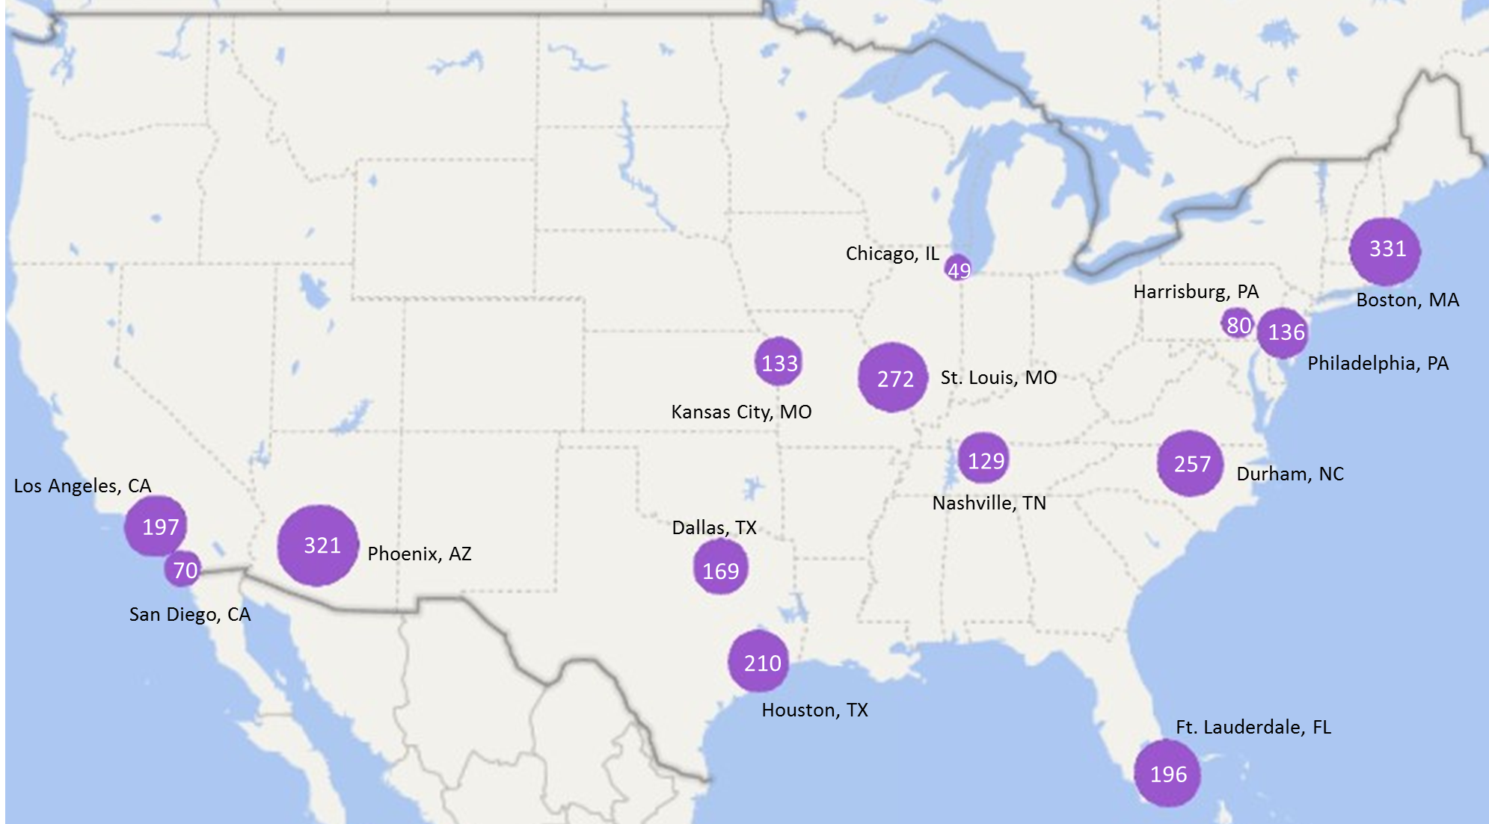
Beta Assessments by Market*
*Numbers reflect assessments submitted as of May 18

Slide 13
Beta Test Analysis Plans
Will conduct analyses to evaluate data elements overall and by setting type during summer and fall
Analyses will provide cross-setting information regarding
  Feasibility
  Reliability
  Preliminary validity (e.g., differences according to clinical groups)
  Optimal format for data elements
    Assessment window
    Look back period

Slide 14
Beta Provider Survey
  Field period ran for one month
  Email invitations to complete web-based survey were sent to 246 provider staff assessors
  We received 139 responses (57% response rate)
    91 (65%) were complete and 48 (35%) were partial

Slide 15
Beta Provider Survey
  All 14 markets are represented with between 4 and 12 respondents (mean=6.5, median=5.5, mode=5)
  Setting representation largely reflective of proportions in beta:
    SNF 36% (40% of beta sample)
    IRF 28% (19% of beta sample)
    HHA 21% (24% of beta sample)
    LTCH 15% (17% of beta sample)

Slide 16
Beta Provider Survey
Data element groupings for survey:
BIMS
CAM
Expression and understanding
Behavioral signs and symptoms
Pain interview
PHQ-2 to 9 interview
PROMIS Depression
PROMIS Anxiety
PROMIS Global health
Hearing and vision
Care Preferences
Continence
Medication reconciliation
Nutritional approaches
Special services, treatments and interventions
Staff assessment of cognitive status
Staff assessment of mood
Staff assessment of pain

Slide 17
Beta Provider Survey
  Survey included questions about
    Clinical utility
    Assessor and patient burden
    Factors affecting ability to collect data
  Respondents made ratings on a 5-point scale (e.g., from not at all useful to extremely useful) for all data element groups (e.g., pain interview) and then ranked data elements within groups (e.g., items in the pain interview) from best to worst

Slide 18
Beta Provider Survey
Clinical utility:
This section focuses on your perceptions of how clinically useful each Beta assessment data element is for patients/residents in the post-acute care setting.
Thinking generally about the data elements within the following categories, how clinically useful are these sections of the assessment?
Not at all useful | Slightly useful | Somewhat useful | Moderately useful | Extremely useful
☐ | ☐ | ☐ | ☐ | ☐

Slide 19
Beta Provider Survey
Clinical utility – overall ratings:
Data element group average ratings ranged from just above slightly useful to just above moderately useful (3.20 – 4.25)
Highest ratings were for Pain Interview (4.25), Expression and Understanding (4.19), and Hearing and Vision (4.10)
Lowest ratings were for Staff Assessment of Mood (3.43), and PROMIS Anxiety (3.41), Global Health (3.39), and Depression (3.20)

Slide 20
Beta Provider Survey

Slide 21
Beta Provider Survey
Clinical utility – setting specific ratings:
Pain Interview was in the top two for all settings, but LTCH and SNF assessors rated Expression and Understanding highest, and HHA assessors rated Medication Reconciliation highest
IRF assessors tended to have lower average ratings overall (range 2.68-4.04)
SSTI group was rated highly by LTCH (4.46, 5th highest), SNF (4.34, 4th highest) and HHA assessors (3.68, 7th highest), but relatively low by IRF assessors (2.88, 3rd lowest)

Slide 22
Beta Provider Survey
Clinical utility – overall rankings:
DE Group | Highest ranked DE (most useful) | Lowest ranked DE (least useful)
Continence: bladder | Frequency of incontinent events | Need for assistance or appliance management
Continence: bowel | Frequency of incontinent events | Appliance use, current setting
Pain Interview | Pain presence | Pain interference, other activities
SSTI | Oxygen therapy | Radiation

Slide 23
Beta Provider Survey
Clinical utility – setting specific rankings:
DE Group | Highest ranked DE | Lowest ranked DE
Continence: bladder | HHA and IRF: frequency of events LTCH: reason for catheter SNF: appliance use | HHA and IRF: appliance use current setting LTCH and SNF: need for assistance
Continence: bowel | frequency of events highest for all settings | HHA, IRF and SNF: appliance use, current setting LTCH: need for assistance
Pain Interview | Pain presence highest for all settings | Pain interference, other activities lowest for all settings
SSTI | HHA, IRF and LTCH: oxygen therapy SNF: IV meds | HHA and SNF: ventilator IRF and LTCH: radiation

Slide 24
Beta Provider Survey
Assessor and patient burden:
This section focuses on your perceptions of how difficult it was to collect information during the Beta assessment and how burdensome information collection was for patients/residents in your current post-acute care setting. It also asks about the factors that contributed to difficulty in collecting information.
Thinking generally about the data elements within the following categories, how difficult was it for you, as the assessor, to collect information for the following sections of the assessment?
Not at all difficult | Slightly difficult | Somewhat difficult | Moderately difficult | Extremely difficult
☐ | ☐ | ☐ | ☐ | ☐

Slide 25
Beta Provider Survey
Assessor burden - overall:
Data element group average ratings ranged from just above not at all difficult to just below somewhat difficult (1.40 – 2.58)
Least difficult ratings were for Hearing and Vision (1.40), Expression and Understanding (1.45), Care Preferences (1.56), Pain Interview (1.57), and BIMS (1.58)
Lowest ratings were for Medication Reconciliation (2.28), PROMIS Anxiety (2.43) and PROMIS Depression (2.58)

Slide 26
Beta Provider Survey

Slide 27
Beta Provider Survey
Assessor burden – setting specific:
HHA and IRF assessors tended to rate the Hearing and Vision and Expression and Understanding least difficult whereas SNF and LTCH assessors found the Pain Interview, Nutritional Approaches and SSTI less difficult
Although assessors from all settings rated Medication reconciliation as relatively more difficult to collect, HHA assessors appeared to have less trouble with this data element

Slide 28
Beta Provider Survey
Factors affecting ability to collect information – overall and setting specific:
Timing constraints (38%) and availability of data (32%) were most frequently endorsed factors overall
HHA and IRF assessors cited availability of data most frequently whereas LTCH and SNF assessors cited timing constraints

Slide 29
Beta Provider Survey
Patient burden – overall and setting specific:
Data element group average ratings for patient interview items ranged from right between not at all and slightly burdensome to moderately burdensome (1.59 – 3.05)
Least burdensome ratings were for Pain Interview (1.59), and Care Preferences (1.59)
Most burdensome ratings were for PROMIS anxiety (2.92), and depression (3.05)
Very few differences by setting

Slide 30
Beta Provider Survey
These results are preliminary – more detailed results, including feedback from ‘free response’ questions, may be presented in upcoming SODFs
We also are holding focus groups with providers to acquire more detail about some of these findings
Results of the beta provider survey will be included as part of the published report on SPADE beta testing

Slide 31
Upcoming Stakeholder Engagement Activities
CMS and RAND will host a mini-conference on Data Element Standardization in PAC in late 2018 to discuss findings of testing and stakeholder engagement activities, answer questions, and hear feedback on candidate data elements
  Mini-conference will provide opportunity for open discussion of candidate data elements with CMS leadership

Slide 32
Milestones Timeline
5 days
Oct 2 - Oct 6
Beta Research Nurse Training
39 days
Oct 9 - Nov 30
Field trainings in 14 markets
155 days
Oct 23 - May 25
Beta data collection
261 days
Stakeholder outreach (e.g., conversations with associations and providers, feedback from Beta assessors)
Jan 1 - Dec 31
CMS/RAND Forum on Data Element Standardization (est.)
Oct 15
TEP (est.)
Start of OY2
Final Beta data delivery
Nov 15
Sep 24
Jun 8
2017
2018
2017
Sep
Nov
Jan
Mar
May
Jul
Sep
Nov
2018
Today
Dec 12
Mar 15
Sep 14
Dec SODF
Mar SODF (est.)
Sept SODF (est.)
Jul 13
June SODF (est.)

Slide 33
Points of Contact
CMS IMPACT Mailbox for comments/ideas:
  PACQualityInitiative@cms.hhs.gov
IMPACT item development general information:
  impactact@rand.org

