Slide 1
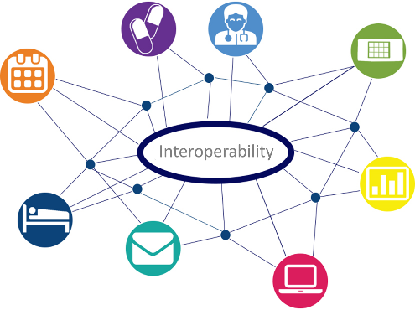

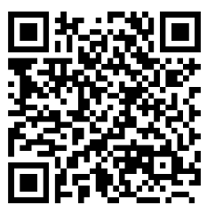

Goals
Electronic Medical Documentation Interoperability (EMDI)
Facilitating the expansion of the secure transport system for interoperable electronic documentation.
Utilizing and filling in the gaps in the current standards to achieve increased level of interoperability among systems and organizations.
Establishing pilot programs with existing Health Information Handlers (HIH), Health Information Service Providers (HISP), and health care providers.
Aid CMS in operating and advancing the health IT Electronic Medical Documentation Interoperability (EMDI) initiatives.
Scan To Visit
Advancing Provider Interoperability
EMDI Website
Visit us on the Web:
www.scopeinfotechinc.com

Slide 2






1.
Real World Use Cases
Get Involved
Hospital/ Clinics/ Physicians that order HHA/ DMEPOS
Home Health Agency (HHA), Durable Medical Equipment Prosthetics, Orthotics, Supplies (DMEPOS), and more coming!
Validate a new technology or process
Re-work business processes
Lower your administrative costs and improve quality
Learn lessons from a real-world use of a solution
2.
Use Case 1 – Order
Hospital sends order to HHA or DMEPOS Supplier
HHA or DMEPOS Supplier sends accept/reject order decision
Use Case 2 – Medical Documentation Requests (MDR)
HHA or DMEPOS Supplier sends an MDR to the hospital/physician
Hospital/physician sends requested documents to HHA/DMEPOS
Use Case 3 – Signature Requests
HHA or DMEPOS Supplier sends a document for signature to hospital/physician
Hospital/physician signs/dates and returns the signed document to the HHA/DMEPOS
Interface Vendor(s)
Supports Hospitals/Clinics/Physicians
3.
Document Transfer Vendor(s)
Learn more: https://oncprojectracking.healthit.gov/wiki/display/TechLabSC/MRII+Home
Supports Hospitals/Clinics/Physicians
4.
Document Transfer Vendor(s)
Supports HHA/
DMEPOS
5.
Contact Us:
Interface Vendor(s)
Supports HHA/
DMEPOS
6.
HHA
Or DMEPOS
EMDI_Team@scopeinfotechinc.com
Over 50+ Participating Pilot Organizations

