Slide 1

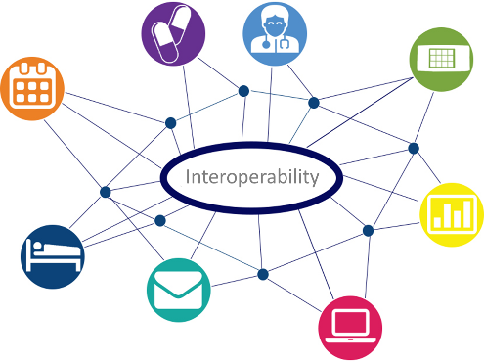






Electronic Medical Documentation Interoperability(EMDI)
Real World Use Cases
Advancing Provider Interoperability
Home Health Agency (HHA), Durable Medical Equipment, Prosthetics, Orthotics, Supplies (DMEPOS), and more coming!
1.
Hospital/
Physicians that order HHA/
DMEPOS
Use Case 1 – Order
Hospital sends order to HHA or DMEPOS Supplier
HHA or DMEPOS Supplier sends accept/reject order decision
Use Case 2 – Medical Documentation Requests (MDR)
HHA or DMEPOS Supplier sends an MDR to the hospital/physician
Hospital/physician sends requested documents to HHA/DMEPOS
Use Case 3 –
Signature Requests
HHA or DMEPOS Supplier sends a document for signature to hospital/physician
Hospital/physician signs/dates and returns the signed document to the HHA/DMEPOS
2.
Interface
Vendor(s)
Supports Hospitals/Clinics/Physicians
EMDI Goals
3.
Document Transfer Vendor(s)
Facilitating the expansion of the secure transport system for interoperable electronic documentation.
Utilizing and filling in the gaps in the current standards to achieve an increased level of interoperability among systems and organizations.
Establishing pilot programs with existing Health Information Handlers (HIH), Health Information Service Providers (HISP), and health care providers.
Aid CMS in operating and advancing the health IT Electronic Medical Documentation Interoperability (EMDI) initiatives.
Supports Hospitals/Clinics/Physicians
4.
Document Transfer Vendor(s)
Supports HHA/
DMEPOS
5.
Interface Vendor(s)
Supports HHA/
DMEPOS
6.
HHA
Or
DMEPOS
Get Involved
Contact Us:
Validate a new technology or process
Re-work business processes
Lower your administrative costs and improve quality
Learn lessons from a real-world use of a solution
50+ Participating Pilot Organizations
EMDI_Team@
scopeinfotechinc.com

